Slide 1
Using DidFail to Analyze
Flow of Sensitive Information in Sets of Android Apps
Will Klieber*, Lori Flynn*,
Amar Bhosale, Limin Jia, and Lujo Bauer
*presenting
June 2015

Slide 2
Copyright 2015 Carnegie Mellon University
This material is based upon work funded and supported by the Department of Defense under Contract No. FA8721-05-C-0003 with Carnegie Mellon University for the operation of the Software Engineering Institute, a federally funded research and development center.
Any opinions, findings and conclusions or recommendations expressed in this material are those of the author(s) and do not necessarily reflect the views of the United States Department of Defense.
References herein to any specific commercial product, process, or service by trade name, trade mark, manufacturer, or otherwise, does not necessarily constitute or imply its endorsement, recommendation, or favoring by Carnegie Mellon University or its Software Engineering Institute.
NO WARRANTY. THIS CARNEGIE MELLON UNIVERSITY AND SOFTWARE ENGINEERING INSTITUTE MATERIAL IS FURNISHED ON AN “AS-IS” BASIS. CARNEGIE MELLON UNIVERSITY MAKES NO WARRANTIES OF ANY KIND, EITHER EXPRESSED OR IMPLIED, AS TO ANY MATTER INCLUDING, BUT NOT LIMITED TO, WARRANTY OF FITNESS FOR PURPOSE OR MERCHANTABILITY, EXCLUSIVITY, OR RESULTS OBTAINED FROM USE OF THE MATERIAL. CARNEGIE MELLON UNIVERSITY DOES NOT MAKE ANY WARRANTY OF ANY KIND WITH RESPECT TO FREEDOM FROM PATENT, TRADEMARK, OR COPYRIGHT INFRINGEMENT.
This material has been approved for public release and unlimited distribution except as restricted below.
This material may be reproduced in its entirety, without modification, and freely distributed in written or electronic form without requesting formal permission. Permission is required for any other use. Requests for permission should be directed to the Software Engineering Institute at permission@sei.cmu.edu.
Carnegie Mellon® and CERT® are registered marks of Carnegie Mellon University.
DM-0002562

Slide 3
Overview
Problem: Sensitive/private information can be leaked by apps on smartphones.
  Precise detection on Android is made difficult by communication between components of apps.
  Malicious apps could evade detection by collusion or by exploiting a leaky app
  using intents (messages to Android app components) to pass sensitive data.
Goal: Precisely detect undesired flows across multiple Android components.
  Remedies if such flows are discovered:
    At present: Refuse to install app
    Future work: Block undesired flows
Our Tool (DidFail):
  Input: set of Android apps (APK files)
  Output: list of flows of sensitive information
Major Achievements:
  First published static taint flow analysis for app sets (not just single apps)
  Fast user response: two-phase method uses phase-1 precomputation
sink
source
Notes:
The problem that we’re addressing is the leakage of sensitive information by smartphone apps.
Android has a very powerful and complex communication system that apps can use can send data to each other.
Previous to our work, little had been done to analyze flows of sensitive across app boundaries.
Malicious apps could take advantage of this to obtain sensitive information from leaky apps, or send sensitive information to a colluding app instead of directly leaking it off the phone.
Sent intents are treated as sinks, and received intents are treated as sources.
Definition. A full taint flow is from a non-intent source to a non-intent sink.
Definition. A source is an external resource (external to the app, not necessarily external to the phone) from which data is read.
Definition. A sink is an external resource to which data is written.
For example,
Sources: Device ID, contacts, photos, current location, etc.
Sinks: Internet, outbound text messages, file system, etc.
The two-phase analysis approach (unique to DidFail, and to be used for the proposed analysis) will allow a security vendor or an app store (such as Google’s or one operated by a government agency for employee use) to respond quickly (within 1 second or so) in typical cases because the first phase is the most time-consuming part of the analysis, and it can be precomputed for all apps in the app store.

Slide 4
Introduction
One billion Android devices (phones and tablets) estimated sold in 2014.¹
Goal: Detect malicious apps that leak sensitive data.
    E.g., leak contacts list to marketing company.
    “All or nothing” permission model.
Apps can collude to leak data.
    Evades precise detection if only analyzed individually.
¹ Gartner Report: http://www.gartner.com/newsroom/id/2665715
Notes:
This problem is made more difficult by Android’s “All or nothing” permission model

Slide 5
Introduction: Android
Android apps have four types of components:
    Activities
    Services
    Content providers
    Broadcast receivers
Intents are messages to components.
    Explicit or implicit designation of recipient
Components declare intent filters to receive implicit intents.
Matched based on properties of intents, e.g.:
    Action string (e.g., “android.intent.action.VIEW”)
    Data MIME type (e.g., “image/png”)
Notes:
An explicit intent designates its recipient by name.
An implicit intent allows the Android OS to try to find a suitable component from among those installed on the device.

Slide 6
Introduction
Taint Analysis tracks the flow of sensitive data.
  Can be static or dynamic.
    Static analysis: Analyze the code without running it.
    Dynamic analysis: Analyze the program by running it.
  Our analysis is static.
Our analysis is built upon existing Android static analyses:
  FlowDroid [1]: finds intra-component information flow
  Epicc [2]: identifies intent specifications
[1] S. Arzt et al., “FlowDroid: Precise Context, Flow, Field, Object-sensitive and Lifecycle-aware Taint Analysis for Android Apps”. PLDI, 2014.
[2] D. Octeau et al., “Effective inter-component communication mapping in Android with Epicc: An essential step towards holistic security analysis”. USENIX Security, 2013.
Notes:
These tools are the state of the art for the problems they intend to solve
FD: State of art for taint flow analysis for intra-component
Epicc: State of the art for identifying intent specifications
Static analysis: testing and evaluation of an application by examining the code without executing the program.
Advantage to SA:
Examines all possible execution paths and variable values, not just those invoked during one (or multiple) executions
Drawbacks to SA:
Effectiveness for particular security issues depends on analysis type, plus on analyzer’s soundness and precision
Automated tools produce false positives and false negatives
- Doesn’t find vulnerabilities introduced in runtime environment
Dynamic analysis: testing and evaluation of an application by executing it (over some inputs) and observing the executions
Advantages to DA:
Identifies vulnerabilities in a runtime environment
Can be used to identify vulns that might have been false negatives in the static analysis
Drawbacks to DA:
Only as good as the analysis being used: what inputs test with, and what v
Automated tools produce false positives and false negatives

Slide 7
Our Contribution
We developed the DidFail static analyzer
(“Droid Intent Data Flow Analysis for Information Leakage”).
    Finds flows of sensitive data across app boundaries.
    Source code available at: (or google “DidFail CERT”)
    http://www.cert.org/secure-coding/tools/didfail.cfm
Two-phase analysis:
  Analyze each app in isolation.
  Use the result of Phase-1 analysis to determine inter-app flows.
We tested our analyzer on sets of apps.

Slide 8
Terminology
Definition. A source is an external resource (external to the component/app, not necessarily external to the phone) from which data is read.
Definition. A sink is an external resource to which data is written.
  For example,
      Sources: Device ID, contacts, photos, location (GPS), intents, etc.
      Sinks: Internet, outbound text messages, file system, intents, etc.
  Definition. Data is tainted if it originated from a (sensitive) source.
Notes:
We don’t even consider sources that aren’t sensitive.
Definition. A taint flow is data flow from a source to a sink.
Definition. A full taint flow is a taint flow where neither the source nor the sink are intents.

Slide 9
Analysis of Android App Sets: Sensitive Dataflow
  If an undesired flow is discovered:
    User might refuse to install app
    App store might remove app
Previous tools: taint flow in single component
  Intents can be treated as sources/sinks.
  But cannot precisely identify full flows involving multiple components.
Malicious developer strategy:
  Hide from tools by using multiple apps for tainted data flow (launder)
  Colluding apps, or combination leaky app and malicious app
DidFail:
  Defeat multiple-app strategy, detect full tainted flows
  First published static taint flow analysis for app sets
  Fast user response: 2 phases
src₁
C₁
sink₁
FlowDroid
Goal
sink
source
Notes:
Definition. A taint flow is data flow from a source to a sink.
Definition. A full taint flow is a taint flow where neither the source nor the sink are intents.

Slide 10
Motivating Example
App SendSMS.apk sends an intent (a message) to Echoer.apk,
which sends a result back.
SendSMS.apk
Echoer.apk
Device ID
(Source)
intent
getIntent()
startActivityForResult()
onActivityResult()
result
setResult()
Text Message
(Sink)
SendSMS.apk tries to launder the taint through Echoer.apk.
Pre-existing static analysis tools could not precisely detect such inter-app data flows.

Slide 11
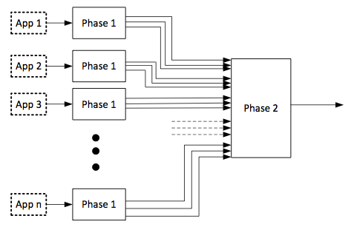
Analysis Design
Phase 1: Each app analyzed once, in isolation.
  FlowDroid: Finds tainted dataflow from sources to sinks.
    Received intents are considered sources.
    Sent intent are considered sinks.
  Epicc: Determines properties of intents.
  Each intent-sending call site is labelled with a unique intent ID.
Phase 2: Analyze a set of apps:
  For each intent sent by a component, determine which components can receive the intent.
  Generate & solve taint flow equations.

Slide 12
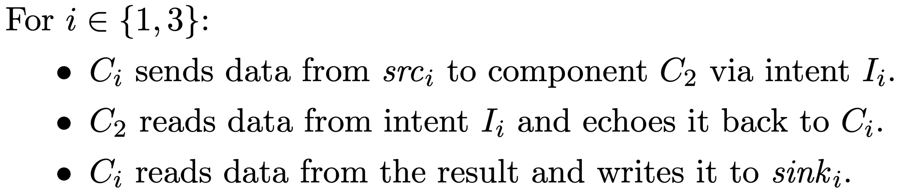
Running Example
src₁
I₁
Three components: C₁, C₂, C₃.
C1 = SendSMS
C2 = Echoer
C3 is similar to C1
C₁
sink₁
C₂
I₃
src₃
C₃
sink₃
sink₁ is tainted with only src₁.
sink₃ is tainted with only src₃.

Slide 13
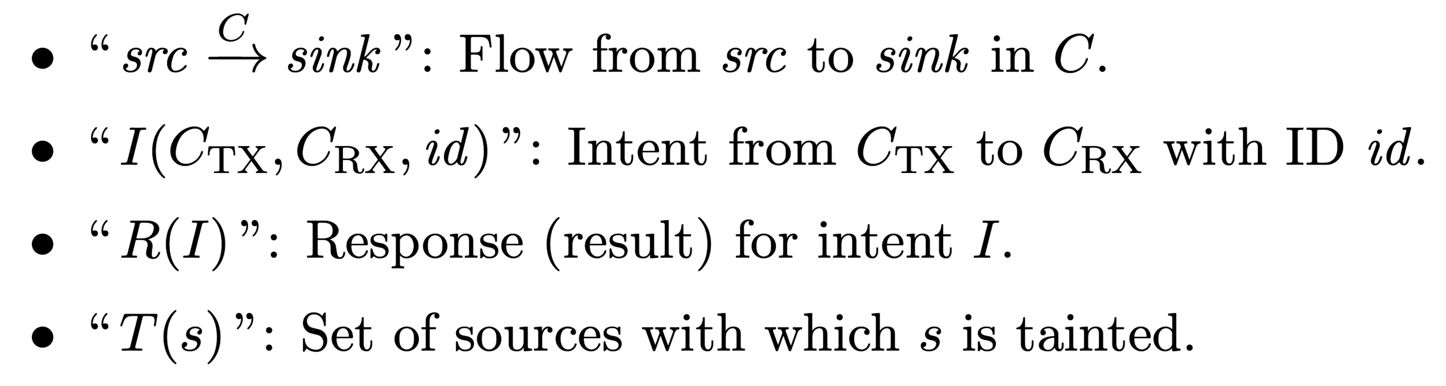
Running Example
src₁
I₁
C₁
sink₁
C₂
I₃
src₃
C₃
sink₃
Notation:
Notes:
We write “source arrow sink” to denote that information flows from src to sink in component C. We write the name of the component above the arrow.
We identify an intent as a tuple of (the sending component $C_TX$, the receiving component $C_RX$, and the intent ID). Each source code location that sends an intent is assigned a unique intent ID.
We write “R of I” to denote the response (result) for intent I.
Given a source or sink $s$, we write “T of s” to denote the set of sources from which $s$ has tainted information.

Slide 14
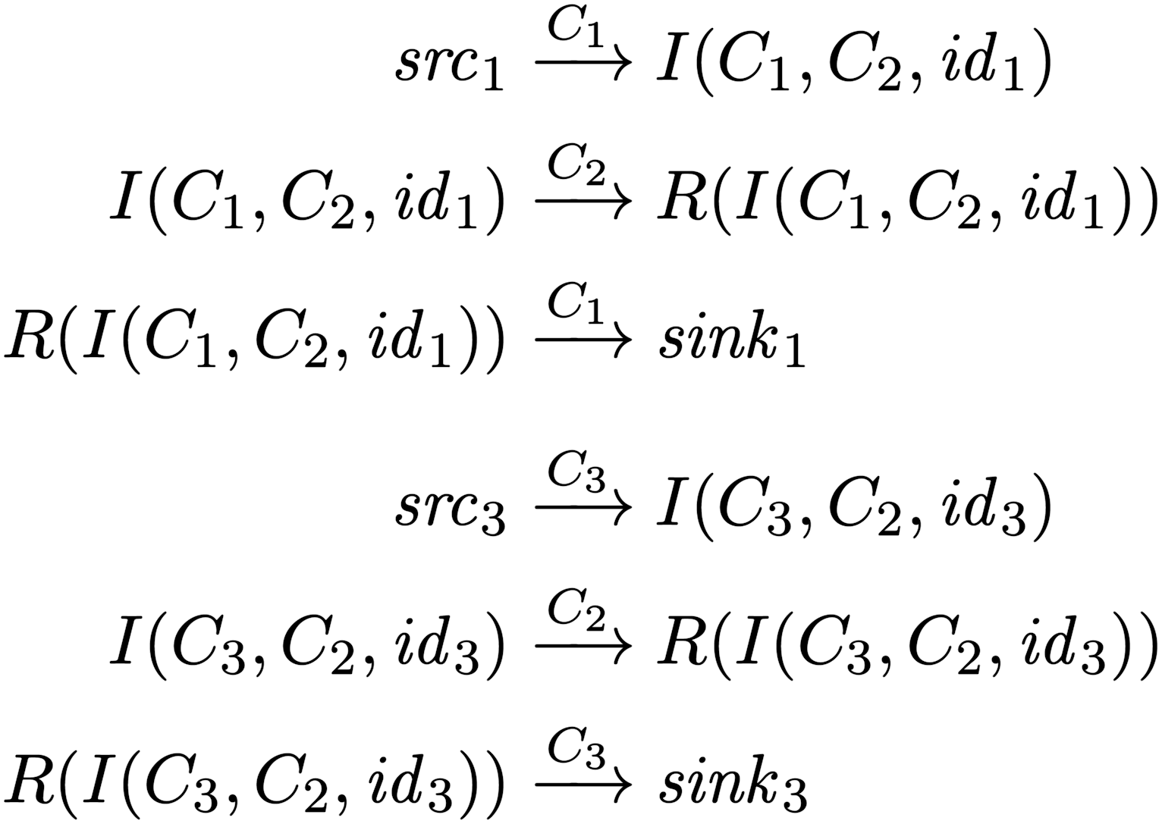
Running Example
src₁
I₁
C₁
sink₁
C₂
I₃
src₃
C₃
sink₃
Notation:
Final Sink Taints:
T(sink₁) = {src₁}
T(sink₃) = {src₃}

Slide 15
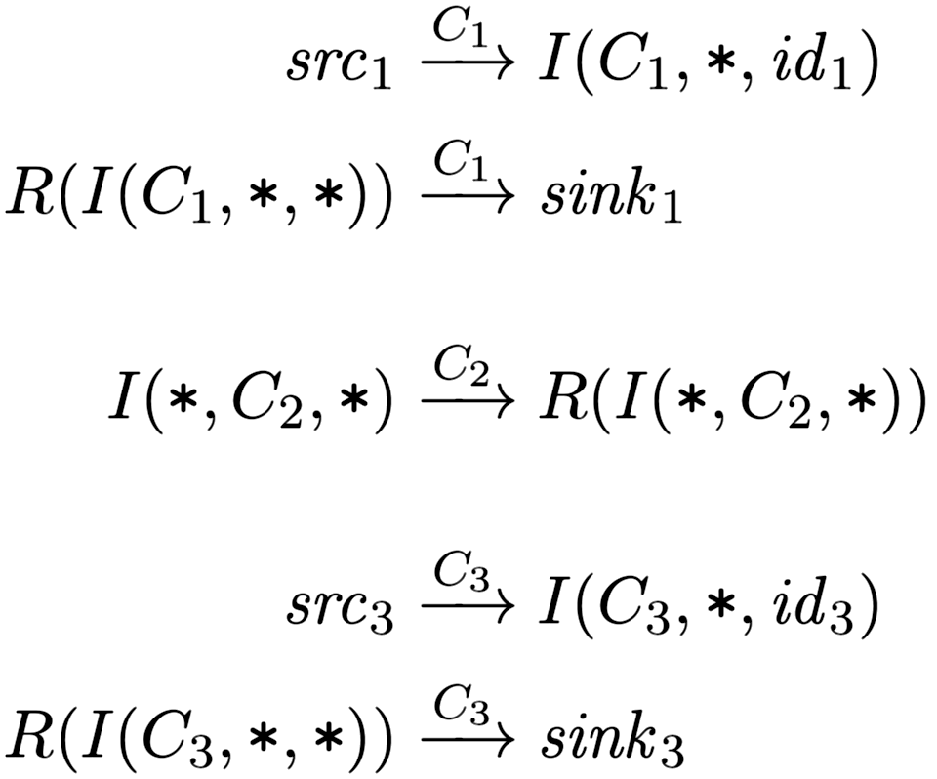
Phase-1 Flow Equations
Analyze each component separately.
Phase 1 Flow Equations:
src₁
C₁
sink₁
C₂
src₃
C₃
sink₃
Notation
• An asterisk (“∗”) indicates an unknown component.
Notes:
Speak about construction of first 3 equations in phase 1.
Each call site (for an intent-sending method) is assigned a unique intent id.

Slide 16
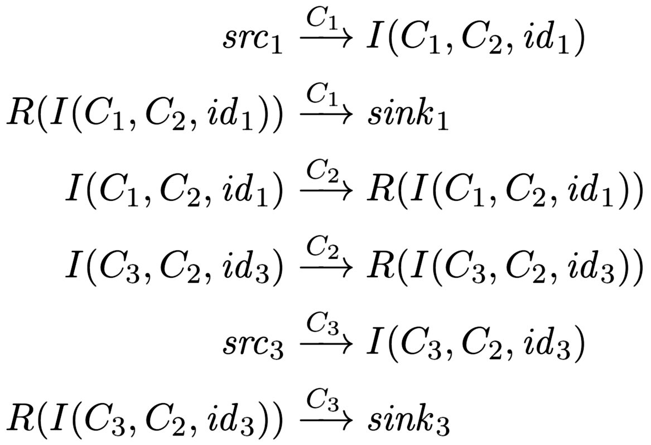
Phase-2 Flow Equations
src₁
I₁
C₁
sink₁
C₂
Instantiate Phase-1 equations for all possible sender/receiver pairs.
I₃
src₃
C₃
sink₃
Phase 1 Flow Equations:
Phase 2 Flow Equations:
Notation
Manifest and Epicc info (not shown) are used to match intent senders and recipients.
Notes:
(‘Flow equations’, versus next part of phase 2 which is ‘taint equations’.)

Slide 17
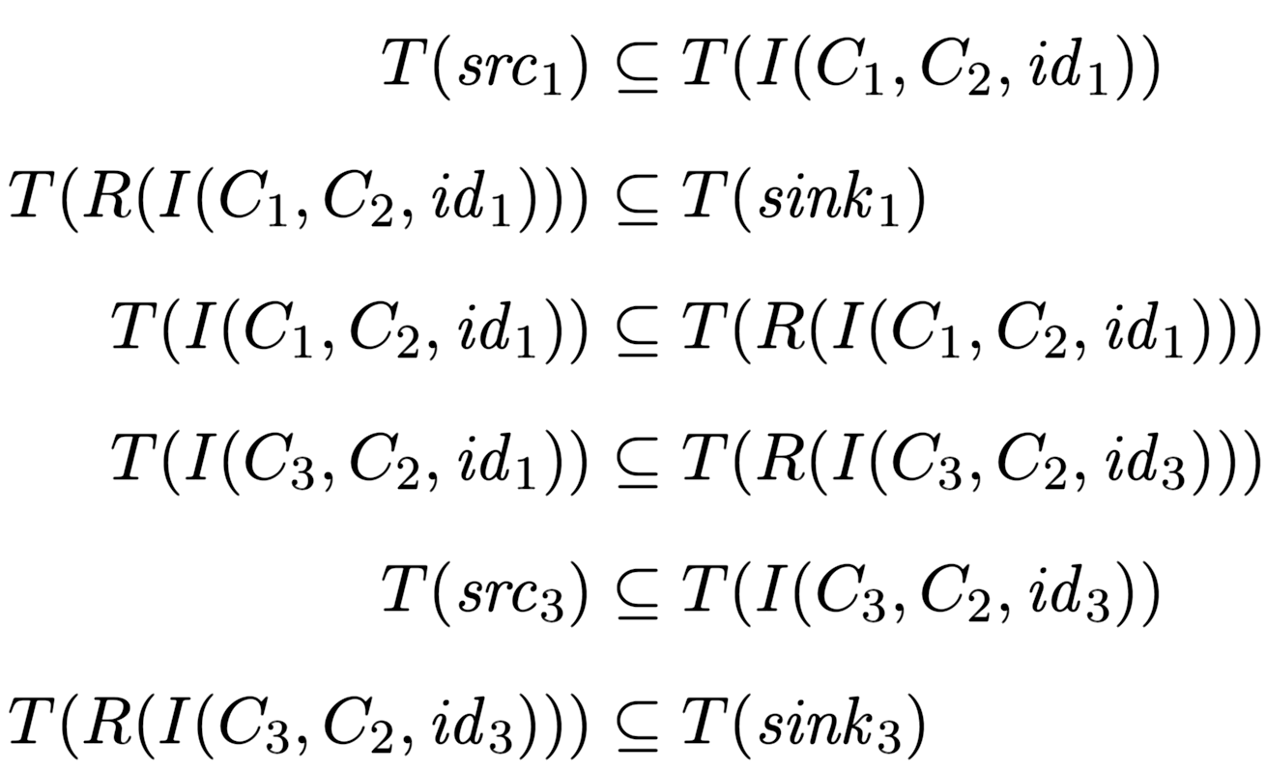
Phase-2 Taint Equations
src₁
I₁
C₁
sink₁
C₂
For each flow equation src → sink,
generate taint equation T(src) ⊆ T(sink).
I₃
src₃
C₃
sink₃
Phase 2 Flow Equations:
Phase 2 Taint Equations:
Notation
Then, solve.
If s is a non-intent source, then T(s) = {s}.
Notes:
(‘Taint equations’, versus previous part of phase 2 which was ‘flow equations’.)
The flow eqns are isomorphic to the taint eqns.

Slide 18
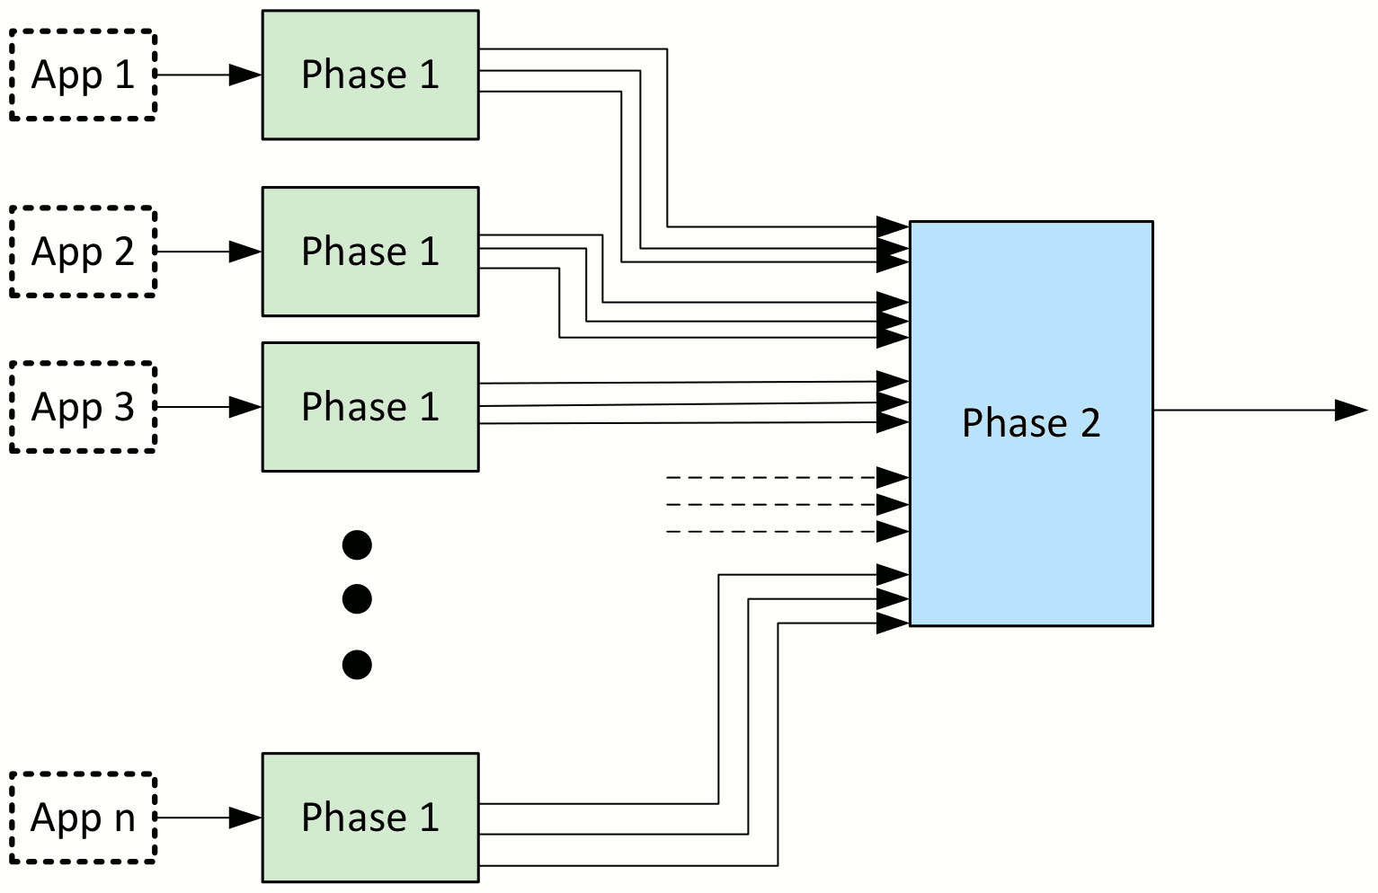
Phase 1
Epicc
Original APK
TransformAPK
FlowDroid
(modified)
Extract manifest
Notes:
In Phase 1, we first transform the APK to add intent IDs for call sites of methods that send intents. We then run Epicc and FlowDroid on the transformed APK. We also extract the manifest, to get the intent filters of each component.
The Phase-2 analysis takes the output of the Phase-1 analysis and produces the final graph of information flows within the set of apps.

Slide 19
Implementation: Phase 1
APK Transformer
  Assigns unique Intent ID to each call site of intent-sending methods.
    Enables matching intents from the output of FlowDroid and Epicc
  Uses Soot to read APK, modify code (in Jimple), and write new APK.
  Problem: Epicc is closed-source. How to make it emit Intent IDs?
  Solution (hack): Add putExtra call with Intent ID.
Phase 1
Epicc
Original APK
TransformAPK
FlowDroid
(modified)
Extract manifest

Slide 20
Implementation: Phase 1
FlowDroid Modifications:
  Extract intent IDs inserted by APK Transformer, and include in output.
  When sink is an intent, identify the sending component.
    In base.startActivity, assume base is the sending component.
  For deterministic output: Sort the final list of flows.
Phase 1
Epicc
Original APK
TransformAPK
FlowDroid
(modified)
Extract manifest
Notes:
Sources/sinks: Added missing intent sending/receiving methods.

Slide 21
Implementation: Phase 2
Phase 2
  Input: Phase 1 output.
  Generate and solve the data-flow equations.
  Output:
    Directed graph indicating information flow between sources, intents, intent results, and sinks.
    Taintedness of each sink.

Slide 22
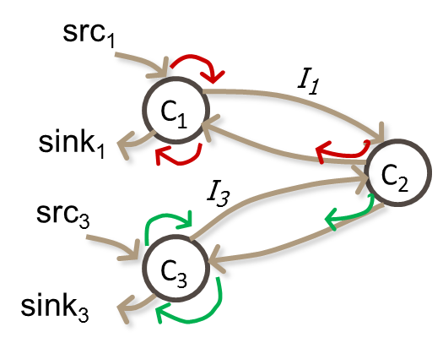
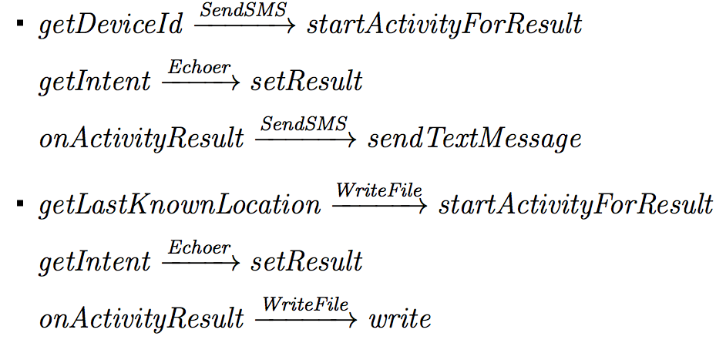
Testing DidFail analyzer: App Set 1
SendSMS.apk
    Reads device ID, passes through Echoer,
    and leaks it via SMS
Echoer.apk
    Echoes the data received via an intent
WriteFile.apk
    Reads physical location (from GPS),
    passes through Echoer, and writes it to a file
Flows found by DidFail
Notes:
App Set 1 corresponds to the running example discussed on previous slides.

Slide 23
Limitations
Unsoundness
    Inherited from FlowDroid/Epicc
      Native code, reflection, etc.
    Shared static fields
      Partially addressed by Jonathan Burket, but with scalability issues
    Implicit flows
    Originally only considered activity intents
      Students added partial support for services and broadcast receivers.
Imprecision
    Inherited from FlowDroid/Epicc
    DidFail doesn’t consider permissions when matching intents
    All intents received by a component are conflated together as a single source
Notes:
Our analyzer does not consider permissions which can be used to restrict intent data flow.
If two running instances of a component use shared static fields to communicate, we miss these flows.
We miss implicit flows, such as where the mere receipt of an intent conveys tainted information, even if the intent itself doesn’t contain any tainted data.
If received intents with different properties (e.g., action string) have different taints, then we could be more precise by distinguishing between these intents.

Slide 24
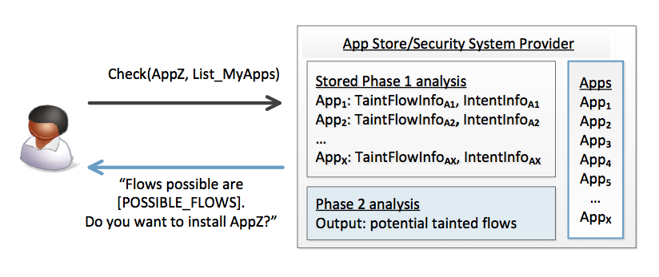
Use of Two-Phase Approach in App Stores
We envision that the two-phase analysis can be used as follows:
    An app store runs the phase-1 analysis for each app it has.
    When the user wants to download a new app, the store runs the phase-2 analysis
    and indicates new flows.
    Fast response to user.
Policy guidance/enforcement, for usability.

Slide 25
Usability: Policies to Determine Allowed Flows
Policies could come from:
App store
Security system provider
Employer
User option
Policy: Prohibit flow from Src₁ to Sink₃
Example 1
Example 2
Src₁
Src₁
I(C₁, C_{2,} id₁)
I(C₁, C_{2,} id₁)
C₁
C₁
Sink₁
Sink₁
C₂
C₂
I(C₃, C₂, id₂)
I(C₃, C₂, id₂)
Src₃
Src₃
C₃
C₃
Sink₃
Compliant
Sink₃
Noncompliant
Notes:
Our analysis differentiates between Example 1 and Example 2.
The equations differentiate to show if C₂ can send tainted data between C₁ and C₃.
Could enable enforcement of a policy declassifying taint (allowing) flow from Src₁ to Sink₁, and from Src₃ to Sink₃, but otherwise flows from a source to sink are disallowed.
For Example 1, the analysis would show compliance.
For Example 2, the analysis would show non-compliance.
Our work is focused on technically enabling precise, sound, efficient determination of taint flows. Usability and policy determination are additional areas of research, not our own focus but important for effective use of the analytical information we output. Policies could be set by an app store, a security system provider, an employer, an ISP, or via some usable interface could be set by the user themselves.

Slide 26
DidFail vs IccTA
IccTA was developed (at roughly the same time as DidFail)
IccTA uses a one-phase analysis
    IccTA is more precise than DidFail’s two-phase analysis.
      More context-sensitive
      Less overestimation of taints reaching sinks
    Two-phase DidFail analysis allows fast 2nd-phase computation.
      Pre-computed Phase-1 analysis done ahead of time
      User doesn’t need to wait long for Phase-2 analysis
Typical time for simple apps:
    DidFail: 2 sec (2nd phase)
    IccTA: 30 sec
Working together now! Ongoing collaboration between IccTA and DidFail teams

Slide 27
Analysis of Android App Sets: Sensitive Dataflow
Goal: enforce confidentiality and integrity
Novel Android static dataflow analysis “DidFail” combines precise single-component taint analysis (FlowDroid) and intent analysis (Epicc).
  Phase 1: Each app analyzed once, in isolation
    Examine flow of tainted data from sources to sinks (including intents)
    Examines intent properties to match senders and receivers
  Phase 2: For a particular set of apps
    Generate taint flow equations
    Iteratively solve equations
    Fast!
Phase 2 fast because of Phase 1 pre-computation
  Source code:
  http://www.cert.org/secure-coding/tools/didfail.cfm
Notes:
Sent intents are treated as sinks, and received intents are treated as sources.
Definition. A full taint flow is from a non-intent source to a non-intent sink.
Definition. A source is an external resource (external to the app, not necessarily external to the phone) from which data is read.
Definition. A sink is an external resource to which data is written.
For example,
Sources: Device ID, contacts, photos, current location, etc.
Sinks: Internet, outbound text messages, file system, etc.

Slide 28
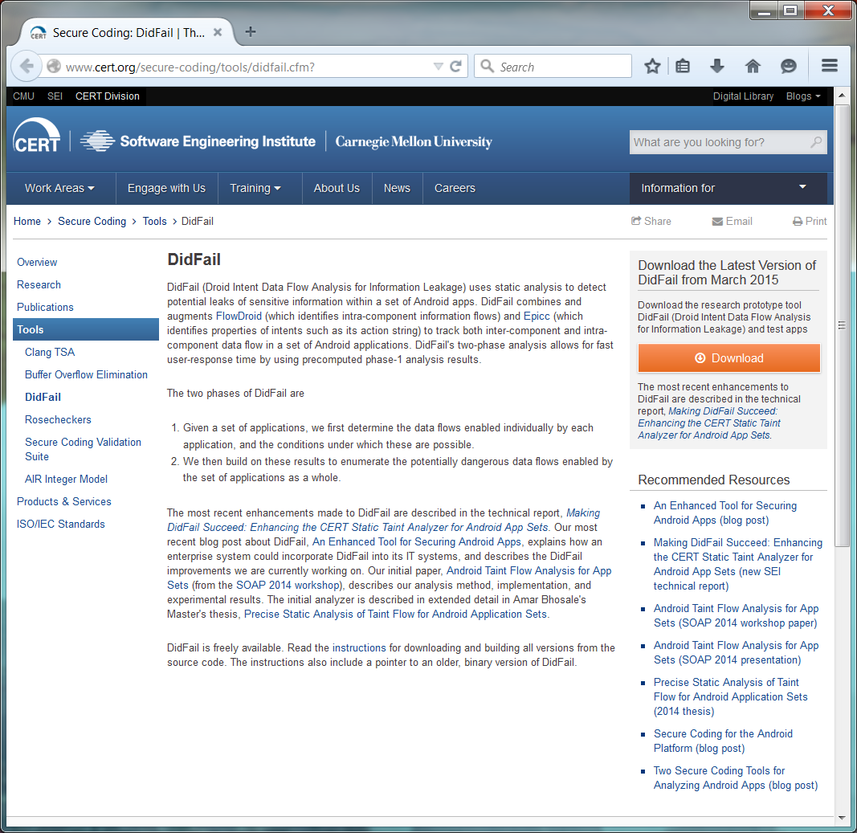
Installing DidFail
Main DidFail website
    http://www.cert.org/secure-coding/tools/didfail.cfm
Detailed install instructions are on the download website
    https://www.cs.cmu.edu/~wklieber/didfail/install-latest.html
  There are 3 branches
    Static fields (Dec. 2014)
    Services and broadcast receivers (Dec. 2014)
    Improved DEX conversion (Nov. 2014)

Slide 29
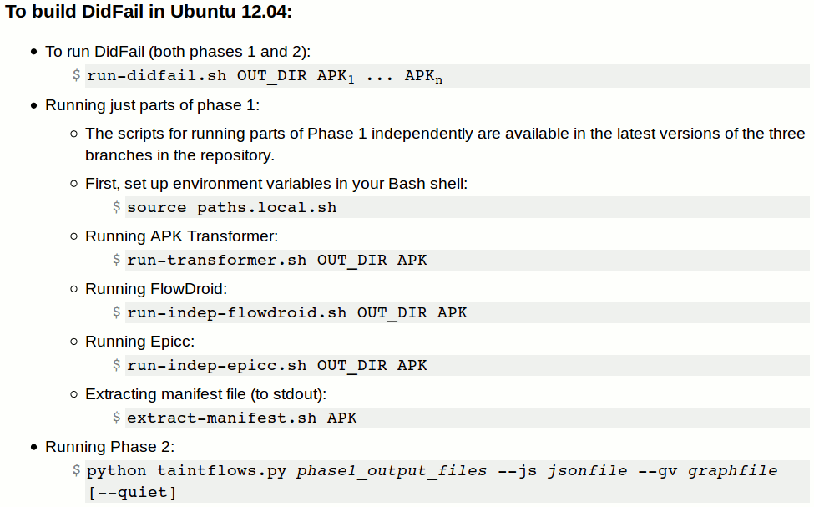
Running DidFail
https://www.cs.cmu.edu/~wklieber/didfail/running.html

Slide 30
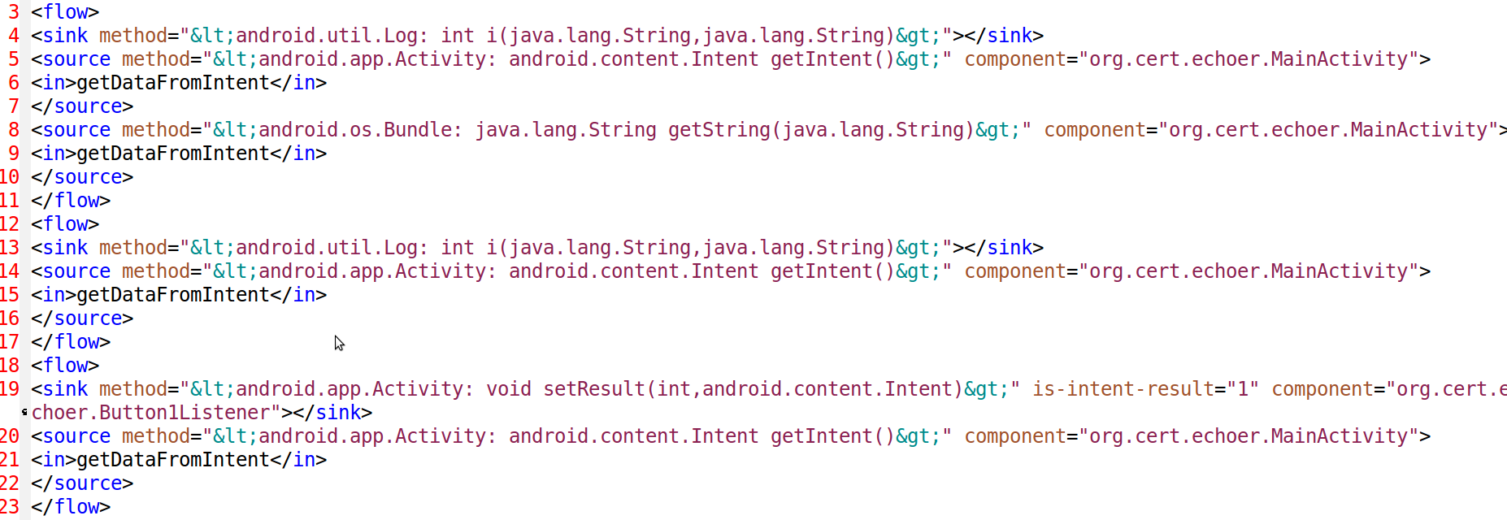
Phase-1 Output from FlowDroid (Echoer Toy App)
3 possible flows to sinks found

Slide 31
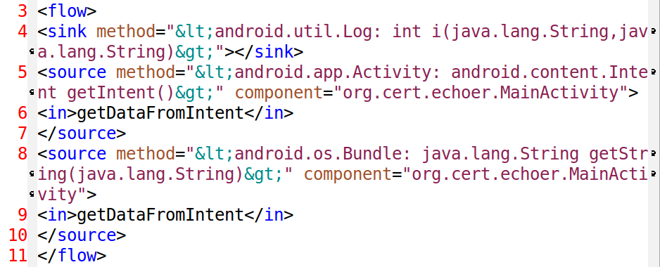
Phase-1 Output from FlowDroid: One XML <flow> for Echoer

Slide 32
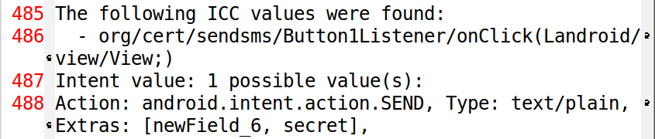
Phase-1 Output from Epicc (SendSMS Toy App)
Epicc provides precision about fields in intents sent

Slide 33
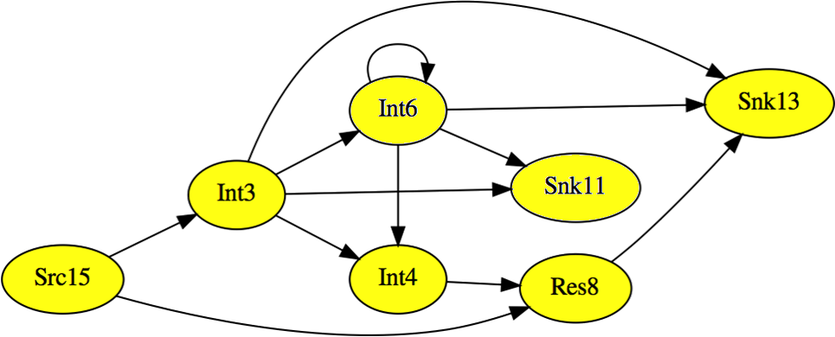
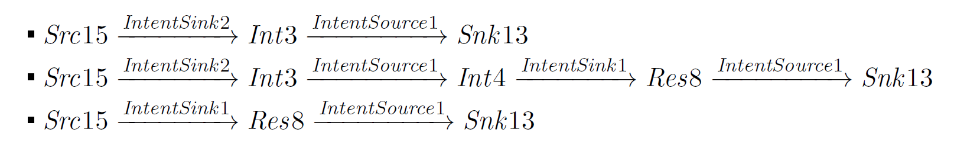
GraphViz output for DroidBench app set
Int3 = I(IntentSink2.apk, IntentSource1.apk, id3)
Int4 = I(IntentSource1.apk, IntentSink1.apk, id4)
Res8 = R(Int4)
Src15 = getDeviceId
Snk13 = Log.i
Graph generated using GraphViz.
Some flows:
Notes:
The yellow highlighted nodes are along three possible taintflow paths between source 15 and sink 13.
Those paths are written on the bottom of the slide.
The white nodes and all the other links can be used for additional taintflow paths (to both sink 13 and sink 11).

Slide 34
Phase-2 Output: JSON-format (excerpts)
{
"Flows": [
[
"Src: <android.telephony.TelephonyManager: java.lang.String getDeviceId()>",
"org.cert.sendsms",
"Sink: <android.util.Log: int i(java.lang.String,java.lang.String)>"
],
[
"Src: <android.telephony.TelephonyManager: java.lang.String getDeviceId()>",
null,
"Intent(tx=('org.cert.sendsms', 'MainActivity'),
rx=('org.cert.echoer', 'MainActivity'), intent_id='newField_6')"
],
[
"Intent(tx=('org.cert.sendsms', 'MainActivity'),
rx=('org.cert.echoer', 'MainActivity'), intent_id='newField_6')",
null,
"Sink: <android.util.Log: int i(java.lang.String,java.lang.String)>"
],
],

Slide 35
Phase-2 Output: JSON-format (excerpts)
"Taints": {
"Intent(tx=('org.cert.sendsms', 'MainActivity'),
rx=('org.cert.echoer', 'MainActivity'), intent_id='newField_6')":
[
"Src: <android.telephony.TelephonyManager: java.lang.String getDeviceId()>"
],
"Sink: <android.telephony.SmsManager:
void sendTextMessage(java.lang.String,java.lang.String,java.lang.String,
android.app.PendingIntent, android.app.PendingIntent)>":
[
"Src: <android.os.Bundle: java.lang.String getString(java.lang.String)>",
"Src: <android.telephony.TelephonyManager: java.lang.String getDeviceId()>"
],
}
}

Slide 36
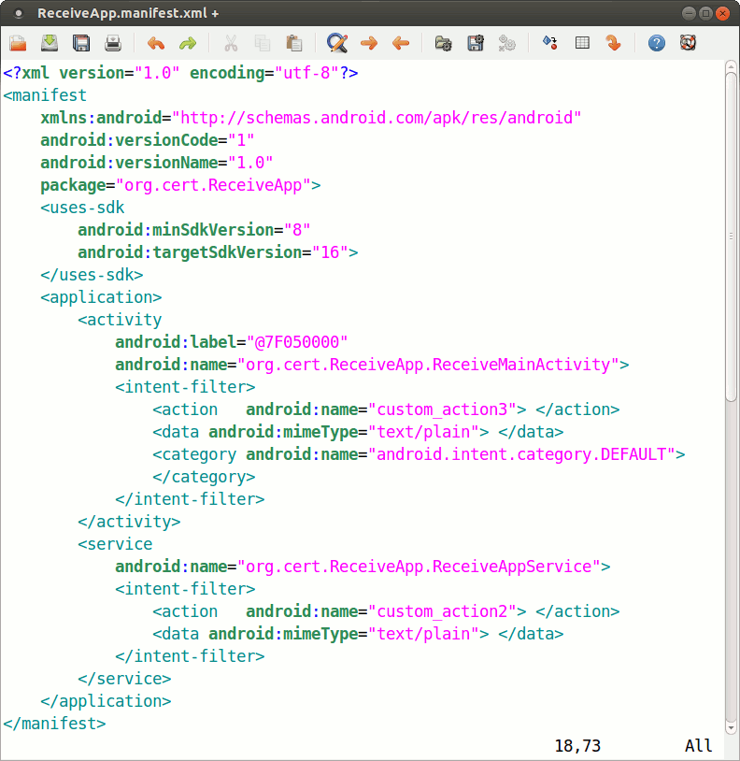
Extracted Manifest XML
(excerpts)

Slide 37


For More Information
Secure Coding Initiative Will Klieber, Lori Flynn {weklieber,lflynn}@cert.org Web www.cert.org/secure-coding www.securecoding.cert.org | U.S. Mail Software Engineering Institute Customer Relations 4500 Fifth Avenue Pittsburgh, PA 15213-2612 Subscribe to the CERT Secure Coding eNewsletter mailto: info@sei.cmu.edu

