Slide 1
A Scorecard for Cyber Resilience: What We Have Observed
(Partial Version)
Robert A. Vrtis, CISSP
Senior Engineer, CERT | Software Engineering Institute | Carnegie Mellon University
Andrew F. Hoover, CISA, CRISC, CISSP
Senior Engineer, CERT | Software Engineering Institute | Carnegie Mellon University

Slide 2
Copyright 2016 Carnegie Mellon University (CMU)
This material is based upon work funded and supported by Department of Homeland Security under Contract No. FA8721-05-C-0003 with Carnegie Mellon University for the operation of the Software Engineering Institute (SEI), a federally funded research and development center sponsored by the United States Department of Defense.
Any opinions, findings and conclusions or recommendations expressed in this material are those of the author(s) and do not necessarily reflect the views of Department of Homeland Security or the United States Department of Defense.
NO WARRANTY. THIS CARNEGIE MELLON UNIVERSITY AND SOFTWARE ENGINEERING INSTITUTE MATERIAL IS FURNISHED ON AN “AS-IS” BASIS. CARNEGIE MELLON UNIVERSITY MAKES NO WARRANTIES OF ANY KIND, EITHER EXPRESSED OR IMPLIED, AS TO ANY MATTER INCLUDING, BUT NOT LIMITED TO, WARRANTY OF FITNESS FOR PURPOSE OR MERCHANTABILITY, EXCLUSIVITY, OR RESULTS OBTAINED FROM USE OF THE MATERIAL. CARNEGIE MELLON UNIVERSITY DOES NOT MAKE ANY WARRANTY OF ANY KIND WITH RESPECT TO FREEDOM FROM PATENT, TRADEMARK, OR COPYRIGHT INFRINGEMENT.
[DISTRIBUTION STATEMENT F] Further dissemination only as directed by Department of Homeland Security (2015-09-25) or higher DoD authority.
Carnegie Mellon® and CERT® are registered marks of Carnegie Mellon University.
DM-0003936

Slide 3
Agenda
What Is the Cyber Resilience Review (CRR)?
How CRR Data Is Collected
Overview of CRR Data that Has Been Collected
CRR Data Analysis Key Observations
  Maturity Indicator Level Practice Observations
  Domain-Specific Observations
NIST Cybersecurity Framework Observations

Slide 4

What Do We Mean by Resilience?
Operational resilience: The emergent property of an organization that can continue to carry out its mission after disruption that does not exceed its operational limit
―CERT-RMM
Where does the disruption come from? Realized risk.
Notes:
Resilience: We adapt the definition from the physical world.
What happens if I pull the slinky too far?
It won’t return to its original shape.
_____
An Emergent property
Resilience isn’t something that you do; it emerges from other collaborative and holistic activities. It is not something that you can buy.
Operational resilience: The organizations ability to adapt to risk that affects core operational capabilities.
Operational resilience is an emergent property of effective operational risk management, supported and enabled by activities such as information technology, security and business continuity.
A subset of enterprise resilience, operational resilience focuses on the organizations ability to manage operational risk, whereas enterprise resilience encompasses additional risk such as business risk and credit risk. [CERT-RMM]
Risk: The possibility of suffering harm or loss.
From a resilience perspective, risk is the combination of a threat and a vulnerability (condition), the impact (consequence) on the organization if the vulnerability is exploited, and the presence of uncertainty.
Operational risk is defined as the potential impact on assets and the related services – the risk that results from operating services and assets on a day-to-day basis
In CERT-RMM, this definition is typically applied to the asset or service level such that risk is the possibility of suffering harm or loss due to disruption of high-value assets and services. [CERT-RMM]

Slide 5
What Is the Cyber Resilience Review (CRR)?
A U.S. Department of Homeland Security (DHS) initiative intended to help the nation’s critical infrastructure providers understand their operational resilience and ability to manage cyber risk
A review of the overall health of an organization’s cybersecurity program, as it relates to a specific critical service
A tool that allows an organization to
  develop an understanding of process-based cybersecurity capabilities
  improve its ability to manage cyber risk to its critical services and related assets
  compare its capabilities to the criteria of the National Institute of Standards and Technology (NIST) Cybersecurity Framework (CSF)

Slide 6
Overview of the CRR
The CRR is derived from the CERT Resilience Management Model (CERT-RMM).
It is a structured assessment conducted during a one day, facilitated session.
The CRR session is facilitated by multiple navigators (DHS and CERT) who solicit the answers to 297 questions.
The CRR results in a summary report that provides the organization with suggested options for consideration.
All CRR practices have been mapped to the subcategories of the NIST CSF, allowing an organization to assess it’s capabilities relative to the CSF criteria.
This analysis was conducted using the CRR results of 245 organizations.

Slide 7
Overview of the NIST Cybersecurity Framework (CSF)
Recognizing that the national and economic security of the United States depends on the reliable functioning of critical infrastructure, the President issued Executive Order (EO) 13636, Improving Critical Infrastructure Cybersecurity, in February 2013.
The order directed NIST to work with stakeholders to develop a voluntary framework for reducing cyber risks to critical infrastructure.
Created through collaboration between industry and government, the framework consists of standards, guidelines, and practices, divided into five functional areas, to promote the protection of critical infrastructure.

Slide 8
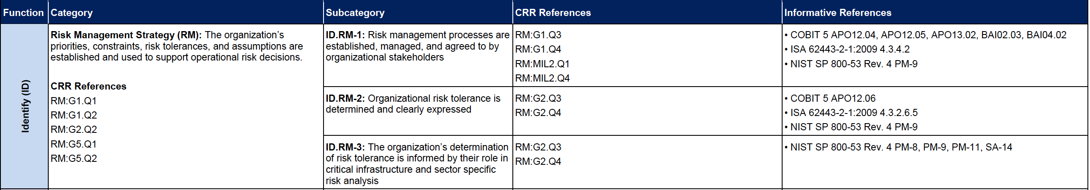
CSF – CRR Mapping
The CRR enables an organization to assess its capabilities relative to CSF
Maps the CSF categories and subcategories to the CRR goals and practices.
This mapping can be found in the DHS C³ Voluntary Program website.

Slide 9
















Who Participates?
Chemical Commercial Facilities Communications Critical Manufacturing Dams Defense Industrial Base Emergency Services Energy Financial Services | Food and Agriculture Government Facilities Health Care and Public Health Information Technology Nuclear Reactors, Materials, and Waste Transportation Systems Water
Organizations within Critical Infrastructure and Key Resources (CIKR) sectors
  State, Local, Tribal, and Territorial (SLTT) governments, within the United States (and its territories)
  Participation is voluntary and protected by the Protected Critical Infrastructure Information (PCII) Program

Slide 10
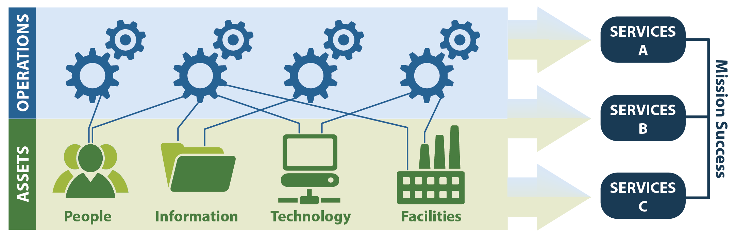
Service-Oriented Approach
The CRR has a service focus.
An organization deploys its assets (people, information, technology, and facilities) to support specific operational missions, or services. For example, the wastewater processing service in a water treatment plant.
A service orientation enables the identification of assets important to achieving an organizational or sector mission.
The service is used to scope the CRR.
Notes:
Graphic akoya
Others, workshop

Slide 11

CRR Domains―What We Examine
CRR Domains
 | Asset Management
 | Controls Management
 | Configuration and Change Management
 | Vulnerability Management
 | Incident Management
 | Service Continuity Management
 | Risk Management
 | External Dependencies Management
 | Training and Awareness
 | Situational Awareness
Based on the CERT-RMM
The ten domains in the CRR represent important areas that contribute to the cyber resilience of an organization.
The domains focus on practices an organization should have in place to assure the protection and sustainment of its critical service.

Slide 12
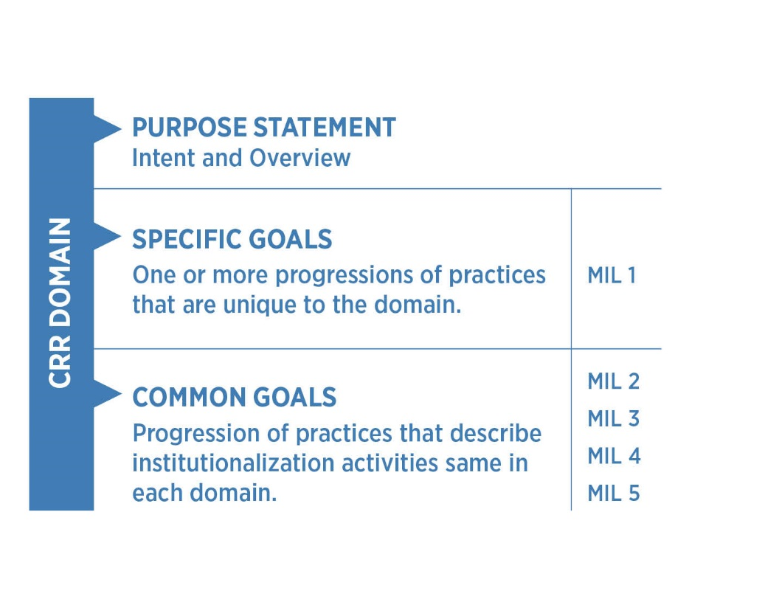
CRR Architecture Overview
What to Do
Making it Stick
Notes:
Each domain is composed of a purpose statement, a set of specific goals and associated practice questions unique to the domain, and a universal or common set of Maturity Indicator Level (MIL) questions.
The MIL questions examine the institutionalization of practices within an organization.

Slide 13
Cyber Resilience Review Numbers
CRR Domains |  | Number of Goals | Number of Goal Practices | Number of MIL Practices
 | Asset Management | 7 | 24 | 13
 | Controls Management | 4 | 7 | 13
 | Configuration and Change Management | 3 | 15 | 13
 | Vulnerability Management | 4 | 12 | 13
 | Incident Management | 5 | 23 | 13
 | Service Continuity Management | 4 | 15 | 13
 | Risk Management | 5 | 13 | 13
 | External Dependencies Management | 5 | 14 | 13
 | Training and Awareness | 2 | 8 | 13
 | Situational Awareness | 3 | 8 | 13
Total |  |  | 167 | 130
Notes:
Consistent tables

Slide 14
Maturity Indicator Level (MIL) Scale
The MIL scale measures process institutionalization
Higher degrees of institutionalization translate to more stable processes that…
  …produce consistent results over time
  …are retained during times of stress
MIL Level 5 – Defined
Processes are acculturated, defined, measured, and governed
MIL Level 4 – Measured
MIL Level 3 – Managed
MIL Level 2 – Planned
Practices are performed
MIL Level 1 – Performed
Practices are incompletely performed, or not performed
MIL Level 0 – Incomplete
Notes:
MIL-0 Incomplete – indicates that practices in the domain are not being performed
MIL-1 Performed – indicates that practices that support the goals in a domain are being performed
MIL-2 Planned – indicates that practices are performed and supported by planning, policy, stakeholders, and relevant standards and guidelines
MIL-3 Managed – indicates that practices are performed, planned, and are supported by governance and adequate resources
MIL-4 Measured – indicates that practices in a domain are performed, planned, managed, and supported by measurement, monitoring, and executive oversight
MIL-5 Defined – indicates that practices in a domain are performed, planned, managed, measured, and supported by enterprise standardization and analysis of lessons learned.
Higher levels of maturity would logically seem to lead to better performance/better resilience.
All practices at lower MILs must be performed before achieving the next MIL
The same MIL concepts in MILs 2 through 5 are asked as they relate to each domain.

Slide 15
Agenda
What Is the Cyber Resilience Review (CRR)?
How CRR Data Is Collected
Overview of CRR Data that Has Been Collected
CRR Data Analysis Key Observations
  Maturity Indicator Level Practice Observations
  Domain-Specific Observations
NIST Cybersecurity Framework Observations

Slide 16
Conducting the CRR: Role of the Navigator
Navigators work with the organization to ensure that the appropriate subject matter experts participate.
Two navigators execute the CRR with the organization’s representatives.
Navigators collect data independently.
Following the CRR, the navigators reconcile discrepancies and validate the data.
Navigators then work with the organization to review the initial draft report.
Notes:
Preparation meetings are conducted to:
ensure the correct personnel from the participating organization are involved in the CRR
establish the logistics for the CRR
identify the critical service that will be examined
introduce the CRR concepts to the organization

Slide 17
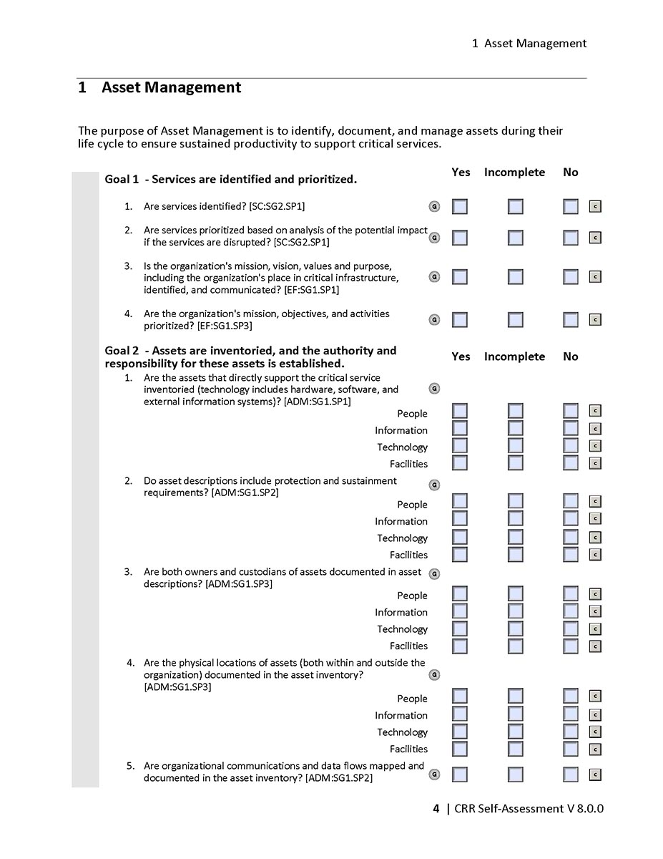
CRR Data Capture Form and Report Preparation
Each Domain is in its own section.
Each Domain is divided into goals.
Each practice question has 3 possible answers:
Yes
Incomplete
No
Each practice question has imbedded guidance.
Following the completion of the CRR, each navigator’s answers will be
compared
reconciled
An initial report is then generated.
Notes:
Although not shown here, guidance is provided to navigators for each practice question (via an active pop up box) to assist in obtaining an accurate response.

Slide 18
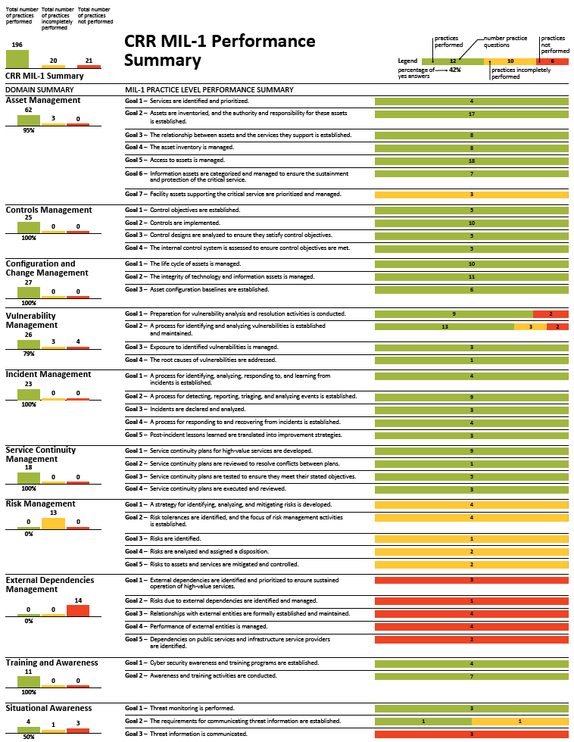
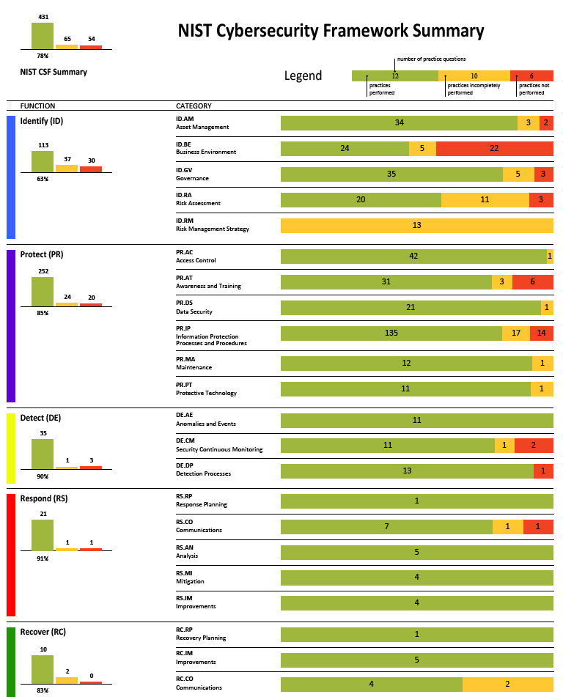
CRR Scoring Depictions

Slide 19
Contact Information
This is a partial version of the presentation. Please contact us for the full version that includes data and observations.
Robert A. Vrtis, CISSP
Senior Engineer
Cybersecurity Assurance - CS2
CERT |Software Engineering Institute | Carnegie Mellon University
rv@cert.org
Andrew F. Hoover, CISA, CRISC, CISSP
Senior Engineer
Cybersecurity Assurance – CS2
CERT | Software Engineering Institute | Carnegie Mellon University
afhoover@cert.org

Slide 20
Supporting Material

Slide 21
List of Acronyms Used
AM – Asset Management
CCM – Configuration and Change Management
CIKR – Critical Infrastructure and Key Resources
CM – Controls Management
CMU – Carnegie Mellon University
CRR - Cyber Resilience Review
DHS – Department of Homeland Security
EDM - External Dependencies Management
IM – Incident Management
MIL – Maturity Indicator Level
RM – Risk Management
RMM – Resilience Management Model
SA – Situational Awareness
SCM – Service Continuity Management
SEI – Software Engineering Institute
SLTT – State, Local, Tribal, and Territorial
TA – Training and Awareness
VM – Vulnerability Management

