Slide 1
Temporal Protection in Real-Time Systems
Software Engineering Institute
Carnegie Mellon University
Pittsburgh, PA 15213
November 2016
Notes:
Title Slide
Title and Subtitle text blocks should not be moved from their position if at all possible.

Slide 2
Copyright 2016 Carnegie Mellon University
This material is based upon work funded and supported by the Department of Defense under Contract No. FA8721-05-C-0003 with Carnegie Mellon University for the operation of the Software Engineering Institute, a federally funded research and development center.
Any opinions, findings and conclusions or recommendations expressed in this material are those of the author(s) and do not necessarily reflect the views of the United States Department of Defense.
NO WARRANTY. THIS CARNEGIE MELLON UNIVERSITY AND SOFTWARE ENGINEERING INSTITUTE MATERIAL IS FURNISHED ON AN “AS-IS” BASIS. CARNEGIE MELLON UNIVERSITY MAKES NO WARRANTIES OF ANY KIND, EITHER EXPRESSED OR IMPLIED, AS TO ANY MATTER INCLUDING, BUT NOT LIMITED TO, WARRANTY OF FITNESS FOR PURPOSE OR MERCHANTABILITY, EXCLUSIVITY, OR RESULTS OBTAINED FROM USE OF THE MATERIAL. CARNEGIE MELLON UNIVERSITY DOES NOT MAKE ANY WARRANTY OF ANY KIND WITH RESPECT TO FREEDOM FROM PATENT, TRADEMARK, OR COPYRIGHT INFRINGEMENT.
[Distribution Statement A] This material has been approved for public release and unlimited distribution. Please see Copyright notice for non-US Government use and distribution.
This material may be reproduced in its entirety, without modification, and freely distributed in written or electronic form without requesting formal permission. Permission is required for any other use. Requests for permission should be directed to the Software Engineering Institute at permission@sei.cmu.edu.
Carnegie Mellon® is registered in the U.S. Patent and Trademark Office by Carnegie Mellon University.
DM-0004174

Slide 3


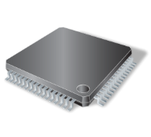
OS Dual Objective
Enhanced
Machine
Multiple
Machines
File System
OS
Disk
Icons credit: http://www.doublejdesign.co.uk

Slide 4

Time-Sharing CPU – Round robin
Scheduler
Same time requirement – Fair Scheduling

Slide 5
Consolidation of Mixed-Criticality Tasks
Planning
Shared Hardware
Can lead to cycle stealing
Obstacle avoidance
Notes:
Functional consolidation
Mixed-Criticality tasksets
Temporal protection (symmetric)
Criticality Inversion
---
CAPA avoids criticality inversion BUT leads to priority inversion and loss of utilization
Combine
---
Metric: Laxity utilization
Evaluation

Slide 6
Consolidation of Mixed-Criticality Tasks
Planning
Obstacle avoidance
To avoid interference
add temporal protection
Notes:
Functional consolidation
Mixed-Criticality tasksets
Temporal protection (symmetric)
Criticality Inversion
---
CAPA avoids criticality inversion BUT leads to priority inversion and loss of utilization
Combine
---
Metric: Laxity utilization
Evaluation

Slide 7
Consolidation of Mixed-Criticality Tasks
Planning
BUT
Symmetric protection
leads to criticality inversion
Obstacle avoidance
Notes:
Functional consolidation
Mixed-Criticality tasksets
Temporal protection (symmetric)
Criticality Inversion
---
CAPA avoids criticality inversion BUT leads to priority inversion and loss of utilization
Combine
---
Metric: Laxity utilization
Evaluation

Slide 8
Criticality Inversion
A higher-criticality task waits for a lower-criticality task to release a resource
  Symmetric temporal protection
  Scheduling policy is aimed at maximizing utilization (RMS/DMS/EDF)

Slide 9
Rate-Monotonic Priority
Shorter Period → Higher Priority
  Ideal utilization
BUT: Poor Criticality Protection Due to Criticality Inversion
  If criticality order is opposite to rate-monotonic priority order
High
Criticality
10/100
100
1/10
Low
Criticality

Slide 10
Criticality As Priority Assignment (CAPA)
Higher Criticality → Higher Priority
  Ideal criticality protection:
    lower criticality cannot interfere with higher criticality
BUT: Poor Utilization Due to Priority Inversion
  If criticality order is opposite to rate-monotonic priority order
10/100
High
Criticality
100
Low
Criticality
1/10
10
20

Slide 11
Task Model
Normal Execution Budget of task i
Overload Execution Budget of task i
Period of task i
Deadline of task i D_{i} ≤ T_{i}
Criticality of task i

Slide 12
Zero-Slack Scheduling
Start with RM
Calculate the last instant before τ_{HC} misses its deadline
  this is called the zero-slack instant
Switch to criticality-as-priority
  Splits the execution window into
    Normal mode (RM)
    Critical mode (CAPA)
τ_{LC} =(2,2,4,4)
2
1
1
τ_{HC} =(2.5,5,8,8)
2
½
2½
Normal Mode
Critical Mode

Slide 13
Critical Instant of a Task τ_{i}

Slide 14
Interference in Zero-Slack Scheduling
Task Set Divided into
  H^{lc} : Higher priority, lower criticality
  H^{hc} : Higher priority, higher criticality
  L^{lc} : Lower priority, lower criticality
  L^{hc} : Lower priority, higher criticality
Interfering tasks in normal mode (Normal mode)
  H^{lc} + H^{hc} + L^{hc}
Interfering tasks in critical mode (C mode)
  H^{hc} + L^{hc}

Slide 15
Scheduling Guarantee
A task is guaranteed before
if no
executes beyond its

Slide 16
Calculating The Zero-Slack Instant
Start of trailing
slack
Slack Normal Mode
Slack Critical Mode

Slide 17
Calculating The Zero-Slack Instant
New slack can open after each iteration
Needs to repeat until no new slack opens

Slide 18
ZSRM Properties
Subsumes RM
  If criticalities are aligned to priorities
  No critical mode
Subsumes CAPA
  If not enough slack, only critical mode
Graceful Degradation
  In overloads, deadlines are missed in reverse criticality order

Slide 19
Implementation
ZSRM
Scheduling algorithm calculates zero-slack instants offline
Linux/ RK
  Resource reservation in Linux
    CPU, Net, Mem, Disk
  Bundled into resource sets that provide a form of virtual machine
  Multiple implementations
    Nano/RK for sensor networks
Special Zero-Slack Reserves
  Switch to critical mode
    Stop lower-criticality tasks on zero-slack instant
  Tasks in critical mode in stack

Slide 20
What about Shared Resources?
Planning
Consider a new medium priority and
Medium criticality task (say v2v task)
Let Planning and Obstacle Avoidance share
an Obstacle Map Data Structure
Obstacle avoidance
Low Criticality
High Priority
Resource
Response
Medium Criticality
Medium Priority
Resource
Request
High Criticality
Low Priority
Zero-Slack Instant
of obstacle Avoidance
Zero-Slack Instant
of V2V Task
Potentially leads to unbounded Criticality Inversion !!!

Slide 21
Priority and Criticality Inversion
Priority Inversion
Low Criticality
High Priority
Arrival
Obtain
Lock
Release
Lock
Medium Criticality
Medium Priority
Arrival
Zero-
Slack Instant
Deadline
Criticality Inversion
High Criticality
Low Priority
Arrival
Zero-
Slack Instant
Wait
on
Lock

Slide 22
Blocking in Zero-Slack Scheduling
A job J_{h} waiting for a job J_{l} to exit critical section Z_{l,k} is considered to be blocked at time t, if and only if one of the following conditions is satisfied at t:
1) The priority of J_{l} is lower than J_{h}'s priority and J_{l} is running in its normal mode.
2) The criticality of J_{l} is lower than J_{h}'s criticality and J_{h} is running in its critical mode.

Slide 23
Priority and Criticality
Inheritance Protocol (PCIP)

Slide 24
PCIP Definition
A task τ_{i} that holds a lock to a resource can inherit the priority from a task τ_{j} and the criticality from a task τ_{k} (τ_{k} can be the same as τ_{j} ), both requesting a lock to the resource held by τ_{i} as follows:
  τ_{i} inherits the priority of τ_{j} if τ_{j} ’s priority is higher.
    This inherited priority has an immediate effect on the scheduling of τ_{i}
  τ_{i} inherits the criticality of τ_{k} if τ_{k}’s criticality is higher.
    This criticality is used by τ_{i} immediately as soon as τ_{k} requests the lock held by τ_{i}

Slide 25
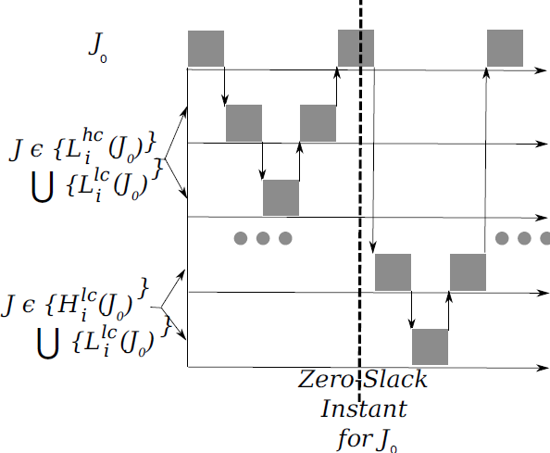
PCIP Possible Blocking
Consider a Job J₀
L_{i}^{hc}(J₀) is the set of jobs with
lower priority and higher criticality
L_{i}^{lc}(J₀) is the set of jobs with
lower priority and lower criticality
H_{i}^{lc}(J₀) is the set of jobs with
higher priority and lower criticality
H_{i}^{hc}(J₀) is the set of jobs with
higher priority and higher criticality
Other than H_{i}^{hc}(J₀) all other sets can lead to priority or criticality inversion

Slide 26
PCIP Properties
Under PCIP, given a job J₀ for which there are n jobs {J₁,J₂ ,...,J_{n}}, with J_{i} in { L_{i}^{hc}(J₀) U L_{i}^{lc}(J₀) U H_{i}^{lc}(J₀) }, job J₀ can be blocked for at most the duration of one critical section in each of β∗_{0,i}.
  - where,
    β∗_{0,i} is the set of critical sections of J_{i} that can block J₀
Under PCIP, if there are “m” locks which can block job J, then J can be blocked at most “m” times in its normal mode and blocked at most “m” times in its critical mode.

Slide 27
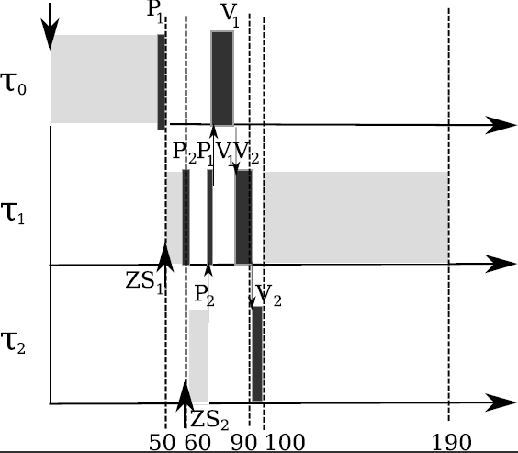

PCIP Illustration
Task τ₁ Inherits Criticality of τ₂
Task τ₀ Inherits Criticality of τ₁ and τ₂
Low Criticality
High Priority
(P₁ V₁)
Medium Criticality
Medium Priority
(P₁ P₂ V₂ V₁)
High Criticality
Low Priority
(P₂ V₂)

Slide 28
Priority and Criticality
Ceiling Protocol (PCCP)

Slide 29
PCCP Definition
Each lock is assigned both a priority ceiling and a criticality ceiling
  - Priority ceiling is the highest possible priority of any locker of the lock
  - Criticality ceiling is the highest possible criticality of any locker of the lock
Both the priority ceiling and the criticality ceiling of a lock are acquired by task whenever it holds the lock

Slide 30
PCCP – Maximum Blocking
Each job J can only be blocked twice
  - At most once in Normal execution mode
  - At most once in Critical execution mode
Each job J_{w} can block job J only once
  - Otherwise, J_{w} is L_{i}^{lc}(J₀)
  - And, Job J has to be blocked by J_{w} once in Normal mode
  - However, J_{w} cannot obtain the processor again as it is in L_{i}^{lc}(J₀) !!!

Slide 31
PCCP - No Deadlocks
Under PCCP, no job J_{k} can preempt another job J_{i} while J_{i} holds a lock (i.e. is inside the critical section) that is also accessed by J_{k}.
PCCP prevents Transitive Blocking
PCCP prevents Deadlocks

Slide 32
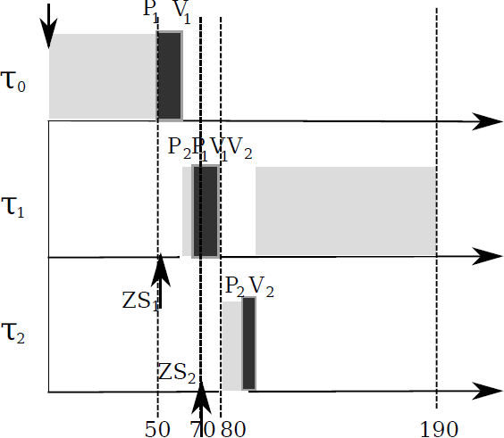
PCCP Illustration
Task τ₀ acquires the Priority and Criticality Ceiling of Lock (P₁, V₁)
Task τ₁ acquires the Priority and Criticality Ceiling of Lock (P₂, V₂)
Low Criticality
High Priority
(P₁ V₁)
Medium Criticality
Medium Priority
(P₁ P₂ V₂ V₁)
High Criticality
Low Priority
(P₂ V₂)

Slide 33

PCIP Blocking Term Analysis
PCIP Blocking Term B_{i} for Task τ_{i}
where,
β∗_{i,j} is the set of critical sections of τ_{j} that can block τ_{i}
λ(β∗_{i,j}) is the length of the longest critical sections of β∗_{i,j} that can block task τ_{i}
Λ(Ψ_{i,j}) is the length of the critical section protected by lock Ψ_{i,j}

Slide 34

PCCP Blocking Term Analysis
PCCP Blocking Term B_{i} for Task τ_{i}
where,
β∗_{i,j} is the set of critical sections of τ_{j} that can block task τ_{i}
λ(β∗_{i,j}) is the length of the longest critical sections of β∗_{i,j} that can block task τ_{i}

Slide 35
Criticality isolation strategy (S)

Slide 36
Criticality mixture strategy (T)

Slide 37
Generalization: Ductility Matrix

Slide 38
Quantification of Ductility

Slide 39
Outline
Mixed-criticality task scheduling problem
Zero-slack scheduling for uni-processors
  Zero-slack metrics & properties
Generalizing resource allocation to distributed mixed criticality tasks
  Generalized metric: Ductility matrix
Compress-on-Overload Packing (COP)
  COP Performance
Radar surveillance case study
Conclusions

Slide 40
Compress-on-Overload Packing (COP)
More critical
Proc 1
Proc 2
Less critical

Slide 41
Compress-on-Overload Packing (COP)
Phase 1: Pack by criticality then size
object size =
More critical
Proc 1
Proc 2
Less critical

Slide 42
Compress-on-Overload Packing (COP)
Phase 2: Pack by criticality then size
object size =
More critical
Proc 1
Proc 2
Less critical

Slide 43
Compress-on-Overload Packing (COP)
Phase 2: Pack by criticality then size
object size =
More critical
Proc 1
Proc 2
Less critical

Slide 44
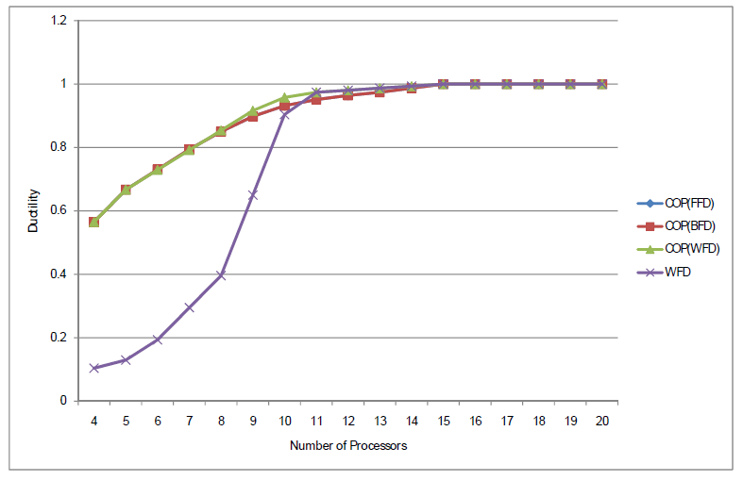
COP Performance

Slide 45
Overloading in Mixed-Criticality Systems
Task | Period | Criticality | WCET | NCET
t₁ Surveillance Cov. | 4 | Mission | 2 | 2
t₂ Collision Avoid. | 8 | Safety | 5 | 2.5
t₁
2
2
t₂
2
½
2.5
4
8

Slide 46
Zero-Slack Rate Monotonic
Task | Period | Criticality | WCET | NCET
t₁ Surveillance Cov. | 4 | Mission | 2 | 2
t₂ Collision Avoid. | 8 | Safety | 5 | 2.5
t₁
2
1
1
t₂
2
½
2.5
4
8
Zero-Slack Instant

Slide 47
Zero-Slack Rate Monotonic
Task | Period | Criticality | WCET | NCET
t₁ Surveillance Cov. | 4 | Mission | 2 | 2
t₂ Collision Avoid. | 8 | Safety | 5 | 2.5
t₁
2
1
1
t₂
2
½
2.5
4
8
Overbooking

Slide 48
Reclaiming Resources in Mixed-Criticality Systems
Task | Period | Criticality | WCET | NCET | Utility
t₁ Surveillance Cov. | 4 | Mission | 2 | 2 | {2,2.5}
t₂ Collision Avoid. | 8 | Safety | 5 | 2.5
t₃ Amount of Intelligence | 4 | Mission | 2 | 2 | {2,2.5}
Reclaimed
Resources
t₁
t₂
2
½
2.5
t₃
4
8

Slide 49
Using Reclaimed Resources to Maximized Utility
Task | Period | Criticality | WCET | NCET | Utility Levels
t₁ Surveillance Cov. | 4 | Mission | 2 | 2 | {2,2.5}
t₂ Collision Avoid. | 8 | Safety | 5 | 2.5
t₃ Amount of Intelligence | 4 | Mission | 2 | 2 | {2,2.5}
2.5
t₁
1
1
1
1
2
Utility
2
½
2.5
1
2
t₂
Resource
Total Utility = 2.5
2.5
Utility
t₃
1
1
2
4
8
1
2
Utility Diminishes: Utility ≠ Criticality

Slide 50
Using Reclaimed Resources to Maximized Utility
Task | Period | Criticality | WCET | NCET | Utility Levels
t₁ Surveillance Cov. | 4 | Mission | 2 | 2 | {2,2.5}
t₂ Collision Avoid. | 8 | Safety | 5 | 2.5
t₃ Amount of Intelligence | 4 | Mission | 2 | 2 | {2,2.5}
2.5
t₁
1
1
2
Utility
2
½
2.5
1
2
t₂
Resource
Total Utility = 4
2.5
Utility
t₃
1
1
2
4
8
1
2
ZS-QRAM: More mission-critical utility from same resources

Slide 51
ZSQRAM: Period Degradation
10
8
6
4
2
100%
Notes:
{insert explanatory text here, if any}
Template Usage Guidance
Insert description of findings, outputs, and other relevant technical information
Conduct demonstrations, as appropriate

Slide 52
ZSQRAM: Period Degradation
10
8
6
4
2
100%
Notes:
{insert explanatory text here, if any}
Template Usage Guidance
Insert description of findings, outputs, and other relevant technical information
Conduct demonstrations, as appropriate

