Slide 1
Avoiding Insecure C++
David Svoboda & Aaron Ballman

Slide 2
Copyright 2016 Carnegie Mellon University
This material is based upon work funded and supported by the Department of Defense under Contract No. FA8721-05-C-0003 with Carnegie Mellon University for the operation of the Software Engineering Institute, a federally funded research and development center.
Any opinions, findings and conclusions or recommendations expressed in this material are those of the author(s) and do not necessarily reflect the views of the United States Department of Defense.
References herein to any specific commercial product, process, or service by trade name, trade mark, manufacturer, or otherwise, does not necessarily constitute or imply its endorsement, recommendation, or favoring by Carnegie Mellon University or its Software Engineering Institute.
NO WARRANTY. THIS CARNEGIE MELLON UNIVERSITY AND SOFTWARE ENGINEERING INSTITUTE MATERIAL IS FURNISHED ON AN “AS-IS” BASIS. CARNEGIE MELLON UNIVERSITY MAKES NO WARRANTIES OF ANY KIND, EITHER EXPRESSED OR IMPLIED, AS TO ANY MATTER INCLUDING, BUT NOT LIMITED TO, WARRANTY OF FITNESS FOR PURPOSE OR MERCHANTABILITY, EXCLUSIVITY, OR RESULTS OBTAINED FROM USE OF THE MATERIAL. CARNEGIE MELLON UNIVERSITY DOES NOT MAKE ANY WARRANTY OF ANY KIND WITH RESPECT TO FREEDOM FROM PATENT, TRADEMARK, OR COPYRIGHT INFRINGEMENT.
[Distribution Statement A] This material has been approved for public release and unlimited distribution. Please see Copyright notice for non-US Government use and distribution.
This material may be reproduced in its entirety, without modification, and freely distributed in written or electronic form without requesting formal permission. Permission is required for any other use. Requests for permission should be directed to the Software Engineering Institute at permission@sei.cmu.edu.
CERT® is a registered mark of Carnegie Mellon University.
DM-0004094

Slide 3
Problem Statement & Focus
Writing secure C++ code is hard, existing coding standards are insufficient
MISRA C++:2008 and JSF++ (2005) focus on safety-critical systems; outdated
  CERT rules focus on modern concerns: C++11 and C++14.
    Concurrency, lambdas, and other modern, high-impact C++ features
C++ Core Guidelines (2015) are modern, but subset the language; e.g.,
    ES.75: Avoid do statements
    I.11: Never transfer ownership by a raw pointer (T*)
  CERT rules do not subset the C++ language
    Encourages adoption within legacy code bases as well as new
Enforceability of the rules is desirable.
  Demonstrate implementing checkers to help strengthen and enforce rules
Do not replicate rules from the CERT C Coding Standard

Slide 4
Our Results: Rules
Declarations and Initialization (DCL)
Expressions (EXP)
Integers (INT)
Containers (CTR)
Characters and Strings (STR)
Memory Management (MEM)
Input Output (FIO)
Exceptions and Error Handling (ERR)
Object Oriented Programming (OOP)
Concurrency (CON)
Miscellaneous (MSC)
All rules were heavily modified
Notes:
2 new C rules, 79 total C rules applicable to C++
14 new C++ rules, 83 total C++ rules

Slide 5
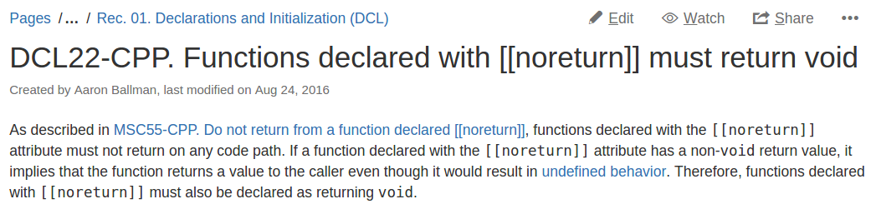
Our Results: Rule Organization
Title
Introduction & Normative Text

Slide 6
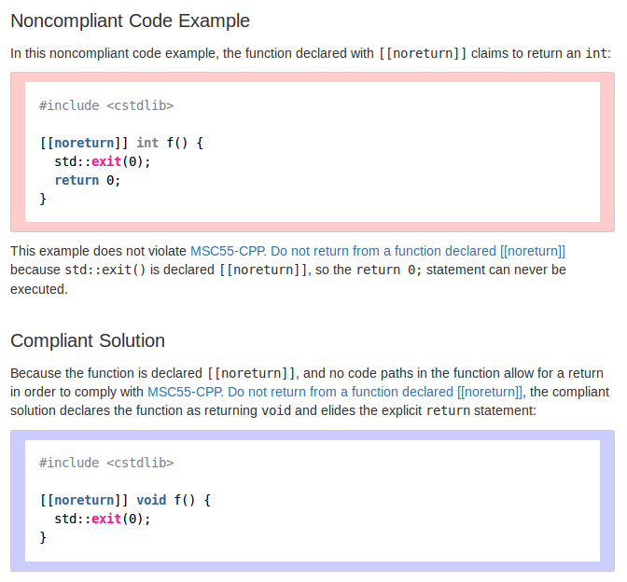
Noncompliant Code
Don’t try this at home!
Compliant Code
Fixes noncompliant code.

Slide 7
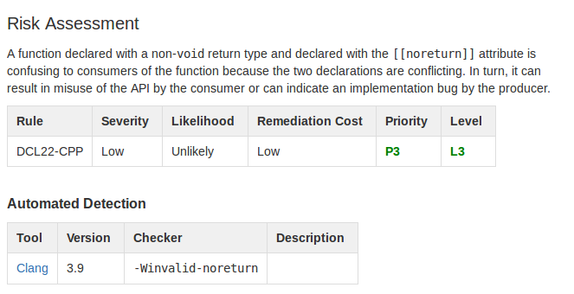

Slide 8
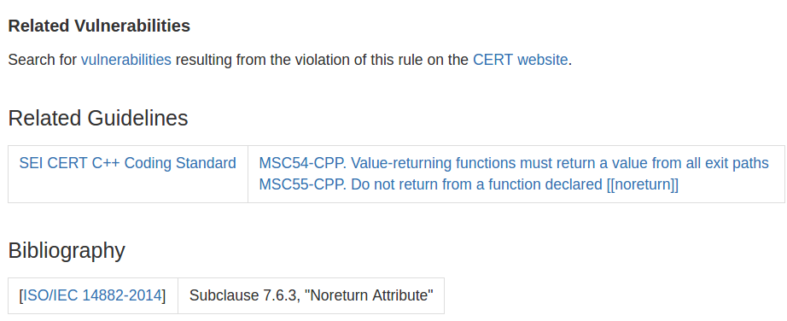

Slide 9
THE END

Slide 10
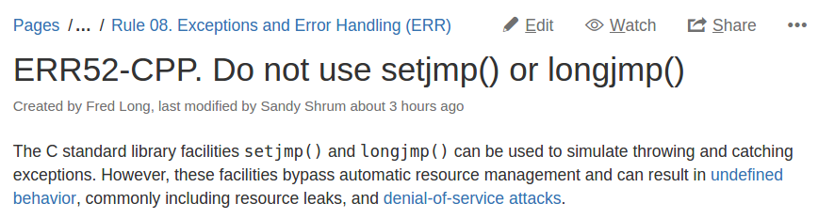
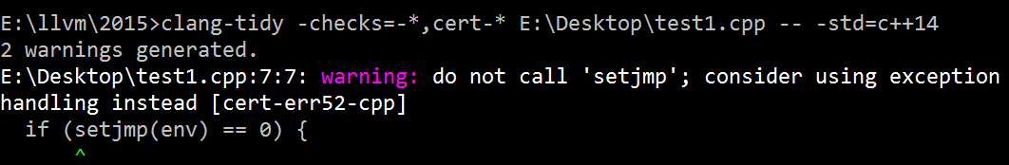
Our Process
ISO WG21 (C++ Standards Committee)
ISO C++14 Standard
C++ Books
MITRE CVEs
CERT Vulnerability Database

Slide 11

Our Results: Checkers
Contributed 15 new checkers to the Clang open source compiler (the C/C++ frontend to the LLVM compiler infrastructure)
Clang community has shown significant interest in CERT's contributions
Community members are making their own contributions based on our rules
Demonstrated a desire to make it easier to enable all checks for CERT rules
Clang is used by 10s of millions of programmers to write 100s of millions of apps that are used by billions of users
Primary compiler for MacOS, iOS, FreeBSD
Supported by Microsoft Visual Studio, Linux
Notes:
19 checkers for CERT rules in Clang (created by others). Independent of our 15 new checkers.
The Clang community wants to build mapping for CERT guidelines (rather than C++ core guidelines or MISRA)
There are 12 million registered users on Apple's app store

Slide 12
Risk Assessment
Risk assessment is performed using failure mode, effects, and criticality analysis.

Slide 13
Our Results: Rules
Modified 137 out of 162 C/C++ rules during FY16
Created 16 new rules; primarily on concurrency and other modern features
Steadily increasing engagement with the CERT C++ Coding Standard

Slide 14
Secure Coding Checker Case Study: OOP11-CPP
Process which occupied 2-3 weeks, 3 man-days of effort.
Operational Theory: it is never valid to copy construct a base class from the initializer-list of a move constructor.
Idea originated from discussions during a WG21 meeting; seems to negatively impact security of code when unexpected code paths are taken.
Initially developed as a rule with the normative restriction being: diagnose when a base class is copy-initialized within the move constructor of a derived class.

Slide 15
Secure Coding checker Case Study: OOP11-CPP
  Implemented basic checker for Clang, ran on default target code base: LLVM family of products (~2M SLoc)
    Found a bug! (Fixed in http://lists.llvm.org/pipermail/llvm-commits/Week-of-Mon-20150810/293133.html)
  Community discussion uncovered the fact that the rule text was too narrow: should also include class data members.
  Iterated normative restrictions to: diagnose when a base class or data member object is copy-initialized within the move constructor of a class.

Slide 16
Secure Coding checker Case Study: OOP11-CPP
  Implemented updated checker, re-ran on LLVM family
    ~800 false positives
    0 true positives (the one in LLVM had already been fixed)
  Community discussion uncovered the fact that the rule text was too strict: should take object triviality into account.
  Iterated normative restrictions to: diagnose when a base class or data member object of non-trivially-copyable type is copy-initialized within the move constructor of a class.

Slide 17
Secure Coding checker Case Study: OOP11-CPP
  Implemented updated checker, re-ran on LLVM family
    0 false positives
    0 true positives
  Ran updated checker on other code bases (~14M SLoc total), found acceptable TP vs FP rate (0 FP, >=1 TP).
  Discussion with CERT and external collaborators determined rule should be downgraded to recommendation
    Did not pass the “would you fail a code audit” sniff test
    Performance issue more than security issue
Notes:
Google regularly pulls newly committed Clang checkers & builds their entire source code. And hollers at false positives.

