Slide 1
These blue flags appear throughout the presentation and contain instructions and tips.
Delete all of them before presenting to the customer.
Update this slide with specifics.
SYSTEM REQUIREMENTS: You must have Arial Narrow loaded as a font for this presentation.
Aspirations Workshop for <Customer name>
DD Month YYYY

Slide 2
Meeting objectives
Update with the customer’s name.
Today’s meeting will accomplish the following:
Broaden the management team’s understanding of the SGMM as a management tool
Help identify where <Customer name> is on the smart grid landscape
Help to understand and prioritize options to support decision making
Measure progress

Slide 3
Contents / agenda
Update with the customer’s name.
Optional: Insert start times for agenda items.
Duration guidelines are:
Opening remarks - 15 min.
SGMM overview - 25 min.
Community data - 15 min.
SGMM scores - 1 hr 30 min.
Aspirations - 3 hr.
Wrap up and next steps - 10 min.
Opening remarks
SGMM overview
Community data
<Customer name>’s SGMM Survey scores and observations
Overall findings
Community comparisons
Findings by domain
<Customer name>’s Smart Grid aspirations
Wrap up and next steps

Slide 4
Opening remarks
Replace this slide with opening remarks from the Sponsor or delete.

Slide 5
Contents / agenda
Update with the customer’s name.
Optional: Insert start times for agenda items.
Duration guidelines are:
Opening remarks - 15 min.
SGMM overview - 25 min.
Community data - 15 min.
SGMM scores - 1 hr 30 min.
Aspirations - 3 hr.
Wrap up and next steps - 10 min.
Opening remarks
SGMM overview
Community data
<Customer name>’s SGMM Survey scores and observations
Overall findings
Community comparisons
Findings by domain
<Customer name>’s Smart Grid aspirations
Wrap up and next steps

Slide 6

A major power grid transformation is underway
How can utilities
Develop effective roadmaps?
Track progress?
Understand their posture in comparison to peers?
The Smart Grid Maturity Model was developed by utilities to address these concerns

Slide 7

The Smart Grid Maturity Model is
A management tool
that provides a
common language and framework
for defining key elements of
smart grid transformation
and helping utilities develop a
programmatic approach
and track their progress

Slide 8
SGMM timeline
2007 |  | 2008 |  | 2009 |  | 2010 |  | 2011 |  | 2012 - 2016 |  | 2017 |  | 2018 |  | …
Global Intelligent Utility Network Coalition (GIUNC) develops SGMM
Utilities use SGMM v1.0
v1.1
v1.2
SGMM public release
Software Engineering Institute becomes model steward
SGMM Open Assess-ment Event
GIUNC:
CenterPoint Energy
Progress Energy
DONG Energy
North Delhi Power Ltd
Country Energy
Sempra Energy
Pepco Holdings
IBM
APQC
SEI releases SGMM v1.1 product suite
Licensing & certification program for SGMM Navigation begins
SEI releases SGMM v1.2 product suite
Developed by utilities, for utilities

Slide 9


The Software Engineering Institute
The SEI is a federally-funded research and development center at Carnegie Mellon University, a global university recognized worldwide for its energy and environmental research initiatives.
A trusted, objective source of best practices, methods and tools to organizations worldwide, the SEI is a global leader in software and systems engineering, process improvement and security best practices – all critical elements of smart grid success.
The SEI collaborates in public-private partnership with government and industry on important cyber security, architecture, and interoperability challenges of the smart grid.

Slide 10


The SEI’s Role as Steward of the SGMM
Provide governance working with multiple stakeholders
Enable widespread availability, adoption, and use of the model for the benefit of the community
Evolve the model based on stakeholder needs, market developments, user feedback, and interactions with domain experts
Develop transition mechanisms—education, training, awareness, research collaboration— to support the model
Grow the SGMM community of users worldwide

Slide 11
SGMM at a glance
6 Maturity Levels: Defined sets of characteristics and outcomes
5
4
3
175 Characteristics: Features you would expect to see at each stage of the smart grid journey
2
1
0
SMR Strategy, Management, & Regulatory
OS Organization & Structure
GO Grid Operations
WAM Work & Asset Management
TECH Technology
CUST Customer
VCI Value Chain Integration
SE Societal & Environmental
8 Domains: Logical groupings of smart grid related characteristics

Slide 12
Smart Grid Maturity Model – levels
PIONEERING
Breaking new ground; industry-leading innovation
OPTIMIZING
Optimizing smart grid to benefit entire organization; may reach beyond organization; increased automation
INTEGRATING
Integrating smart grid deployments across the organization, realizing measurably improved performance
ENABLING
Investing based on clear strategy, implementing first projects to enable smart grid (may be compartmentalized)
INITIATING
Taking the first steps, exploring options, conducting experiments, developing smart grid vision
DEFAULT
Default level (status quo)

Slide 13
Smart Grid Maturity Model – domains
SMR
Strategy, Mgmt & Regulatory
TECH
Technology
Vision, planning, governance, stakeholder collaboration
IT architecture, standards, infrastructure, integration, tools
OS
Organization and Structure
CUST
Customer
Culture, structure, training, communications, knowledge mgmt
Pricing, customer participation & experience, advanced services
GO
Grid Operations
VCI
Value Chain Integration
Reliability, efficiency, security, safety, observability, control
Demand & supply management, leveraging market opportunities
WAM
Work & Asset Management
SE
Societal & Environmental
Asset monitoring, tracking & maintenance, mobile workforce
Responsibility, sustainability, critical infrastructure, efficiency

Slide 14

Model | Fully described in the Model Definition document
Compass Survey | Questionnaire-based assessment yields maturity ratings and comparisons
Navigation Process | Defined process to complete Compass to build a common understanding and set aspirations across the organization
V 1.2 Product Suite
To download the SGMM product suite, go to
https://resources.sei.cmu.edu/library/asset-view.cfm?assetid=512758

Slide 15
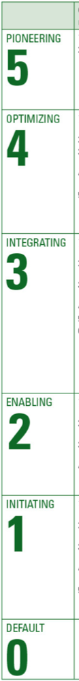
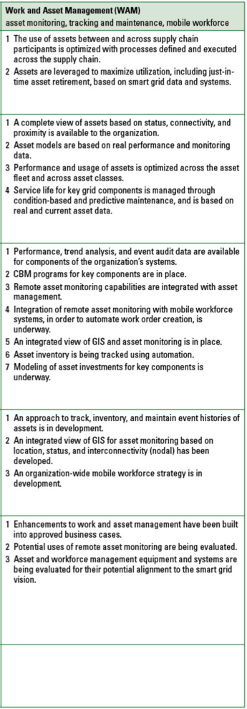
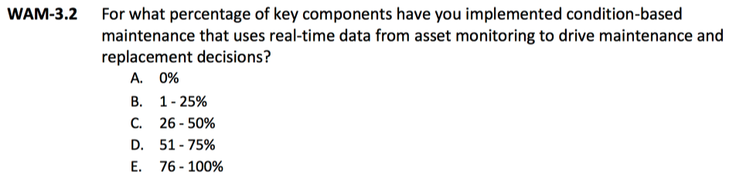
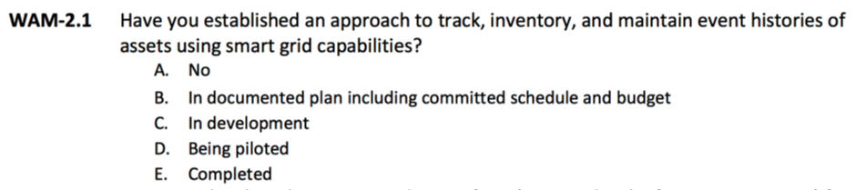
SGMM Compass Survey
WAM
Work and Asset Management
Contains
One question for each expected characteristic in the model and
Attribute and performance questions
Example questions:
WAM-3.2 Condition-based maintenance programs for key components are in place.
WAM-2.1 An approach to track, inventory, and maintain event histories of assets is in development.

Slide 16





SGMM Navigation: five-phase, expert-led process
Stakeholders complete SGMM Compass survey
Discussion and consensus answers lead to internal alignment on current state
Stakeholders review survey findings & set aspirational profile
Consensus on aspirational state and identification of motivations, actions, and obstacles to achieve it

Slide 17
SGMM benefits – a community view
Use of SGMM by utilities
Utilities
Guidance, common language, & means to track progress
SGMM Partners
Product to help customers and participation in roadmap development
DOE
Another mechanism to support grid modernization
SEI
Maturity & Performance Data
“What works” patterns to inform strategies, services, & programs.
Correlations of performance to maturity patterns and other analyses
Demonstrations of the value of grid modernization.
Improvements to SGMM product suite.

Slide 18
Contents / agenda
Update with the customer’s name.
Optional: Insert start times for agenda items.
Duration guidelines are:
Opening remarks - 15 min.
SGMM overview - 25 min.
Community data - 15 min.
SGMM scores - 1 hr 30 min.
Aspirations - 3 hr.
Wrap up and next steps - 10 min.
Opening remarks
SGMM overview
Community data
<Customer name>’s SGMM Survey scores and observations
Overall findings
Community comparisons
Findings by domain
<Customer name>’s Smart Grid aspirations
Wrap up and next steps

Slide 19
SGMM community baseline: 384 utilities in 47 countries
=1
=5

Slide 20
SGMM community baseline: 384 utilities in 47 countries
13 Australia
2 Bahrain
10 Bangladesh
2 Belgium
4 Brazil
26 Canada
3 China
1 Colombia
8 Costa Rica
2 Denmark
1 Ecuador
3 Finland
1 France
2 Hong Kong
57 India
2 Indonesia
1 Ireland
2 Israel
1 Jamaica
1 Japan
1 Kuwait
1 Malaysia
6 Mexico
1 Myanmar
1 Nepal
2 Netherlands
8 New Zealand
4 Nigeria
7 Oman
1 Pakistan
1 Panama
3 Philippines
1 Poland
1 Russia
6 Saudi Arabia
1 Scotland
1 Singapore
8 South Africa
1 South Korea
1 Spain
17 Sweden
1 Switzerland
10 United Arab Emirates
7 United Kingdom
133 United States
1 Vietnam
1 Zimbabwe
Other
13%
USA
36%
Asia- Pacific
29%
Europe, Middle East, and Africa
22%

Slide 21

Utilities in SGMM community baseline
37 U.S. States 9 Canadian Provinces
Abu-Sultan Thermal Power Plant
Abuja Electricity Distribution Company
ActewAGL
Adani Transmission Ltd. Ahmedabad
AES Electropaulo
Ajmer Vidyut Vitran Nigam Ltd.
Alameda Municipal Power
Alectra Utilities Corporation
Alfanar Construction Saudi Arabia
Allegheny Power
Alliander
Alliant Energy Corporation
AltaLink
Ameren Illinois
Ameren Missouri
American Electric Power
Andhra Pradesh Gas Power Company Ltd.
Andhra Pradesh Power Generation Corp. Ltd.
APCPDCL
Arkansas Electric Cooperatives, INC
ASAB Zero Substation (GASCO – Power Generation Units at Habshan
AtA
Atchison-Holt Electric Cooperative
ATCO Electric
ATCO Gas
Atlantica Yield plc
Aurora Energy
Ausgrid
Ausnet
Austin Energy
Avantha Power & Infrastructure Ltd.
AZUSA Light and Water
Bangladesh Power Development Board
Bangladesh Rural Electrification Board
Baraka Power Ltd.
Barapukuria Power Station
Basin Electric Power Cooperative
Bayfield Electric Cooperative
BC Hydro
BESCOM
Bhutan Power Corp. Ltd.
Bonneville Power Admin.
Boone Electric Cooperative
Bruce Power L.P.
BSES Yamuna Power Ltd.
BSES- Rajdhani
Burbank Water and Power
Calcutta Electric Cooperative Corp.
Capital Power Corporation
Carroll Electric Cooperative Corp.
Carteret-Craven Electric Cooperative
Cauvery Power Generation Chennai Pvt Ltd.
Cegelec Saudi Co. MNC
CELPE
CENACE
CenterPoint Energy
Central Maine Power Company
Centro Sur
CESC Limited
CESC Mysore
47 Countries

Slide 22
Utilities in SGMM community baseline (cont.)
CFE (Mexico) Gulfonorte
CFE (Mexico) Jalisco
CFE (Mexico) Peninsular
CFE Distribution
CFE Transmission
Chelan County PUD
Chettinad Corp. Ltd. – Power Division
Chhattisgarh State Power Distribution Company Ltd.
Chugach Electric
CitiPower and Powercor Australia Ltd.
City of Anaheim
City Of Columbus
City Of Danville
City Of Dover
City of Ekurhuleni (Energy)
City Of Hamilton
City Of Hudson
City Of Jackson
City Of Napoleon
City Of Painesville
City Of Palo Alto
City Of Piqua Power System
City of Riverside Public Utilities
City of Tshwane
City Of Wapakoneta
City Of Westerville
City Power Johannesburg (SOC) Ltd.
Cleco Power
CLP Power
Cogentrix Energy Power Management LLC
Coldwater Board Of Public Utilities
Columbus Southern Power Company
Comisión Federal de Electricidad- Corprativo
Compañía Nacional de Fuerza y Luz, S.A.
Connexus Energy
COOPEALFARORUIZ R.L
Coopeguanacaste R.L.
COOPELESCA RL
COOPESANTOS, R.L.
Corn Belt Energy
Coserv Electric
Cotton Electric Cooperative Inc.
Country Energy
CPFL Paulista
Dairyland Power Cooperative
Damodar Valley Corp.
Davao Light and Power Company
Desh Energy Ltd.
Dhofar Power Company S.A.O.C.
DNH Power Distribution Corp. Ltd.
Dominion Virginia Power
DONG Energy Sales & Distribution A/S
DPA Power Generation International Ltd.
Dr Narla Tata Rao (Vijayawada) TPS
Drax Power
DTE Energy
Dubai Electricity and Water Authority
DUBAL Power Plant
Duke Energy
Eandis
Eandis cvba
East Kentucky Power Cooperative, Inc.
Dr Narla Tata Rao (Vijayawada) TPS
Drax Power
DTE Energy
Dubai Electricity and Water Authority
DUBAL Power Plant
Duke Energy
Eandis
Eandis cvba
East Kentucky Power Cooperative, Inc.
East Miss EPA
EDF Energy Networks Branch
EDP - Energias do Brasil, S.A.
Eggborough Power Ltd.
Electricity and Water Authority of Bahrain (Transmission Division)
Ellevio AB
Emera Maine
Empresa de Servicios Públicos de Heredia
Empresas Públicas de Medellin, Centro de Excelencia Técnica
Energinet
EnergyAustralia
EnergyPac Power Generation Ltd.
EnergyUnited Electric Membership Corp.
Enexis
ENSA
Entergy
EPCOR Distribution & Transmission
Ephrata Borough
ERDF
Ergon Energy
ESB Networks
Eskom Holdings SOC Ltd.
Essar Power Transmission Company Ltd.
Essel Utilities Distribution Company Ltd.
eThekwini Municipality, Electricity Unit
Everest Power Generation Company Ltd.
Eversource Energy
Exelon/ComEd
Exelon/PECO Energy
Fingrid Oyj

Slide 23
Utilities in SGMM community baseline (cont.)
Fingrid Oyj
First Electric Cooperative
FirstEnergy
Fortum
Foster Wheeler
Garland Power & Light
GASCO – Power Generation Units at Habshan
Genesis Energy
Glendale Water & Power
Göteborg Energi Nät AB
Great Lakes Energy
Great River Energy
Guandong Power Co.
Guernsey Electricity
Gujarat Energy Transmission Corp. Ltd.
Hajar Trading and Technical services WLL (Transmission Division)
Hallstaviks Elverk
HAWK Power Generation
Hidd Power Company
Hindalco Industries Ltd.
Holland Board of Public Works
Horizon Power
Hydro One
Hydro One - Distribution
Hydro Ottawa Ltd.
Hydro-Québec Distribution
ICE (Instituto Costarricense de Electricidad)
IEC
Imperial Irrigation District
Infigen Energy
Integral Energy
Intergys
Intermountain Rural Electric Association
Israel Electric Corporation
IVRCL
Jamaica Public Service Company
JASEC
Jindal India Thermal Power Ltd.
Jos Electricity distribution PLC
Kalpataru Power Transmission Ltd.
Kamo Electric Cooperative, Inc.
Karlskoga Elnät AB
Kathmandu Alternative Power and Energy Group (KAPEG)
KaXu Solar One
Kelvin Power Station
Kentucky Utilities Company Inc.
KEPCO
Kerala State Electricity Board Ltd.
Kissimmee Utility Authority
Köyliön-Säkylän Sähkö Oy
Kristinehamns Elnät AB
L&T Power
Lahore Electric Supply Company
Lamma Coal Power Station
London Hydro Inc.
Los Angeles Department of Water and Power
M.P. Power Transmission Co. Ltd.
Maharashtra Electricity Regulatory Commission
Maharashtra State Electricity Distribution Co. Ltd.
Majan Electricity Company S.A.O.C.
Mälarenergi Elnät AB
Mangalore Electricity Supply
Manila Electric Company
Manitoba Hydro - T&D
Maquoketa Valley Rural Electric Cooperative
Marietta Board of Lights and Water
Marquette Board of Light & Power
Mazoon Electricity Company
Mellersta Skånes Kraft
Memphis Light, Gas, and Water Division
Meridian Energy
Minnkota Power Cooperative Inc.
Mjölby Kraftnät AB
Mogale City Electricity
MSEDCL
Msunduzi Electricity Sub-Unit
Muscat Electricity Distribution Company S.A.O.C
Muscatine Power & Water
PHE J&K Sub Division I
PNM
Pohjolan Voima Oy
Port-Burnett Electric Cooperative
Port-Harcourt Electricity Distribution Co.
Portland General Electric
Power & Water Utility Company for Jubail & Yanbu
Powerco
PowerGrid Corporation of India
PPL Electric Utilities
Princeton Electric Plant Board
Progress Energy
PSEG Power LLC.
PT. International Power Mitsui
PT. Jawa power
Public Utility District 1 of Clark County
Puget Sound
Quilliq Energy Corp.
Rabigh Arabian Water & Electricity Company
REC Power Distribution Co. Ltd.
Redding

Slide 24
Utilities in SGMM community baseline (cont.)
Reliance Energy
Reliance Infrastructure Ltd.
Reliance Power Transmission Ltd.
Rihand Super Thermal power
Roseville Electric
Rural Areas Electricity Co.
SA Power Network
Sabiya CCGT Power Plant
Sacramento Municipal Utility District
Salt River Project
Sand Mountain Electric Cooperative
Sandhult-Sandareds Elektriska
Santee Cooper
SaskPower
Saudi Electricity Company (SEC) National Grid
SCANA
Scottish Power
SDG&E
Sevab Nat AB
Shams Solar Power Station
SIG Geneva
Silicon Valley Power
SJVN Ltd.
SMEPC - International Cooperation Dept.
Snohomish
Snohomish County Public Utility District (PUD)
Södra Hallands Kraft Ekonomisk Fören
South Central Power Co.
South River Electric Membership Corporation
South Texas Electric Cooperative Inc.
Southern Company
Southern Electricity Supply Company of Orissa Ltd.
Southern Maryland Electric Cooperative
Southwestern Public Services Co.
SSE PLC
Sterlite Power Transmission Ltd.
Summit Power Ltd.
Talen Energy Corporation
Tamil Nadu Electricity Board
Tampa Electric Company
TAQA
TasNetworks Pty Ltd.
Tata Power
Te Mihi Power Station
Tenaga Nasionale Berhad
The Middle Tennessee Electric Membership Corporation
The United Illuminating Co.
Tihama Power Generation Co.
Tokyo Electric Power Co.
Top Energy
Toronto Hydro Electric System Ltd.
Torrent Power Ltd.
Town Of Front Royal
Toyo-Thai Corp. Public Co. Ltd.
TransAlta Renewables
Tri-State Generation and Transmission Association Inc.
TTPMC
Tuas Power Generation
Tucson Electric Power
UGVCL
Umeå Energi AB
Unidaan FZ LLC, Aljouf Cement Company (O&M Site)
Unión Fenosa Distribución
Unison Networks Ltd.
United Power Inc.
UNS Electric
Vara Energi Ek.
Varbergortens Elkraft
Vattenfall Distribution
Vattenfall INC.
Vattenfall Wind Power Ltd
Vector Ltd.
VELCO
Venture Energy Resources Ltd.
Vietnam Electricity
Village Of Carey, Ohio
Village Of Clinton
Village Of Oak Harbor
Village Of Yellow Springs
Visayan Electric Company Inc.
Wadi Al Jazzi Power Co.
Wadsworth Electric And Communications
West Bengal State Electricity Transmission Co.
Westar Energy Inc.
Western Electricity Supply Company of Orissa Ltd.
Western Power Distribution
Wind World (India) Ltd.
Wyandotte Municipal Service
Xcel Energy
Yantarenergo
Yola Electricity Distribution Co.
ZADCO – Upper Zakum Project
Zhejiang Jiaxing Electric Power Bureau
Zimbabwe Power Company

Slide 25
SGMM community baseline: meter count
Largest: 40,194,371 Meters
Median: 1,000,000 Meters
250,000
Community segmentation breakpoint: 250,000 meters
Smallest: 40 Meters

Slide 26
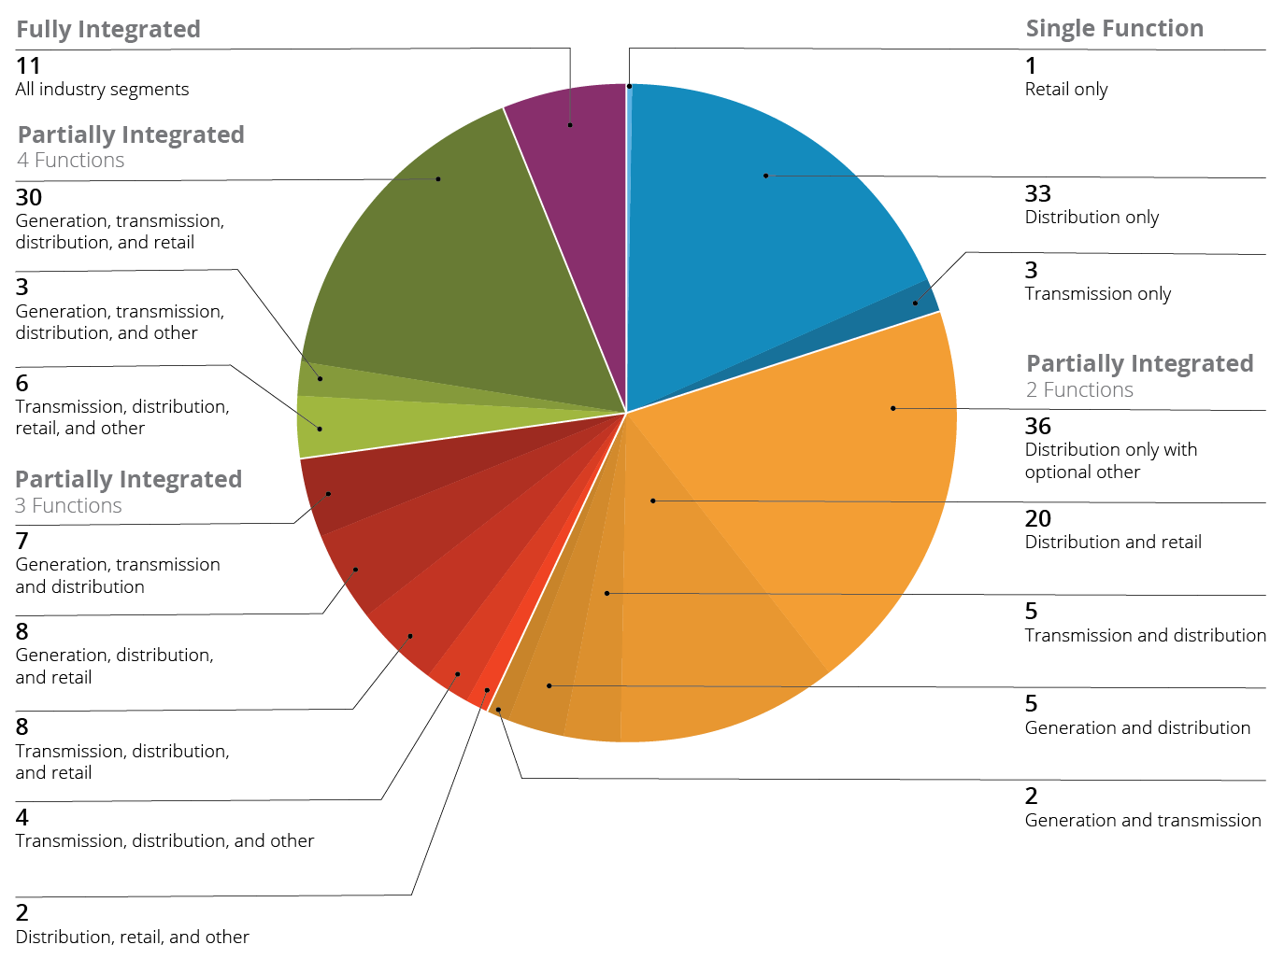
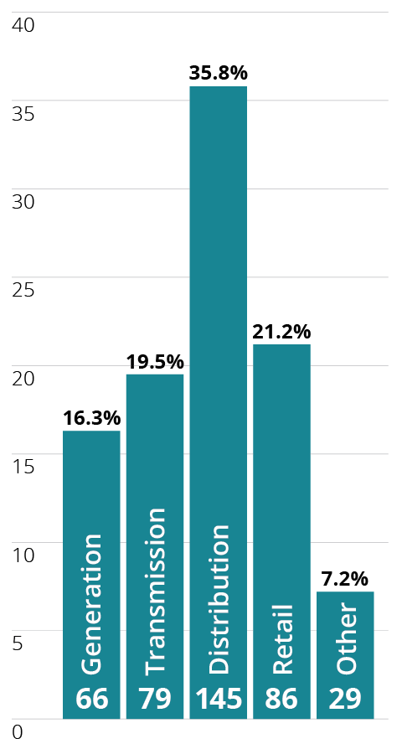
SGMM community baseline: utility type

Slide 27
Contents / agenda
Update with the customer’s name.
Optional: Insert start times for agenda items.
Duration guidelines are:
Opening remarks - 15 min.
SGMM overview - 25 min.
Community data - 15 min.
SGMM scores - 1 hr 30 min.
Aspirations - 3 hr.
Wrap up and next steps - 10 min.
Opening remarks
SGMM overview
Community data
<Customer name>’s SGMM Survey scores and observations
Overall findings
Community comparisons
Findings by domain
<Customer name>’s Smart Grid aspirations
Wrap up and next steps

Slide 28
Overall observations
See script ANA, step 3.2.6.
Include a summary of your findings e.g.:
a summary of how the organization compares to the peer community data
the number of domains where the organization is better or worse than their peers
domains where the organization has the most and/or least “best practices”
overall strengths and weaknesses
contradictory answers or themes
observations that are counter to the organization’s stated or implied objectives
spikes between or within SGMM domains
other trends or groupings
if the organization has previous SGMM scores, summarize the changes here
Follow this slide with one or more pages of specifics (e.g. question data) to support these observations.

Slide 29
Overall observations – supporting data
See script ANA, step 3.2.6.
Include a summary of your findings e.g.:
a summary of how the organization compares to the peer community data
the number of domains where the organization is better or worse than their peers
domains where the organization has the most and/or least “best practices”
overall strengths and weaknesses
contradictory answers or themes
observations that are counter to the organization’s stated or implied objectives
spikes between or within SGMM domains
other trends or groupings
if the organization has previous SGMM scores, summarize the changes here
Follow this slide with one or more pages of specifics (e.g. question data) to support these observations.

Slide 30
Compass results: maturity profile
Update with customer data. Change questions marks in dots to reflect customer’s score and move dots accordingly to create the profile.
?
?
?
?
?
?
?
?
<Customer name> today

Slide 31
Previous maturity profile
OPTIONAL: Include this slide if the organization has previous scores. Add the previous profile in a different color and update with legend with the date of the previous results.
Current Results
?
?
?
?
?
?
?
?
?
?
?
?
?
?
?
?
<DATE Results>

Slide 32
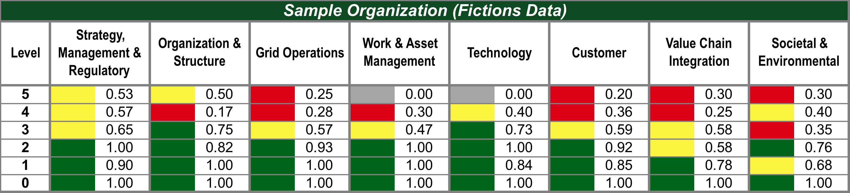
Compass results: dashboard
Replace with customer data.
 | Point Range | Meaning
 | ≥ 0.70 | Green reflects level compliance within the domain
 | ≥ 0.40 and < 0.70 | Yellow reflects significant progress
 | < 0.40 | Red reflects initial progress
 | = 0 | Grey reflects has not started

Slide 33
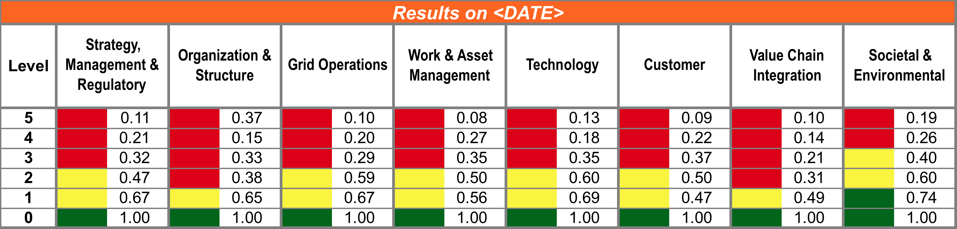
Previous dashboard
OPTIONAL: Include this slide if the organization has previous scores. Add the previous dashboard in a different color and update with legend with the date of the previous results. Update the arrows to highlight the changes from the previous dashboard.
2 levels
higher
3 levels
higher
2 levels
higher
2 levels
higher
3 levels
higher
2 levels
higher
1 level
higher
1 level lower

Slide 34
Contents / agenda
Update with the customer’s name.
Optional: Insert start times for agenda items.
Duration guidelines are:
Opening remarks - 15 min.
SGMM overview - 25 min.
Community data - 15 min.
SGMM scores - 1 hr 30 min.
Aspirations - 3 hr.
Wrap up and next steps - 10 min.
Opening remarks
SGMM overview
Community data
<Customer name>’s SGMM Survey scores and observations
Overall findings
Community comparisons
Findings by domain
<Customer name>’s Smart Grid aspirations
Wrap up and next steps

Slide 35
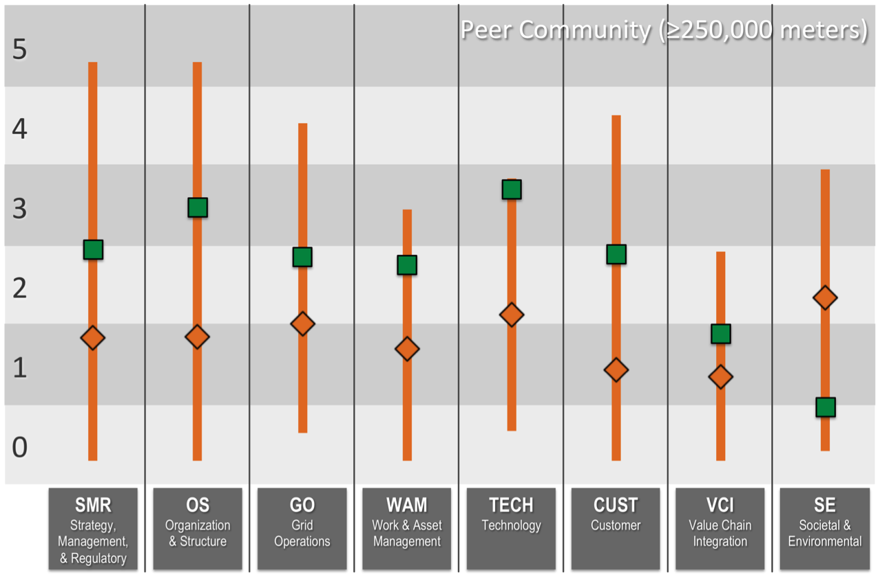
SGMM peer community: average/range comparison
Copy this chart from the Navigator report. Ensure that you include the appropriate peer community data.
OPTION: You may want to add another slide that includes the average/range comparison of the customer against the total community.

Slide 36
Contents / agenda
Update with the customer’s name.
Optional: Insert start times for agenda items.
Duration guidelines are:
Opening remarks - 15 min.
SGMM overview - 25 min.
Community data- 15
SGMM scores - 1 hr 30 min.
Aspirations - 3 hr.
Wrap up and next steps - 10 min.
Opening remarks
SGMM overview
Community data
<Customer name>’s SGMM Survey scores and observations
Overall findings
Community comparisons
Findings by domain
<Customer name>’s Smart Grid aspirations
Wrap up and next steps

Slide 37
Strategy, Mgmt, & Regulatory
Legend: Top 10-33% Bottom 33% Top 10% Red Italics Weakness against the model
5 |  | 5.3 New business model opportunities emerge as a result of smart grid capabilities and are implemented.
 |  | 5.2 Smart grid business activities provide sufficient financial resources to enable continued investment in smart grid sustainment and expansion.
 |  | 5.1 Smart grid strategy capitalizes on smart grid as a foundation for the introduction of new services and product offerings.
4 |  | 4.3 Smart grid strategy is shared and revised collaboratively with external stakeholders.
 |  | 4.2 Smart grid is a core competency throughout the organization.
 |  | 4.1 Smart grid vision and strategy drive the organization’s strategy and direction.
3 |  | 3.4 Required authorizations for smart grid investments have been secured.
 |  | 3.3 Smart grid leaders with explicit authority across functions and lines of business are designated to ensure effective implementation of the smart grid strategy.
 |  | 3.2 A smart grid governance model is established.
 |  | 3.1 The smart grid vision, strategy, and business case are incorporated into the vision and strategy.
2 |  | 2.6 There is support and funding for conducting proof-of-concept projects to evaluate feasibility and alignment.
 |  | 2.5 There is collaboration with regulators and other stakeholders regarding implementation of the smart grid vision and strategy.
 |  | 2.4 Budgets are established specifically for funding the implementation of the smart grid vision.
 |  | 2.3 Operational investment is explicitly aligned to the smart grid strategy.
 |  | 2.2 A common smart grid vision is accepted across the organization.
 |  | 2.1 An initial smart grid strategy and a business plan are approved by management.
1 |  | 1.3 Discussions have been held with regulators about the organization’s smart grid vision.
 |  | 1.2 Experimental implementations of smart grid concepts are supported.
 |  | 1.1 Smart grid vision is developed with a goal of operational improvement.
See ANA script steps 3.2.3 and 3.2.4. Highlight the table with your findings.
Adjust colors in maturity level column to correspond to customer’s score. Sample these color swatches to select correct colors as needed:
Place icons as appropriate to highlight observations in comparison to peer community data.
RGB=255:0:0
RGB=255:255:0
RGB=0:128:0
RGB=165:165:165

Slide 38
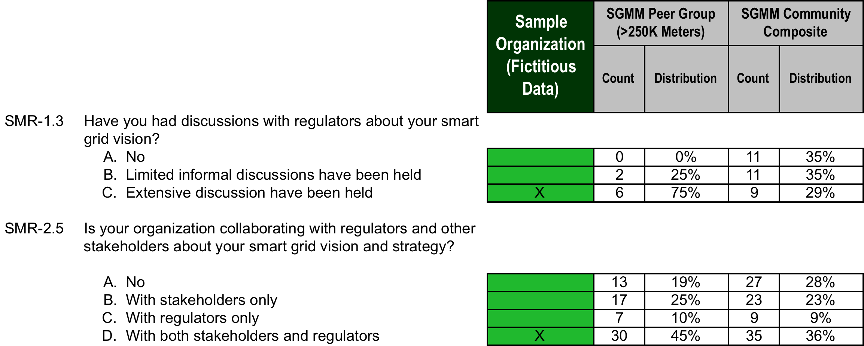
SMR – detailed findings
See script ANA, steps 3.2.3, 2.3.4, and 2.3.5.
Include questions and that support detailed findings. Include a description of the finding followed by the supporting question(s). See the example below:
An organizational strength is your relationship with your regulators and stakeholders about your smart grid vision and strategy.
TIP: Copy from the excel report; paste here as a picture (use “paste special” command).
TIP: Consider highlighting items in the question you would like to discuss.

Slide 39
Organization & Structure
Legend: Top 10-33% Bottom 33% Top 10% Red Italics Weakness against the model
5 |  | 5.3 Channels are in place to harvest ideas, develop them, and regard those who help shape future advances in process, workforce competencies, and technology.
 |  | 5.2 The organization is able to readily adapt to support new ventures, products, and services that emerge as a result of smart grid.
 |  | 5.1 The organizational structure enables collaboration with other grid stakeholders to optimize overall grid operation and health.
4 |  | 4.3 Decision making occurs at the closest point of need as a result of an efficient organizational structure and the increased availability of information due to smart grid.
 |  | 4.2 There is end-to-end grid observability that can be leveraged by internal and external stakeholders.
 |  | 4.1 Management systems and organizational structure are capable of taking advantage of the increased visibility and control provided through smart grid.
3 |  | 3.6 Education and training are aligned to exploit smart grid capabilities.
 |  | 3.5 A matrix or overlay structure to support smart grid activities is in place.
 |  | 3.4 Leadership is consistent in communication and actions regarding smart grid.
 |  | 3.3 Performance and/or compensation are linked to smart grid success.
 |  | 3.2 Smart grid measures are incorporated into the measurement system.
 |  | 3.1 The smart grid vision and strategy are driving organizational change.
2 |  | 2.5 The linking of performance and/or compensation plans to achieve smart grid milestones is in progress.
 |  | 2.4 Education and training to develop smart grid competencies have been identified and are available.
 |  | 2.3 Most smart grid implementation and deployment teams include participants from all functions and LOBs that the deployment will impact.
 |  | 2.2 The organization has aligned most operations around end-to-end processes.
 |  | 2.1 A new vision for a smart grid begins to drive change and affect related priorities like addressing the need for an adequately skilled workforce in a smart grid environment.
1 |  | 1.3 Smart grid awareness efforts to inform the workforce of smart grid activities have been initiated.
 |  | 1.2 Leadership has demonstrated a commitment to change the organization in support of achieving smart grid.
 |  | 1.1 The organization has articulated its need to build smart grid competencies in its workforce.
See ANA script steps 3.2.3 and 3.2.4. Highlight the table with your findings.
Adjust colors in maturity level column to correspond to customer’s score. Sample these color swatches to select correct colors as needed:
Place icons as appropriate to highlight observations in comparison to peer community data.
RGB=255:0:0
RGB=255:255:0
RGB=0:128:0
RGB=165:165:165

Slide 40
OS – detailed findings

Slide 41
Grid Operations
Legend: Top 10-33% Bottom 33% Top 10% Red Italics Weakness against the model
5 |  | 5.2 System-wide, analytics-based, and automated grid decision making is in place.
 |  | 5.1 Self-healing capabilities are present.
4 |  | 4.5 There is automated decision-making within protection schemes that is based on wide-area monitoring.
 |  | 4.4 Grid operations information has been made available across functions and LOBs.
 |  | 4.3 Operational forecasts are based on data gathered through smart grid.
 |  | 4.2 Grid operational management is based on near real-time data.
 |  | 4.1 Operational data from smart grid deployments is being used to optimize processes across the organization.
3 |  | 3.6 There is automated decision-making within protection schemes.
 |  | 3.5 Grid data is used by an organization’s security functions.
 |  | 3.4 Smart meters are important grid management sensors.
 |  | 3.3 Grid operations planning is now fact-based using grid data made available by smart grid capabilities.
 |  | 3.2 Control analytics have been implemented and are used to improve cross-LOB decision-making.
 |  | 3.1 Smart grid information is available across systems and organizational functions.
2 |  | 2.4 Investment in and expansion of data communications networks in support of grid operations is underway.
 |  | 2.3 Aside from SCADA, piloting of remote asset monitoring of key grid assets to support manual decision making is underway.
 |  | 2.2 Advanced outage restoration schemes are being implemented, which resolve or reduce the magnitude of unplanned outages.
 |  | 2.1 Distribution substation are automated and linked to some form of remote distribution automation.
1 |  | 1.5 Safety and security (physical and cyber) requirements are considered.
 |  | 1.4 Outage and distribution management systems linked to substation automation are being explored and evaluated.
 |  | 1.3 Proof-of-concept projects and component testing for grid monitoring and control are underway.
 |  | 1.2 New sensors, switches, and communications technologies are evaluated for grid monitoring and control.
 |  | 1.1 Business cases for new equipment and systems related to smart grid are approved.
See ANA script steps 3.2.3 and 3.2.4. Highlight the table with your findings.
Adjust colors in maturity level column to correspond to customer’s score. Sample these color swatches to select correct colors as needed:
Place icons as appropriate to highlight observations in comparison to peer community data.
RGB=255:0:0
RGB=255:255:0
RGB=0:128:0
RGB=165:165:165

Slide 42
GO – detailed findings

Slide 43
Work and Asset Management
Legend: Top 10-33% Bottom 33% Top 10% Red Italics Weakness against the model
5 |  | 5.2 Assets are leveraged to maximize utilization, including just-in-time asset retirement, based on smart grid data and systems.
 |  | 5.1 The use of assets between and across supply chain participants is optimized with processes defined and executed across the supply chain.
4 |  | 4.4 Service life for key grid components is managed through condition-based and predictive maintenance, and is based on real and current asset data.
 |  | 4.3 Performance and usage of assets is optimized across the asset fleet and across asset classes.
 |  | 4.2 Asset models are based on real performance and monitoring data.
 |  | 4.1 A complete view of assets based on status, connectivity, and proximity is available to the organization.
3 |  | 3.7 Modeling of asset investments for key components is underway.
 |  | 3.6 Asset inventory is being tracked using automation.
 |  | 3.5 An integrated view of GIS and asset monitoring is in place.
 |  | 3.4 Integration of remote asset monitoring with mobile workforce systems, in order to automate work order creation, is underway.
 |  | 3.3 Remote asset monitoring capabilities are integrated with asset management.
 |  | 3.2 CBM programs for key components are in place.
 |  | 3.1 Performance, trend analysis, and event audit data are available for components of the organization’s systems.
2 |  | 2.3 An organization-wide mobile workforce strategy is in development.
 |  | 2.2 An integrated view of GIS for asset monitoring based on location, status, and interconnectivity (nodal) has been developed.
 |  | 2.1 An approach to track, inventory, and maintain event histories of assets is in development.
1 |  | 1.3 Asset and workforce management equipment and systems are being evaluated for their potential alignment to the smart grid vision.
 |  | 1.2 Potential uses of remote asset monitoring are being evaluated.
 |  | 1.1 Enhancements to work and asset management have been built into approved business cases.
See ANA script steps 3.2.3 and 3.2.4. Highlight the table with your findings.
Adjust colors in maturity level column to correspond to customer’s score. Sample these color swatches to select correct colors as needed:
Place icons as appropriate to highlight observations in comparison to peer community data.
RGB=255:0:0
RGB=255:255:0
RGB=0:128:0
RGB=165:165:165

Slide 44
WAM – detailed findings

Slide 45
Technology
Legend: Top 10-33% Bottom 33% Top 10% Red Italics Weakness against the model
5 |  | 5.2 The enterprise information infrastructure can automatically identify, mitigate, and recover from cyber incidents.
 |  | 5.1 Autonomic computing and machine learning are implemented.
4 |  | 4.6 Security strategy and tactics continually evolve based on changes in the operational environment and lessons learned.
 |  | 4.5 Performance is improved through sophisticated systems that are informed by smart grid data.
 |  | 4.4 Predictive modeling and near real-time simulation are used to optimize support processes.
 |  | 4.3 Systems have sufficient wide-area situational awareness to enable real-time monitoring and control for complex events.
 |  | 4.2 Business processes are optimized by leveraging the enterprise IT architecture.
 |  | 4.1 Data flows end to end from customer to generation.
3 |  | 3.6 A detailed data communication strategy and corresponding tactics that cross functions and LOBs are in place.
 |  | 3.5 The organization has an advanced sensor plan.
 |  | 3.4 The use of advanced distributed intelligence and analytical capabilities are enabled through smart grid technology.
 |  | 3.3 Smart grid-specific technology has been implemented to improve cross-LOB performance.
 |  | 3.2 Systems adhere to an enterprise IT architectural framework for smart grid.
 |  | 3.1 Smart grid-impacted business processes are aligned with the enterprise IT architecture across LOBs.
2 |  | 2.7 Security is built into all smart grid initiatives from the outset.
 |  | 2.6 Pilots based on connectivity to distributed IEDs are underway.
 |  | 2.5 There is a data communications strategy for the grid.
 |  | 2.4 A common technology evaluation and selection process is applied for all smart grid activities.
 |  | 2.3 Standards are selected to support the smart grid strategy within the enterprise IT architecture.
 |  | 2.2 Changes to the enterprise IT architecture that enable smart grid are being deployed.
 |  | 2.1 Tactical IT investments are aligned to an enterprise IT architecture within an LOB.
1 |  | 1.5 There is a process to evaluate and select technologies in alignment with smart grid vision and strategies.
 |  | 1.4 Opportunities are identified to use technology to improve departmental performance.
 |  | 1.3 A change control process is used for applications and IT infrastructure.
 |  | 1.2 Existing or proposed IT architectures have been evaluated for quality attributes that support smart grid applications.
 |  | 1.1 An enterprise IT architecture exists or is under development.
See ANA script steps 3.2.3 and 3.2.4. Highlight the table with your findings.
Adjust colors in maturity level column to correspond to customer’s score. Sample these color swatches to select correct colors as needed:
Place icons as appropriate to highlight observations in comparison to peer community data.
RGB=255:0:0
RGB=255:255:0
RGB=0:128:0
RGB=165:165:165

Slide 46
TECH – detailed findings

Slide 47
Customer
Legend: Top 10-33% Bottom 33% Top 10% Red Italics Weakness against the model
5 |  | 5.5 The organization plays a leadership role in industry-wide information sharing and standards development efforts for smart grid.
 |  | 5.4 Security and privacy for all customer data is assured.
 |  | 5.3 Plug-and-play, customer-based generation is supported.
 |  | 5.2 There is automatic outage detection at premise or device level.
 |  | 5.1 Customers can manage their end-to-end energy supply and usage levels.
4 |  | 4.7 A common customer experience has been integrated.
 |  | 4.6 In-home net billing programs are enabled.
 |  | 4.5 Automatic response to pricing signals for devices within the customer’s premise is supported.
 |  | 4.4 Residential customers participate in demand response and/or utility-managed remote load control programs.
 |  | 4.3 Customers have access to near real-time data on their own usage.
 |  | 4.2 There is outage detection and proactive notification at the circuit level.
 |  | 4.1 Support is provided to customers to help analyze and compare usage against all available pricing programs.
3 |  | 3.9 All customer products and services have built-standards based on security and privacy controls.
 |  | 3.8 Customer education on how to use smart grid services to curtail peak usage is provided.
 |  | 3.7 A common experience has been implemented across two or more customer interface channels.
 |  | 3.6 Residential customers have on-demand access to daily usage data.
 |  | 3.5 There is automatic outage detection at the substation level.
 |  | 3.4 Demand response and/or remote load control is available to customers.
 |  | 3.3 A remote connect/disconnect capability is deployed.
 |  | 3.2 Two-way meter communication has been deployed.
 |  | 3.1 The organization tailors programs to customer segments.
2 |  | 2.6 Security and privacy requirements for customer protection are specified for smart grid-related pilot projects and RFPs.
 |  | 2.5 The impact on the customer of new services and delivery processes is being assessed.
 |  | 2.4 Remote connect/disconnect is being piloted for residential customers.
 |  | 2.3 The organization is modeling the reliability of grid equipment.
 |  | 2.2 The organization has frequent (more than monthly) knowledge of residential customer usage.
 |  | 2.1 Pilots of remote AMI/AMR are being conducted or have been deployed.
1 |  | 1.4 The utility consults with public utility commissions and/or other government organizations concerning the impact on customers.
 |  | 1.3 A vision of the future grid is being communicated to customers.
 |  | 1.2 Security and privacy implications of smart grid are being investigated.
 |  | 1.1 Research is being conducted on how to use smart grid technologies to enhance the customer’s experience, benefits, and participation.
See ANA script steps 3.2.3 and 3.2.4. Highlight the table with your findings.
Adjust colors in maturity level column to correspond to customer’s score. Sample these color swatches to select correct colors as needed:
Place icons as appropriate to highlight observations in comparison to peer community data.
RGB=255:0:0
RGB=255:255:0
RGB=0:128:0
RGB=165:165:165

Slide 48
CUST – detailed findings

Slide 49
Value Chain Integration
Legend: Top 10-30% Bottom 30% Top 10% BOLD Weakness against the model
Legend: Top 10-33% Bottom 33% Top 10% Red Italics Weakness against the model
5 |  | 5.3 The organization’s automated control and resource optimization schemes consider and support regional and/or national grid optimization.
 |  | 5.2 Resources are adequately dispatchable and controllable so that the organization can take advantage of granular market options.
 |  | 5.1 The optimization of energy assets is automated across the full value chain.
4 |  | 4.4 Visibility and potential control of customers’ large-demand appliances to balance demand and supply is available.
 |  | 4.3 Secure two-way communications with Home Area Networks (HANs) are available.
 |  | 4.2 Portfolio optimization models that encompass available resources and real-time markets are implemented.
 |  | 4.1 Energy resources (including Volt/VAR, DG, and DR) are dispatchable and tradable.
3 |  | 3.4 Security management and monitoring processes are deployed to protect the interactions with an expanded portfolio of value chain partners.
 |  | 3.3 Additional resources are available and deployed to provide substitutes for market products to support reliability or other objectives.
 |  | 3.2 Customer premise energy management solutions with market and usage information are enabled.
 |  | 3.1 An integrated resource plan is in place and includes new targeted resources and technologies.
2 |  | 2.4 Secure interactions have been piloted with an expanded portfolio of value chain partners.
 |  | 2.3 Pilots to support a diverse resource portfolio have been conducted.
 |  | 2.2 The value chain has been redefined based on its smart grid capabilities.
 |  | 2.1 Support is provided for energy management systems for residential customers.
1 |  | 1.5 Security requirements to enable interaction with an expanded portfolio of value chain partners have been identified.
 |  | 1.4 There is a strategy for creating and managing a diverse resource portfolio.
 |  | 1.3 Energy storage options and the capabilities needed to support them are identified.
 |  | 1.2 Distributed generation sources and the capabilities needed to support them are identified.
 |  | 1.1 Assets and programs necessary to facilitate load management are identified.
See ANA script steps 3.2.3 and 3.2.4. Highlight the table with your findings.
Adjust colors in maturity level column to correspond to customer’s score. Sample these color swatches to select correct colors as needed:
Place icons as appropriate to highlight observations in comparison to peer community data.
RGB=255:0:0
RGB=255:255:0
RGB=0:128:0
RGB=165:165:165

Slide 50
VCI – detailed findings

Slide 51
Societal and Environmental
Legend: Top 10-33% Bottom 33% Top 10% Red Italics Weakness against the model
5 |  | 5.3 The organization is a leader in developing and promoting industry-wide resilience best practices and/or technologies for protection of the national critical infrastructure.
 |  | 5.2 Customers control their energy-based environmental footprints through automatic optimization of their end-to-end energy supply and usage level (energy source and mix).
 |  | 5.1 Triple bottom line goals align with local, regional, and national objectives.
4 |  | 4.5 The organization fulfills its critical infrastructure assurance goals for resiliency, and contributes to those of the region and the nation.
 |  | 4.4 End-user energy usage and devices are actively managed through the utility’s network.
 |  | 4.3 Programs are in place to shave peak demand.
 |  | 4.2 A public environmental and societal scorecard is maintained.
 |  | 4.1 The organization collaborates with external stakeholders to address environmental and societal issues.
3 |  | 3.4 The organization regularly reports on the societal and environmental impacts of its smart grid programs and technologies.
 |  | 3.3 Programs to encourage off-peak usage by customers are in place.
 |  | 3.2 Segmented and tailored information that includes environmental and societal benefits and costs is available to customers.
 |  | 3.1 Performance of societal and environmental programs are measured and effectiveness is demonstrated.
2 |  | 2.5 Increasingly granular and more frequent consumption information is available to customers.
 |  | 2.4 Environmental proof-of-concept projects are underway that demonstrate smart grid benefits.
 |  | 2.3 The organization considers a “triple bottom line” view when making decisions.
 |  | 2.2 Energy efficiency programs for customers have been established
 |  | 2.1 Smart-grid strategies and work plans address societal and environmental issues.
1 |  | 1.4 The smart grid vision or strategy specifies the organization’s role in protecting the nation’s critical infrastructure.
 |  | 1.3 Environmental compliance performance records are available for public inspection.
 |  | 1.2 The environmental benefits of the smart grid vision and strategy are publicly promoted.
 |  | 1.1 The smart grid strategy addresses the organization’s role in societal and environmental issues.
See ANA script steps 3.2.3 and 3.2.4. Highlight the table with your findings.
Adjust colors in maturity level column to correspond to customer’s score. Sample these color swatches to select correct colors as needed:
Place icons as appropriate to highlight observations in comparison to peer community data.
RGB=255:0:0
RGB=255:255:0
RGB=0:128:0
RGB=165:165:165

Slide 52
SE – detailed findings

Slide 53
Contents / agenda
Update with the customer’s name.
Optional: Insert start times for agenda items.
Duration guidelines are:
Opening remarks - 15 min.
SGMM overview - 25 min.
Community data - 15 min
SGMM scores - 1 hr 30 min.
Aspirations - 3 hr.
Wrap up and next steps - 10 min.
Opening remarks
SGMM overview
Community data
<Customer name>’s SGMM Survey scores and observations
Overall findings
Community comparisons
Findings by domain
<Customer name>’s Smart Grid aspirations
Wrap up and next steps

Slide 54
Strategy, Mgmt, & Regulatory
Aspiration Setting Tool
See script ASPIRATIONS WS, step 4.4.
If any characteristics were marked in red, italics in detailed findings, make them red, italic here as well.
Note: If you copy the table from a previous slide, ensure you can type in the blank column.
If you’ve used symbols to mark characteristics e.g. s = stretch, y = yes, n = no, etc, then include a legend when you send the updated slides back.
5 |  | 5.3 New business model opportunities emerge as a result of smart grid capabilities and are implemented.
 |  | 5.2 Smart grid business activities provide sufficient financial resources to enable continued investment in smart grid sustainment and expansion.
 |  | 5.1 Smart grid strategy capitalizes on smart grid as a foundation for the introduction of new services and product offerings.
4 |  | 4.3 Smart grid strategy is shared and revised collaboratively with external stakeholders.
 |  | 4.2 Smart grid is a core competency throughout the organization.
 |  | 4.1 Smart grid vision and strategy drive the organization’s strategy and direction.
3 |  | 3.4 Required authorizations for smart grid investments have been secured.
 |  | 3.3 Smart grid leaders with explicit authority across functions and lines of business are designated to ensure effective implementation of the smart grid strategy.
 |  | 3.2 A smart grid governance model is established.
 |  | 3.1 The smart grid vision, strategy, and business case are incorporated into the vision and strategy.
2 |  | 2.6 There is support and funding for conducting proof-of-concept projects to evaluate feasibility and alignment.
 |  | 2.5 There is collaboration with regulators and other stakeholders regarding implementation of the smart grid vision and strategy.
 |  | 2.4 Budgets are established specifically for funding the implementation of the smart grid vision.
 |  | 2.3 Operational investment is explicitly aligned to the smart grid strategy.
 |  | 2.2 A common smart grid vision is accepted across the organization.
 |  | 2.1 An initial smart grid strategy and a business plan are approved by management.
1 |  | 1.3 Discussions have been held with regulators about the organization’s smart grid vision.
 |  | 1.2 Experimental implementations of smart grid concepts are supported.
 |  | 1.1 Smart grid vision is developed with a goal of operational improvement.

Slide 55
Strategy, Mgmt, & Regulatory
Update with customer data.
Color level bar to indicate customer’s score. Sample these color swatches to select correct colors as needed:
Place Current and Aspiration arrow at current level
During (OR AFTER) the findings workshop, move the Aspiration arrow up to point to the Aspiration that has been selected.
During (OR AFTER) the findings workshop, document the motivations, what must happen, and obstacles sections based on the discussion from the findings workshop.
Aspiration Setting Tool
5
4
3
2
1
0
What motivates this aspiration?
What actions must happen to achieve this aspiration?
What obstacles must be overcome to achieve this aspiration?
RGB=255:0:0
RGB=255:255:0
RGB=0:128:0
RGB=165:165:165
Aspiration
Current

Slide 56
Organization & Structure
Aspiration Setting Tool
See script ASPIRATIONS WS, step 4.4.
If any characteristics were marked in red, italics in detailed findings, make them red, italic here as well.
Note: If you copy the table from a previous slide, ensure you can type in the blank column.
If you’ve used symbols to mark characteristics e.g. s = stretch, y = yes, n = no, etc, then include a legend when you send the updated slides back.
5 |  | 5.3 Channels are in place to harvest ideas, develop them, and regard those who help shape future advances in process, workforce competencies, and technology.
 |  | 5.2 The organization is able to readily adapt to support new ventures, products, and services that emerge as a result of smart grid.
 |  | 5.1 The organizational structure enables collaboration with other grid stakeholders to optimize overall grid operation and health.
4 |  | 4.3 Decision making occurs at the closest point of need as a result of an efficient organizational structure and the increased availability of information due to smart grid.
 |  | 4.2 There is end-to-end grid observability that can be leveraged by internal and external stakeholders.
 |  | 4.1 Management systems and organizational structure are capable of taking advantage of the increased visibility and control provided through smart grid.
3 |  | 3.6 Education and training are aligned to exploit smart grid capabilities.
 |  | 3.5 A matrix or overlay structure to support smart grid activities is in place.
 |  | 3.4 Leadership is consistent in communication and actions regarding smart grid.
 |  | 3.3 Performance and/or compensation are linked to smart grid success.
 |  | 3.2 Smart grid measures are incorporated into the measurement system.
 |  | 3.1 The smart grid vision and strategy are driving organizational change.
2 |  | 2.5 The linking of performance and/or compensation plans to achieve smart grid milestones is in progress.
 |  | 2.4 Education and training to develop smart grid competencies have been identified and are available.
 |  | 2.3 Most smart grid implementation and deployment teams include participants from all functions and LOBs that the deployment will impact.
 |  | 2.2 The organization has aligned most operations around end-to-end processes.
 |  | 2.1 A new vision for a smart grid begins to drive change and affect related priorities like addressing the need for an adequately skilled workforce in a smart grid environment.
1 |  | 1.3 Smart grid awareness efforts to inform the workforce of smart grid activities have been initiated.
 |  | 1.2 Leadership has demonstrated a commitment to change the organization in support of achieving smart grid.
 |  | 1.1 The organization has articulated its need to build smart grid competencies in its workforce.

Slide 57
Organization & Structure
Update with customer data.
Color level bar to indicate customer’s score. Sample these color swatches to select correct colors as needed:
Place Current and Aspiration arrow at current level
During (OR AFTER) the findings workshop, move the Aspiration arrow up to point to the Aspiration that has been selected.
During (OR AFTER) the findings workshop, document the motivations, what must happen, and obstacles sections based on the discussion from the findings workshop.
Aspiration Setting Tool
5
4
3
2
1
0
What motivates this aspiration?
What action must happen to achieve this aspiration?
What obstacles must be overcome to achieve this aspiration?
RGB=255:0:0
RGB=255:255:0
RGB=0:128:0
RGB=165:165:165
Aspiration
Current

Slide 58
Grid Operations
Aspiration Setting Tool
See script ASPIRATIONS WS, step 4.4.
If any characteristics were marked in red, italics in detailed findings, make them red, italic here as well.
Note: If you copy the table from a previous slide, ensure you can type in the blank column.
If you’ve used symbols to mark characteristics e.g. s = stretch, y = yes, n = no, etc, then include a legend when you send the updated slides back.
5 |  | 5.2 System-wide, analytics-based, and automated grid decision making is in place.
 |  | 5.1 Self-healing capabilities are present.
4 |  | 4.5 There is automated decision-making within protection schemes that is based on wide-area monitoring.
 |  | 4.4 Grid operations information has been made available across functions and LOBs.
 |  | 4.3 Operational forecasts are based on data gathered through smart grid.
 |  | 4.2 Grid operational management is based on near real-time data.
 |  | 4.1 Operational data from smart grid deployments is being used to optimize processes across the organization.
3 |  | 3.6 There is automated decision-making within protection schemes.
 |  | 3.5 Grid data is used by an organization’s security functions.
 |  | 3.4 Smart meters are important grid management sensors.
 |  | 3.3 Grid operations planning is now fact-based using grid data made available by smart grid capabilities.
 |  | 3.2 Control analytics have been implemented and are used to improve cross-LOB decision-making.
 |  | 3.1 Smart grid information is available across systems and organizational functions.
2 |  | 2.4 Investment in and expansion of data communications networks in support of grid operations is underway.
 |  | 2.3 Aside from SCADA, piloting of remote asset monitoring of key grid assets to support manual decision making is underway.
 |  | 2.2 Advanced outage restoration schemes are being implemented, which resolve or reduce the magnitude of unplanned outages.
 |  | 2.1 Distribution substation are automated and linked to some form of remote distribution automation.
1 |  | 1.5 Safety and security (physical and cyber) requirements are considered.
 |  | 1.4 Outage and distribution management systems linked to substation automation are being explored and evaluated.
 |  | 1.3 Proof-of-concept projects and component testing for grid monitoring and control are underway.
 |  | 1.2 New sensors, switches, and communications technologies are evaluated for grid monitoring and control.
 |  | 1.1 Business cases for new equipment and systems related to smart grid are approved.

Slide 59
Grid Operations
Update with customer data.
Color level bar to indicate customer’s score. Sample these color swatches to select correct colors as needed:
Place Current and Aspiration arrow at current level
During (OR AFTER) the findings workshop, move the Aspiration arrow up to point to the Aspiration that has been selected.
During (OR AFTER) the findings workshop, document the motivations, what must happen, and obstacles sections based on the discussion from the findings workshop.
Aspiration Setting Tool
5
4
3
2
1
0
What motivates this aspiration?
What actions must happen to achieve this aspiration?
What obstacles must be overcome to achieve this aspiration?
RGB=255:0:0
RGB=255:255:0
RGB=0:128:0
RGB=165:165:165
Aspiration
Current

Slide 60
Work and Asset Management
Aspiration Setting Tool
See script ASPIRATIONS WS, step 4.4.
If any characteristics were marked in red, italics in detailed findings, make them red, italic here as well.
Note: If you copy the table from a previous slide, ensure you can type in the blank column.
If you’ve used symbols to mark characteristics e.g. s = stretch, y = yes, n = no, etc, then include a legend when you send the updated slides back.
5 |  | 5.2 Assets are leveraged to maximize utilization, including just-in-time asset retirement, based on smart grid data and systems.
 |  | 5.1 The use of assets between and across supply chain participants is optimized with processes defined and executed across the supply chain.
4 |  | 4.4 Service life for key grid components is managed through condition-based and predictive maintenance, and is based on real and current asset data.
 |  | 4.3 Performance and usage of assets is optimized across the asset fleet and across asset classes.
 |  | 4.2 Asset models are based on real performance and monitoring data.
 |  | 4.1 A complete view of assets based on status, connectivity, and proximity is available to the organization.
3 |  | 3.7 Modeling of asset investments for key components is underway.
 |  | 3.6 Asset inventory is being tracked using automation.
 |  | 3.5 An integrated view of GIS and asset monitoring is in place.
 |  | 3.4 Integration of remote asset monitoring with mobile workforce systems, in order to automate work order creation, is underway.
 |  | 3.3 Remote asset monitoring capabilities are integrated with asset management.
 |  | 3.2 CBM programs for key components are in place.
 |  | 3.1 Performance, trend analysis, and event audit data are available for components of the organization’s systems.
2 |  | 2.3 An organization-wide mobile workforce strategy is in development.
 |  | 2.2 An integrated view of GIS for asset monitoring based on location, status, and interconnectivity (nodal) has been developed.
 |  | 2.1 An approach to track, inventory, and maintain event histories of assets is in development.
1 |  | 1.3 Asset and workforce management equipment and systems are being evaluated for their potential alignment to the smart grid vision.
 |  | 1.2 Potential uses of remote asset monitoring are being evaluated.
 |  | 1.1 Enhancements to work and asset management have been built into approved business cases.

Slide 61
Work and Asset Management
Update with customer data.
Color level bar to indicate customer’s score. Sample these color swatches to select correct colors as needed:
Place Current and Aspiration arrow at current level
During (OR AFTER) the findings workshop, move the Aspiration arrow up to point to the Aspiration that has been selected.
During (OR AFTER) the findings workshop, document the motivations, what must happen, and obstacles sections based on the discussion from the findings workshop.
Aspiration Setting Tool
5
4
3
2
1
0
What motivates this aspiration?
What actions must happen to achieve this aspiration?
What obstacles must be overcome to achieve this aspiration?
RGB=255:0:0
RGB=255:255:0
RGB=0:128:0
RGB=165:165:165
Aspiration
Current

Slide 62
Technology
Aspiration Setting Tool
See script ASPIRATIONS WS, step 4.4.
If any characteristics were marked in red, italics in detailed findings, make them red, italic here as well.
Note: If you copy the table from a previous slide, ensure you can type in the blank column.
If you’ve used symbols to mark characteristics e.g. s = stretch, y = yes, n = no, etc, then include a legend when you send the updated slides back.
5 |  | 5.2 The enterprise information infrastructure can automatically identify, mitigate, and recover from cyber incidents.
 |  | 5.1 Autonomic computing and machine learning are implemented.
4 |  | 4.6 Security strategy and tactics continually evolve based on changes in the operational environment and lessons learned.
 |  | 4.5 Performance is improved through sophisticated systems that are informed by smart grid data.
 |  | 4.4 Predictive modeling and near real-time simulation are used to optimize support processes.
 |  | 4.3 Systems have sufficient wide-area situational awareness to enable real-time monitoring and control for complex events.
 |  | 4.2 Business processes are optimized by leveraging the enterprise IT architecture.
 |  | 4.1 Data flows end to end from customer to generation.
3 |  | 3.6 A detailed data communication strategy and corresponding tactics that cross functions and LOBs are in place.
 |  | 3.5 The organization has an advanced sensor plan.
 |  | 3.4 The use of advanced distributed intelligence and analytical capabilities are enabled through smart grid technology.
 |  | 3.3 Smart grid-specific technology has been implemented to improve cross-LOB performance.
 |  | 3.2 Systems adhere to an enterprise IT architectural framework for smart grid.
 |  | 3.1 Smart grid-impacted business processes are aligned with the enterprise IT architecture across LOBs.
2 |  | 2.7 Security is built into all smart grid initiatives from the outset.
 |  | 2.6 Pilots based on connectivity to distributed IEDs are underway.
 |  | 2.5 There is a data communications strategy for the grid.
 |  | 2.4 A common technology evaluation and selection process is applied for all smart grid activities.
 |  | 2.3 Standards are selected to support the smart grid strategy within the enterprise IT architecture.
 |  | 2.2 Changes to the enterprise IT architecture that enable smart grid are being deployed.
 |  | 2.1 Tactical IT investments are aligned to an enterprise IT architecture within an LOB.
1 |  | 1.5 There is a process to evaluate and select technologies in alignment with smart grid vision and strategies.
 |  | 1.4 Opportunities are identified to use technology to improve departmental performance.
 |  | 1.3 A change control process is used for applications and IT infrastructure.
 |  | 1.2 Existing or proposed IT architectures have been evaluated for quality attributes that support smart grid applications.
 |  | 1.1 An enterprise IT architecture exists or is under development.

Slide 63
Technology
Update with customer data.
Color level bar to indicate customer’s score. Sample these color swatches to select correct colors as needed:
Place Current and Aspiration arrow at current level
During (OR AFTER) the findings workshop, move the Aspiration arrow up to point to the Aspiration that has been selected.
During (OR AFTER) the findings workshop, document the motivations, what must happen, and obstacles sections based on the discussion from the findings workshop.
Aspiration Setting Tool
5
4
3
2
1
0
What motivates this aspiration?
What actions must happen to achieve this aspiration?
What obstacles must be overcome to achieve this aspiration?
RGB=255:0:0
RGB=255:255:0
RGB=0:128:0
RGB=165:165:165
Aspiration
Current

Slide 64
Customer
Aspiration Setting Tool
See script ASPIRATIONS WS, step 4.4.
If any characteristics were marked in red, italics in detailed findings, make them red, italic here as well.
Note: If you copy the table from a previous slide, ensure you can type in the blank column.
If you’ve used symbols to mark characteristics e.g. s = stretch, y = yes, n = no, etc, then include a legend when you send the updated slides back.
5 |  | 5.5 The organization plays a leadership role in industry-wide information sharing and standards development efforts for smart grid.
 |  | 5.4 Security and privacy for all customer data is assured.
 |  | 5.3 Plug-and-play, customer-based generation is supported.
 |  | 5.2 There is automatic outage detection at premise or device level.
 |  | 5.1 Customers can manage their end-to-end energy supply and usage levels.
4 |  | 4.7 A common customer experience has been integrated.
 |  | 4.6 In-home net billing programs are enabled.
 |  | 4.5 Automatic response to pricing signals for devices within the customer’s premise is supported.
 |  | 4.4 Residential customers participate in demand response and/or utility-managed remote load control programs.
 |  | 4.3 Customers have access to near real-time data on their own usage.
 |  | 4.2 There is outage detection and proactive notification at the circuit level.
 |  | 4.1 Support is provided to customers to help analyze and compare usage against all available pricing programs.
3 |  | 3.9 All customer products and services have built-standards based on security and privacy controls.
 |  | 3.8 Customer education on how to use smart grid services to curtail peak usage is provided.
 |  | 3.7 A common experience has been implemented across two or more customer interface channels.
 |  | 3.6 Residential customers have on-demand access to daily usage data.
 |  | 3.5 There is automatic outage detection at the substation level.
 |  | 3.4 Demand response and/or remote load control is available to customers.
 |  | 3.3 A remote connect/disconnect capability is deployed.
 |  | 3.2 Two-way meter communication has been deployed.
 |  | 3.1 The organization tailors programs to customer segments.
2 |  | 2.6 Security and privacy requirements for customer protection are specified for smart grid-related pilot projects and RFPs.
 |  | 2.5 The impact on the customer of new services and delivery processes is being assessed.
 |  | 2.4 Remote connect/disconnect is being piloted for residential customers.
 |  | 2.3 The organization is modeling the reliability of grid equipment.
 |  | 2.2 The organization has frequent (more than monthly) knowledge of residential customer usage.
 |  | 2.1 Pilots of remote AMI/AMR are being conducted or have been deployed.
1 |  | 1.4 The utility consults with public utility commissions and/or other government organizations concerning the impact on customers.
 |  | 1.3 A vision of the future grid is being communicated to customers.
 |  | 1.2 Security and privacy implications of smart grid are being investigated.
 |  | 1.1 Research is being conducted on how to use smart grid technologies to enhance the customer’s experience, benefits, and participation.

Slide 65
Customer
Update with customer data.
Color level bar to indicate customer’s score. Sample these color swatches to select correct colors as needed:
Place Current and Aspiration arrow at current level
During (OR AFTER) the findings workshop, move the Aspiration arrow up to point to the Aspiration that has been selected.
During (OR AFTER) the findings workshop, document the motivations, what must happen, and obstacles sections based on the discussion from the findings workshop.
Aspiration Setting Tool
5
4
3
2
1
0
What motivates this aspiration?
What actions must happen to achieve this aspiration?
What obstacles must be overcome to achieve this aspiration?
RGB=255:0:0
RGB=255:255:0
RGB=0:128:0
RGB=165:165:165
Aspiration
Current

Slide 66
Value Chain Integration
Aspiration Setting Tool
See script ASPIRATIONS WS, step 4.4.
If any characteristics were marked in red, italics in detailed findings, make them red, italic here as well.
Note: If you copy the table from a previous slide, ensure you can type in the blank column.
If you’ve used symbols to mark characteristics e.g. s = stretch, y = yes, n = no, etc, then include a legend when you send the updated slides back.
5 |  | 5.3 The organization’s automated control and resource optimization schemes consider and support regional and/or national grid optimization.
 |  | 5.2 Resources are adequately dispatchable and controllable so that the organization can take advantage of granular market options.
 |  | 5.1 The optimization of energy assets is automated across the full value chain.
4 |  | 4.4 Visibility and potential control of customers’ large-demand appliances to balance demand and supply is available.
 |  | 4.3 Secure two-way communications with Home Area Networks (HANs) are available.
 |  | 4.2 Portfolio optimization models that encompass available resources and real-time markets are implemented.
 |  | 4.1 Energy resources (including Volt/VAR, DG, and DR) are dispatchable and tradable.
3 |  | 3.4 Security management and monitoring processes are deployed to protect the interactions with an expanded portfolio of value chain partners.
 |  | 3.3 Additional resources are available and deployed to provide substitutes for market products to support reliability or other objectives.
 |  | 3.2 Customer premise energy management solutions with market and usage information are enabled.
 |  | 3.1 An integrated resource plan is in place and includes new targeted resources and technologies.
2 |  | 2.4 Secure interactions have been piloted with an expanded portfolio of value chain partners.
 |  | 2.3 Pilots to support a diverse resource portfolio have been conducted.
 |  | 2.2 The value chain has been redefined based on its smart grid capabilities.
 |  | 2.1 Support is provided for energy management systems for residential customers.
1 |  | 1.5 Security requirements to enable interaction with an expanded portfolio of value chain partners have been identified.
 |  | 1.4 There is a strategy for creating and managing a diverse resource portfolio.
 |  | 1.3 Energy storage options and the capabilities needed to support them are identified.
 |  | 1.2 Distributed generation sources and the capabilities needed to support them are identified.
 |  | 1.1 Assets and programs necessary to facilitate load management are identified.

Slide 67
Value Chain Integration
Update with customer data.
Color level bar to indicate customer’s score. Sample these color swatches to select correct colors as needed:
Place Current and Aspiration arrow at current level
During (OR AFTER) the findings workshop, move the Aspiration arrow up to point to the Aspiration that has been selected.
During (OR AFTER) the findings workshop, document the motivations, what must happen, and obstacles sections based on the discussion from the findings workshop.
Aspiration Setting Tool
5
4
3
2
1
0
What motivates this aspiration?
What actions must happen to achieve this aspiration?
What obstacles must be overcome to achieve this aspiration?
RGB=255:0:0
RGB=255:255:0
RGB=0:128:0
RGB=165:165:165
Aspiration
Current

Slide 68
Societal and Environmental
Aspiration Setting Tool
See script ASPIRATIONS WS, step 4.4.
If any characteristics were marked in red, italics in detailed findings, make them red, italic here as well.
Note: If you copy the table from a previous slide, ensure you can type in the blank column.
If you’ve used symbols to mark characteristics e.g. s = stretch, y = yes, n = no, etc, then include a legend when you send the updated slides back.
5 |  | 5.3 The organization is a leader in developing and promoting industry-wide resilience best practices and/or technologies for protection of the national critical infrastructure.
 |  | 5.2 Customers control their energy-based environmental footprints through automatic optimization of their end-to-end energy supply and usage level (energy source and mix).
 |  | 5.1 Triple bottom line goals align with local, regional, and national objectives.
4 |  | 4.5 The organization fulfills its critical infrastructure assurance goals for resiliency, and contributes to those of the region and the nation.
 |  | 4.4 End-user energy usage and devices are actively managed through the utility’s network.
 |  | 4.3 Programs are in place to shave peak demand.
 |  | 4.2 A public environmental and societal scorecard is maintained.
 |  | 4.1 The organization collaborates with external stakeholders to address environmental and societal issues.
3 |  | 3.4 The organization regularly reports on the societal and environmental impacts of its smart grid programs and technologies.
 |  | 3.3 Programs to encourage off-peak usage by customers are in place.
 |  | 3.2 Segmented and tailored information that includes environmental and societal benefits and costs is available to customers.
 |  | 3.1 Performance of societal and environmental programs are measured and effectiveness is demonstrated.
2 |  | 2.5 Increasingly granular and more frequent consumption information is available to customers.
 |  | 2.4 Environmental proof-of-concept projects are underway that demonstrate smart grid benefits.
 |  | 2.3 The organization considers a “triple bottom line” view when making decisions.
 |  | 2.2 Energy efficiency programs for customers have been established
 |  | 2.1 Smart-grid strategies and work plans address societal and environmental issues.
1 |  | 1.4 The smart grid vision or strategy specifies the organization’s role in protecting the nation’s critical infrastructure.
 |  | 1.3 Environmental compliance performance records are available for public inspection.
 |  | 1.2 The environmental benefits of the smart grid vision and strategy are publicly promoted.
 |  | 1.1 The smart grid strategy addresses the organization’s role in societal and environmental issues.

Slide 69
Societal and Environmental
Update with customer data.
Color level bar to indicate customer’s score. Sample these color swatches to select correct colors as needed:
Place Current and Aspiration arrow at current level
During (OR AFTER) the findings workshop, move the Aspiration arrow up to point to the Aspiration that has been selected.
During (OR AFTER) the findings workshop, document the motivations, what must happen, and obstacles sections based on the discussion from the findings workshop.
Aspiration Setting Tool
5
4
3
2
1
0
What motivates this aspiration?
What actions must happen to achieve this aspiration?
What obstacles must be overcome to achieve this aspiration?
RGB=255:0:0
RGB=255:255:0
RGB=0:128:0
RGB=165:165:165
Aspiration
Current

Slide 70
<Customer name> SGMM aspirations
Prior to the workshop:
Move the green dots to the appropriate level to represent the current profile for the customer. Change the ‘?’ in each dot to the maturity rating.
Move the gold dots to one level higher than the green, but do not change the ‘?’
Place customer name in the designated places
Change <n> in ‘<n>-year’ to the aspiration horizon that has been agreed
OPTIONAL: Add another profile (in a different color) to show the result of the customer’s previous survey.
During the workshop: Move the gold dots to the aspired levels and replace the ‘?’ in each dot with the appropriate value.
<Customer name> <n>-year aspirations
?
?
?
?
?
?
?
?
?
?
?
?
?
?
?
?
<Customer name> today

Slide 71
Contents / agenda
Update with the customer’s name.
Optional: Insert start times for agenda items.
Duration guidelines are:
Opening remarks - 15 min.
SGMM overview - 25 min.
Peer community data- 15
SGMM scores - 1 hr 30 min.
Aspirations - 3 hr.
Wrap up and next steps - 10 min.
Opening remarks
SGMM overview
Peer community data
<Customer name>’s SGMM Survey scores and observations
Overall findings
Community comparisons
Findings by domain
<Customer name>’s Smart Grid aspirations
Wrap up and next steps

Slide 72

Navigation process
✔
✔
✔
✔
Next
A five-step process lead by a certified SGMM Navigator
Preparations are complete, first four Compass survey sections are completed
Survey Workshop: stakeholders from utility complete the Compass survey as a team, discussions occur to develop consensus on responses
Navigator analyzes results and prepares findings
Aspirations Workshop: Compass survey results and findings are presented and discussed; aspirations for planning horizon are agreed through consensus discussions
Actions are planned and documentation is completed to conclude the process

Slide 73
Next steps
Update with next steps
This Aspirations workshop presentation will be updated with today’s results

Slide 74
Contact information
Insert contact information; delete placeholders as needed
<navigator name>
<navigator title>
<navigator email>
<navigator phone>
<person 2 name>
<person 2 title>
<person 2 email>
<person 2 phone>
<person 3 name>
<person 3 title>
<person 3 email>
<person 3 phone>
www.sei.cmu.edu/smartgrid

Slide 75
Notices
Copyright 2018 Carnegie Mellon University. All rights reserved. This material is based upon work funded and supported by the Department of Defense under Contract No. FA8721-05-C-0003 with Carnegie Mellon University for the operation of the Software Engineering Institute, a federally funded research and development center. Any opinions, findings and conclusions or recommendations expressed in this material are those of the author(s) and do not necessarily reflect the views of the United States Department of Defense. NO WARRANTY. THIS MATERIAL IS FURNISHED ON AN “AS-IS” BASIS WITH NO WARRANTIES OF ANY KIND, EITHER EXPRESSED OR IMPLIED, INCLUDING, BUT NOT LIMITED TO, WARRANTY OF FITNESS FOR PURPOSE OR MERCHANTABILITY, ANY WARRANTY WITH RESPECT TO FREEDOM FROM PATENT, TRADEMARK, OR COPYRIGHT INFRINGEMENT, OR THIRD PARTY INTELLECTUAL PROPERTY RIGHTS. [Distribution Statement A] This material has been approved for public release and unlimited distribution. The United States Government has Unlimited Rights in this material as defined by DFARS 252.227-7013.
The text and illustrations in this material are licensed by Carnegie Mellon University under a Creative Commons Attribution 4.0 International License.
The Creative Commons license does not extend to logos, trade marks, or service marks of Carnegie Mellon University.

Slide 76
Back up slides
SGMM Navigation Process

Slide 77

Color chart
Green Utility as-is R=4, G=129, B=60
Gold Utility to-be R=231, G=172, B=67
Blue Full Community R=64, G=108, B=187
Orange Peer Community R=222, G=102, B=33

