Slide 1
Mini-Tutorial: Emerging Technologies for Software-Reliant Systems
February 13, 2019
Eileen Wrubel, Grace Lewis, Ipek Ozkaya, Sam Procter, Erin Harper

Slide 2
Copyright 2019 Carnegie Mellon University. All Rights Reserved.
This material is based upon work funded and supported by the Department of Defense under Contract No. FA8702-15-D-0002 with Carnegie Mellon University for the operation of the Software Engineering Institute, a federally funded research and development center.
The view, opinions, and/or findings contained in this material are those of the author(s) and should not be construed as an official Government position, policy, or decision, unless designated by other documentation.
NO WARRANTY. THIS CARNEGIE MELLON UNIVERSITY AND SOFTWARE ENGINEERING INSTITUTE MATERIAL IS FURNISHED ON AN "AS-IS" BASIS. CARNEGIE MELLON UNIVERSITY MAKES NO WARRANTIES OF ANY KIND, EITHER EXPRESSED OR IMPLIED, AS TO ANY MATTER INCLUDING, BUT NOT LIMITED TO, WARRANTY OF FITNESS FOR PURPOSE OR MERCHANTABILITY, EXCLUSIVITY, OR RESULTS OBTAINED FROM USE OF THE MATERIAL. CARNEGIE MELLON UNIVERSITY DOES NOT MAKE ANY WARRANTY OF ANY KIND WITH RESPECT TO FREEDOM FROM PATENT, TRADEMARK, OR COPYRIGHT INFRINGEMENT.
[DISTRIBUTION STATEMENT A] This material has been approved for public release and unlimited distribution. Please see Copyright notice for non-US Government use and distribution.
This material may be reproduced in its entirety, without modification, and freely distributed in written or electronic form without requesting formal permission. Permission is required for any other use. Requests for permission should be directed to the Software Engineering Institute at permission@sei.cmu.edu.
DM19-0126

Slide 3
Background
This presentation is a result of an exercise that we do every 2–3 years to inform the SEI technical strategy.
The task is to explore a wide range of emerging technologies to provide input for software-reliant systems that answers this question:
What are the emerging technologies that will affect how software-reliant systems are developed, deployed and acquired in the DoD, now and in the future?

Slide 4
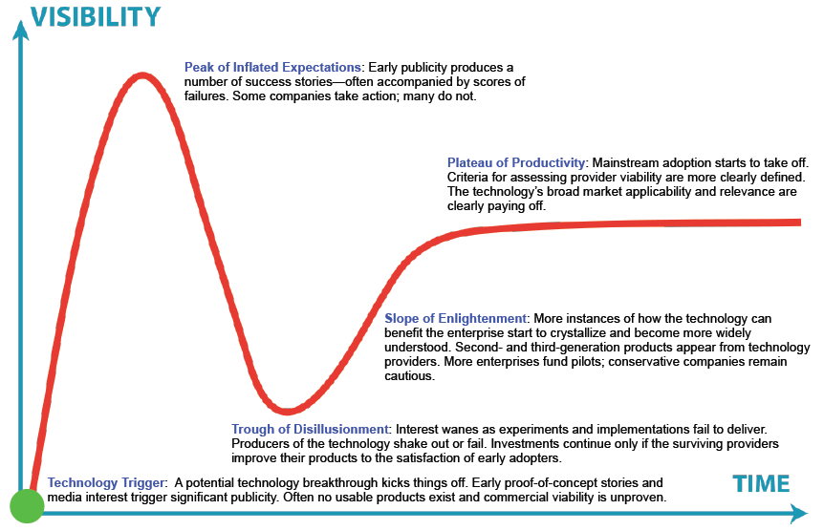
Background: Gartner’s Five-Stage Technology Lifecycle
Time to reach plateau dimension
Less than 2 years
2–5 years
5–10 years
More than 10 years
Obsolete before plateau
Source: http://www.gartner.com/technology/research/metodologies/hype-cycle.jsp
Notes:
Sample technologies from 2018 Report:
Technology Trigger: Bio Tech: Artificial Tissue, Smart Dust, Flying Autonomous Vehicles
Peak of Inflated Expectations: Digital Twin
Trough of Disillusionment: Smart Fabrics
Slope of Enlightenment: Augmented Reality

Slide 5
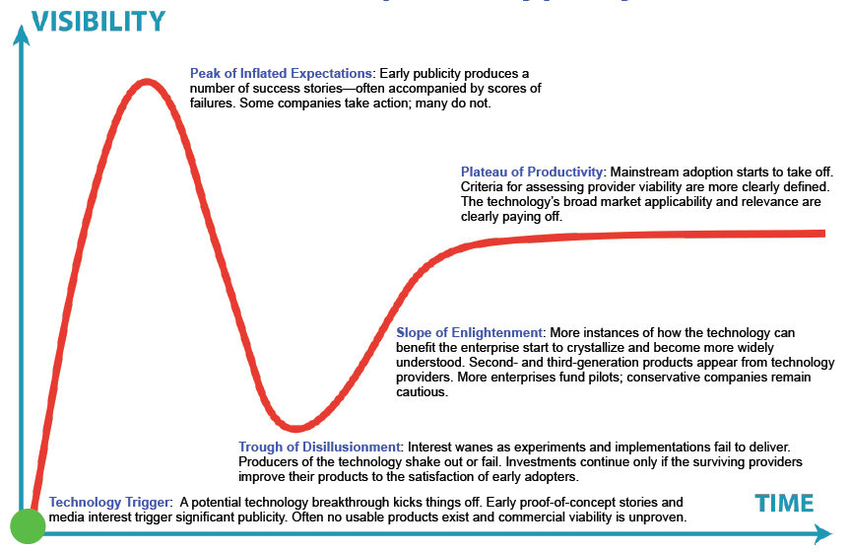
Background: Exploiting and Not Being Exploited by Emerging Changes in Computing
The focus of our work is different depending on where technologies are in the hype cycle
Use cases for how these technologies (may) affect DoD system development, deployment, and acquisition
Feasibility studies
Training and other transition materials
Reference architectures, methodologies, and prototypes that demonstrate how technologies can be inserted into new and existing systems
New use cases
Technology scouting

Slide 6
Sources
Business analysts (e.g., Gartner Hype Cycle for Emerging Technologies 2018; International Data Corporation (IDC), FutureScape: Worldwide IT Industry 2018 Predictions; ThoughtWorks, Technology Radar)
Resources at the intersection of business and technology (e.g., Harvard Business Review, MIT Technology Review)
Top software engineering resources (e.g., ICSE and IEEE Software)
DoD studies and strategies (e.g., Summary of the National Defense Strategy 2018, Defense Science Board report, Design and Acquisition of Software for Defense Systems)

Slide 7
Selected Emerging Technologies
Now Technologies
AI/ML
Continuous automated software engineering
IoT platforms
Near-Term Technologies Now–2 years
Digital thread and digital twin
New programming languages and network technologies
Low-code platforms (end-user programming)
Mid-Term Technologies
2–5 years (watch near term)
Blockchain
Long-Term Technologies
5+ years (watch long term)
Quantum computing
Smart dust
Notes:
There are two ways that the technologies can not be in use now: sometimes the technology is not ready, and sometimes there is not an appropriate use case

Slide 8

Artificial Intelligence/ Machine Learning
Artificial intelligence (AI) is the theory and development of computer systems able to perform tasks that normally require human intelligence, such as visual perception, speech recognition, decision making, and translation between languages.
Machine learning (ML) is a way of achieving AI.
DoD Connections
DoD is moving from C4I (command, control, communications, and intelligence) to A4I (advanced algorithms, autonomy, and AI).
DoD has made AI a priority, which will require contractors to address AI and ML in systems.
AI faces an “explainability” problem: If warfighters don’t understand why a particular decision was made, they won’t trust it. AI needs to explain its rationale and characterize how it will behave in the future (large DARPA research investment).

Slide 9

Artificial Intelligence/ Machine Learning
Potential Areas for Innovation
AI for software engineering: Use of ML techniques to improve software engineering practices
Engineering AI systems: Best practices for incorporating ML capabilities into new and existing systems
AI for DoD missions: ML techniques that consider the often-unique nature of DoD AI problems
Explainable AI (XAI)
Verification and validation for AI/ML systems
Notes:
Subtest for Bullet 1: ML applied to development artifacts (e.g., release notes, chat, issue trackers, source code, code repositories) and operational artifacts (e.g., performance logs, security logs)
Subtext for Bullet 2:
What does it mean for a system to be “AI-ready”?
Role of data engineering in AI systems: technologies to ingest, profile, validate, and cleanse multiple streams of high-volume data
How and when to integrate AI PaaS technologies in ML systems
Examples of AI PaaS technologies:
AI Platforms: allow users to build and train machine and deep learning models and applications
Amazon Sagemaker
Azure Machine Learning Studio
Google Cloud Machine Learning Engine
NLP (Natural Language Processing) services
Amazon Polly
Amazon Lex
Amazon Translate
Amazon Comprehend: NLP
Azure Language Understanding (LUIS)
Azure Bing Spell Check API
Azure Web Language Model API
Azure Text Analytics API
Azure Linguistic Analysis API
Azure Translator Text API
Google Cloud Translation API
Google Cloud Natural Language API
Speech Recognition services
Amazon Lex
Amazon Transcribe
Azure Bing Speech API
Azure Speaker Recognition API
Azure Translator Speech API
Azure Custom Speech Service
Google Cloud Speech API
Google Dialogflow Enterprise Edition
Computer Vision services
Amazon Rekognition
Azure Computer Vision API
Azure Content Moderator
Azure Custom Vision Service
Azure Face API
Azure Emotion API
Azure Video Indexer
Google Cloud Vision API
Google Cloud Video Intelligence

Slide 10
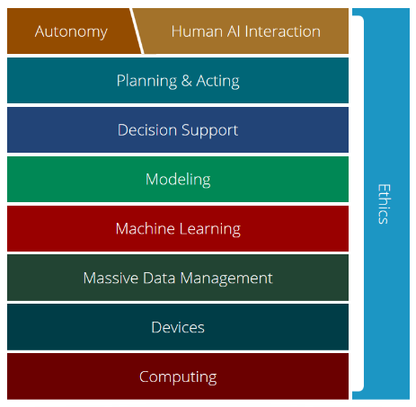
Artificial Intelligence/ Machine Learning
AI and ML spending in the DoD will likely increase modestly in the next two years, but more so after that as plans and the reality of what is possible become clearer.
Challenges
Explainability, trust, repeatability, and reliability
Determining what is unique about applying ML to DoD problems
Understanding effects of incorporating AI/ML components in new and legacy systems
Ethics and AI (including security and privacy)
“Global business value derived from artificial intelligence (AI) is projected to total $1.2 trillion in 2018, an increase of 70 percent from 2017… AI-derived business value is forecast to reach $3.9 trillion in 2022.”
–Gartner Research
Source: https://ai.cs.cmu.edu/about

Slide 11

Continuous Automated Software Engineering
Automate the lifecycle: Expand on SecDevOps and CI/CD to build resilient, smart pipelines for automated development, verification, certification, deployment, delivery, and repair.
Integrate into SecDevOps
Development assistance
Debugging assistance
Automated code repair
Chaos engineering
AI/ML components, explainable AI
DoD Connections
Compile to Combat in 24: allow the Navy to deploy new software capabilities in under 24 hours instead of the current 18-month time frame (tactical cloud, continuous authorization, microservices, continuous ATO via accredited toolchain)
Multiple high-assurance/safety-critical systems programs
Programs in which development and deployment environments operate at different classification levels
Establishment of USAF PEO Digital
Notes:
Automated Code Repair
There is quite a bit of academic research going into the ability to automatically repair buggy software. Often, fixes are synthesized based on failing tests, but other oracles have been used (reference implementations, crash reports, exceptions, etc.). This work can speed up debugging / overall development time and improve final product quality.
Debugging Assistance
Debugging standard programs is challenging, and the continuing shift to multicore and GPU-based systems has made it more difficult still. Academic research has developed a number of promising approaches to address these challenges, and there is an opportunity for the SSD to understand the costs and benefits of these techniques. If it can do so, it would be well positioned to guide the DoD as its systems transition to these more modern hardware architectures.
Development Assistance
Automated assistance for a range of standard development tasks – from actually writing code to (re)ordering regression tests to architecting systems – is improving in maturity. While there is considerable value to found in these technologies, the SSD will have to spend research effort on understanding them / their applicability to DoD systems. As with Debugging Assistance technologies, the SSD would be well positioned to advise the DoD on modernizing its software
Chaos Engineering
Chaos Engineering is as a method of experimenting on infrastructure that exposes weaknesses in distributed systems before they become a real problem. The term comes from Chaos Monkey, a tool developed in 2011 by Netflix to test their infrastructure. The tool intentionally disables components in the production network to test how remaining systems respond to the outage. Chaos Monkey is now part of a larger open source Simian Army Tool Suite that also includes Janitor Monkey (searches for unused resources and disposes of them) and Conformity Monkey (finds instances that do not adhere to best practices and shuts them down). There are other Monkeys in different states of open source development/maintenance such as Latency Monkey (induces artificial delays), Doctor Monkey (detects and removes unhealthy instances) and Security Monkey (detects and removes instances with security violations). Aspects to be investigated include
Definition of experiments for continuous testing of new quality attributes
Reference architectures for “monkeys”
Reference architectures for “monkey-friendly systems”

Slide 12

Continuous Automated Software Engineering
Potential Areas for Innovation
Using infrastructure as code (IaC) to produce ATO-ready deployments and formal verification of IaC scripts
DevOps for ML systems
Incorporating Chaos Engineering practices into the CI/CD pipeline
Integration of modeling, simulation, automated debugging, code assistance, and automated test generation/repair into the CI/CD pipeline
Notes:
Expand certification and governance automation using infrastructure-as-code (IaC) to produce ATO-ready deployments and formal verification of IaC scripts
DevOps for ML: Understand how DevOps processes change when ML algorithms and data are deployed; ML in continuously adapting SecDevOps pipelines/identifying patterns in complex and safety critical systems
Chaos engineering: Incorporate experimenting on infrastructure into the CI/CD pipeline to expose/correct weaknesses in complex/distributed systems before they become a real problem
Investigate how to fully integrate modeling, simulation, automated debugging, code assistance, chaos engineering, and automated test generation/repair

Slide 13
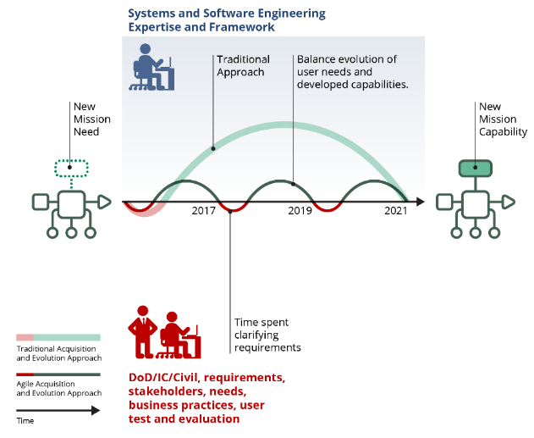

Continuous Automated Software Engineering
Iterative Development Process
Challenges
Integrating DevOps pipelines in legacy environments
SecDevOps-enabled automated governance requires explainable, trusted evidence to support accreditation
Closing the gap with production-representative environments for complex safety-critical systems
Integration and alignment of acquisition/business and technical processes throughout the disparate elements of the acquisition ecosystem
“In a future war we could be changing software every day as a necessary factor for winning”
–Dr. Will Roper, Assistant Secretary of the Air Force for Acquisition, Technology and Logistics
Notes:
The SEI approach—increase automation to enable repeatable, scalable software lifecycle practices:
Apply model-based techniques to enable safe and secure system development while decreasing uncertainty
Implement tool-supported system analysis to collect reliable data and enable just-in-time response to problems
Develop software data analytics, such as applying AI techniques to software data, to improve decision making
Rapidly pilot interim results with government, industry, tool vendors, and industry partners
In an iterative development process you spend more time on requirements, but at each increment you are developing capabilities that meet the need at the moment. In the traditional development process you do requirements once and deliver a product at a time where you don’t even have the same users,

Slide 14

Internet of Things (IoT) Platforms
An internet of things (IoT) platform is software that enables development, deployment, and management of solutions that connect to and capture data from IoT endpoints.
IoT platforms can be delivered as a hybrid combination of edge platforms and/or cloud IoT platform as a service.
DoD Connections
Edge devices for tactical users that collect and process data from IoT devices
Managing security risks from commercial devices at the edge to further enable the DoD’s use of IoT technology
IoT applications within the DoD typically incorporate several aspects of big data, AI/ML, and the cloud
While the DoD has made progress in adopting IoT technologies, there are still many unexplored/untapped use cases, such as growth in off-battlefield application areas including facility management and environmental monitoring
Notes:
Examples of IoT Platforms:
Amazon Web Services: AWS IoT Core, AWS IoT Device Management , AWS IoT Analytics, AWS IoT Device Defender
Google Cloud IoT
Microsoft Azure IoT Suite
SAP
Salesforce IoT
Oracle Internet of Things
Cisco IoT Cloud Connect
Bosch IoT Suite
IBM Watson Internet of Things
ThingWorx Industrial IoT Platform

Slide 15
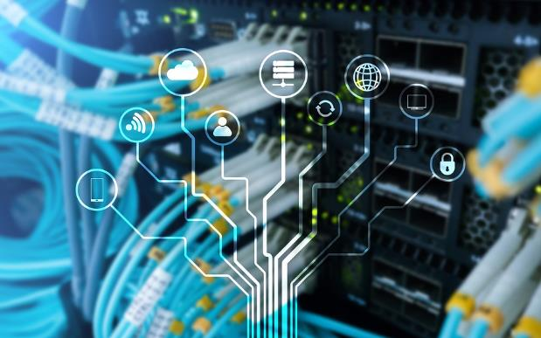
Internet of Things (IoT) Platforms
Potential Areas for Innovation
Secure IoT platforms
Edge ML for IoT
5G and IoT
Changing interaction models with technology
Notes:
Secure IoT platforms: Secure integration and data flow between IoT – edge – core – cloud
Edge ML for IoT: Support for running complex ML algorithms at the edge, which might require use of application-specific integrated circuits (ASICs) and new computing platforms
5G and IoT: Multiple sources state that 5G will greatly benefit IoT. However, what does this mean exactly? Does it change the architecture of IoT systems?
Changing interaction models with technology (e.g., FDA cleared Apple’s new electrocardiogram for commercial use, yet it’s very error prone)

Slide 16
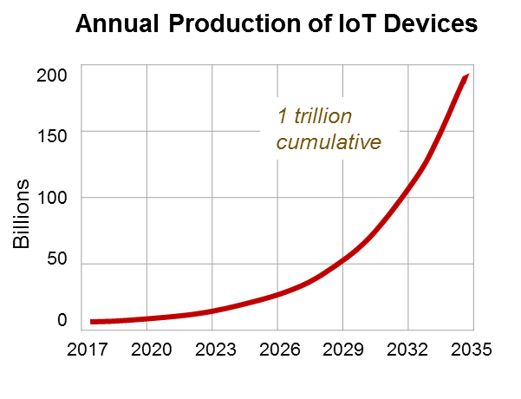
Internet of Things (IoT) Platforms
“IoT represents the next phase in the evolution of technology…If the government and DoD aren’t involved in shaping the security of these devices, we’re going to find ourselves at a severe loss.”
–National Security Agency
Challenges
IoT security (at the top of the challenges list, in particular for DoD)
Hardware dependency and connectivity
IoT data deluge
Lack of regulations, in particular from government to accelerate application of IoT advances for the public sector (e.g., for smart cities)
International Data Corporation reports that, by next year, “over 20% of container instances will be running at edge locations serving IoT workloads,” which supports the use of edge computing as a solution for the “IoT data deluge.”
Source data: ARM Holdings

Slide 17

Digital Thread and Digital Twin
The digital thread is a model of the system that begins at conceptualization and evolves through its life to retirement; the digital twin is a model of the system as built, including any manufacturing discrepancies, that is used to support the system in service.
Digital twins include the model, data, a one-to-one association to the object, and the ability to monitor it.
DoD Connections
DoD recognizes that the “fly-fix-fly” or “operate-fix-operate” modes of operation are not sustainable anymore. Digital thread and digital twin are the next-generation models, which also incorporate model-based-engineering techniques.
DoD has several small to large efforts underway in this area (e.g., at AFRL; three pilots in Air Force)
“AFRL began investigating a digital twin approach to predict aircraft structural life around 2009. Recent discussion with the AFRL lead indicates they see it as a 30+ year objective (Tuegel),” in Navy Platform Digital Twin, by Thomas C. Fu, PhD, SES Director, Ship Systems & Engineering Research, May 2017
Notes:
Digital Twin
The digital twin refers to a digital model of a particular asset that includes design specifications and engineering models describing its geometry, materials, components and behavior. More important, it also includes the as-built and operational data unique to the specific physical asset that it represents. For example, for an aircraft, the digital twin would be identified to the physical product unit identifier which is referred to as the tail number. The data in the digital twin of an aircraft includes things like specific geometry extracted from aircraft 3D models, aerodynamic models, engineering changes cut in during the production cycle, material properties, inspection, operation and maintenance data, aerodynamic models, and any deviations from the original design specifications approved due to issues and work-arounds on the specific product unit.
A digital twin is basically a virtual version of a physical entity, whether product, factory, or some other type of asset or system. The digital twin unites business, contextual and sensor data to represent the physical object.
Digital twin comprises several elements like manufacturing simulations, 3D CAD models, and real-time data feeds from sensors that are incorporated into the physical operating environment. Digital twin can benefit all aspects of manufacturing, right from design to real-time data feed. The aim of creating a digital twin is not just to cut prototyping or construction costs, but also to predict failures more easily and accurately and effectively, thereby reducing both maintenance costs and downtime.
Digital Thread
The digital thread consists of a communication framework that helps in facilitating an integrated view and connected data flow of the product’s data throughout its lifecycle. The digital thread concept helps in delivering the right information at the right time and at the right place. Digital thread provides the ability of accessing, integrating, analyzing, and transforming data from disparate systems into actionable information throughout the product lifecycle.
Digital threads refer to the digitization and traceability of product “from cradle to grave.” The digital thread connects all the various capabilities in the digital twin back to the part designs, requirements and software that goes into the product represented by the digital twin.
“Digital thread” and “full traceability across a full lifecycle” are synonymous
Together, the digital thread and digital twin include as-designed requirements, validation and calibration records, as-built data, as-used data, and as-maintained data.
The concept of digital twin and digital thread helps in creating a virtual copy, running in the cloud for every physical asset, thereby making that asset enhanced and accurate by feeding it with operational data every second.

Slide 18
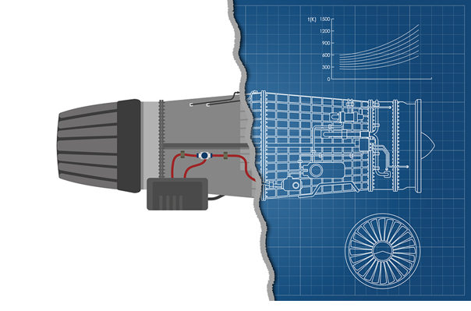
Digital Thread and Digital Twin
Potential Areas for Innovation
Developing modeling techniques for digital twins
Real-time and data architectures to leverage digital twins
Applying ML techniques to continuously update and learn from collected data
Real-time data analysis and decision support
Predictive and just-in-time maintenance to improve supply chain resource management

Slide 19

Digital Thread and Digital Twin
“The current acceleration of digital twins is mainly possible thanks to the IoT and the lowering costs of technologies that boosted both IoT and the digital twin. IoT and sensors (transducers) power digital twins.”
–www.i-scoop.eu/
Challenges
Implementing such a framework is not trivial as there are many subcomponents.
Progress is needed in model-based engineering, ML, and the availability of database technology for big data to accelerate pilots and adoption.
Different stakeholders need to consume the digital twin and thread for different decision-making capabilities.
We need to learn how to expose this information to all stakeholders, who might not be software engineers.
By 2020, 30% of G2000 companies will be using data from digital twins of IoT-connected products and assets to improve product innovation success rates, and organizational productivity, achieving gains of up to 25%. –IDC

Slide 20






New Programming Languages and Network Technologies
New languages such as Go, Rust, and Elixir have been developed in response to shortcomings in C and C++. They enable faster development of systems that are more
performant (by making concurrent programming easier)
secure (by eliminating classes of memory errors typically used in exploits)
safe (enabling static checks for more types of errors)
New networking technologies such as named data networking (NDN) and software-defined networks (SDN) also provide improved capability.
DoD Connections
The programming languages most in use in the DoD are Java, C, C++, and Ada—yet many new languages should be evaluated in DoD contexts because they could significantly impact the safety, security, and affordability of the DoD codebase, such as
new, commercially supported languages (e.g., Rust, maintained by Mozilla; Go, maintained by Google)
new, academically developed languages with improved feature sets (e.g., Wyvern from CMU)
The programmability of SDNs can help make the DoD’s networks more secure and flexible, and less expensive to deploy and manage
NDN’s premise of being able to access data using named content instead of named hosts has high value for DoD systems focused on data dissemination
Notes:
Go (or GoLang): Open source programming language maintained by Google. Designed at Google in 2007 to improve programming productivity in an era of multicore, networked machines and extremely large codebases. Go is syntactically similar to C, but with the added benefits of memory safety, garbage collection, structural typing, and CSP-style concurrency.
Rust: Open source programming language designed and maintained by Mozilla. Rust is a multi-paradigm systems programming language focused on safety, especially safe concurrency. Rust is syntactically similar to C++, but is designed to provide better memory and thread safety while maintaining high performance. Rust is intended to be a language for highly concurrent and highly safe systems, and "programming in the large", that is, creating and maintaining boundaries that preserve large-system integrity. This has led to a feature set with an emphasis on safety, control of memory layout, and concurrency.
Elixir: Functional, concurrent, general-purpose programming language that runs on the Erlang virtual machine (BEAM). Elixir builds on top of Erlang and shares the same abstractions for building distributed, fault-tolerant applications. Elixir also provides a productive tooling and an extensible design. The latter is supported by compile-time metaprogramming with macros and polymorphism via protocols.
Software Defined Networking (SDN): Network architecture decouples the network control (control plane) and forwarding functions (data plane) enabling the network control to become directly programmable and the underlying infrastructure to be abstracted for applications and network services. While the control plane makes decisions about how packets should flow through the network, the data plane actually moves packets from place to place. With SDN, an administrator can change any network switch's rules when necessary -- prioritizing, deprioritizing or even blocking specific types of packets with a granular level of control and security. Other benefits of SDN are network management and end-to-end visibility. A network administrator need only deal with one centralized controller to distribute policies to the connected switches, instead of configuring multiple individual devices. This capability is also a security advantage because the controller can monitor traffic and deploy security policies. If the controller deems traffic suspicious, for example, it can reroute or drop the packets. SDN also virtualizes hardware and services that were previously carried out by dedicated hardware, resulting in the touted benefits of a reduced hardware footprint and lower operational costs.
Named Data Networking (NDN): Named Data Networking started in 2010 as an NSF research project that was used to create the architecture for the future Internet. Its premise is that the Internet is primarily used as an information distribution network, which is not a good match for IP, and that the future Internet's "thin waist" should be based on named data rather than numerically addressed hosts. The underlying principle is that a communication network should allow a user to focus on the data he or she needs, named content, rather than having to reference a specific, physical location where that data is to be retrieved from, named hosts. The motivation for this is derived from the fact that the vast majority of current Internet usage (a "high 90% level of traffic") consists of data being disseminated from a source to a number of users. Named-data networking comes with potential for a wide range of benefits such as content caching to reduce congestion and improve delivery speed, simpler configuration of network devices, and building security into the network at the data level.

Slide 21


New Programming Languages
New Network Technologies
Potential Areas for Innovation
Analysis of benefits/drawbacks of the use of new languages in the DoD
Migration from legacy in other languages
Making formal languages more accessible (e.g., SPARK Ada)
Potential Areas for Innovation
Understanding effects of new networking technologies on system qualities such as security, scalability, performance, and reliability
Using SDN for building dynamic network security frameworks
Trust management and secure data naming models in NDN
Notes:
SPARK Ada: SPARK is a formally defined computer programming language based on the Ada programming language, intended for the development of high integrity software used in systems where predictable and highly reliable operation is essential. It facilitates the development of applications that demand safety, security, or business integrity. Guarantees are specified through contracts, which are not trivial as the constructions requires knowledge of formal specifications.
The programmability and separation of control plane from data plane in SDN can enable security policies to be embedded in highly dynamic micro-middleboxes.
Trust management is an issue in NDN because keys are shared in the same way as data. How do you guarantee authenticity of a key? Secure data naming is also a challenge because names are not encrypted, just the data, and that would give too much information away.

Slide 22

New Programming Languages and Network Technologies
Some desirable features of modern languages include
thread safety – Code can be safely run in multithreaded environments without manual coordination
memory safety – Pointers cannot be null, data races are impossible, etc.
memory management – Memory can be automatically reclaimed, greatly reducing memory leaks
sophisticated type systems – Enhance static verification capabilities
Challenges
Understanding how to integrate new languages with existing codebases
Understanding opportunities and challenges of polyglot programming
How to choose which languages to incorporate and when to ensure they will be pervasive/ “stick”
Understanding the effect of SDN and NDN on software systems
The Defense Information Systems Agency (DISA) is suggesting the use of SDN to make DoD networks more secure, flexible, and cheaper to deploy and manage. DISA director Alan Lynn described SDN as “instead of having hardware … it’s building a huge network just with software.”
–FedTech
Notes:
Polyglot programming: Practice of writing code in multiple languages to capture additional functionality and efficiency not available in a single language. Proponents of polyglot programming contend that using the most effective language for each aspect of a program enables faster development, greater comprehension for business stakeholders, and a more optimal end product. However, integrating a wide variety of languages into a single application may entail added complexity. Resource consumption may increase in terms of training, testing and maintenance. Polyglot programming may also make code difficult to deploy if operations is not familiar with the same languages used in development.

Slide 23

Low-Code Platforms (End-User Programming)
Low-code platforms provide an environment for the creation of software through graphical user interfaces and configuration. They reduce the amount of traditional hand-coding, enabling accelerated delivery of business applications.
A common benefit is that a wider range of people can contribute to an application's development—not only those with formal programming skills.
DoD Connections
Low-code platforms could lower the barrier to entry for nontraditional suppliers bidding on major weapon systems. To better compete with large defense contractors, smaller competitors with good ideas could use low-code platforms to prototype them and prove their concepts in the DoD space.
These platforms enable citizen data science by providing interfaces for non-programmers. For example, in the DoD the Jupyter Notebook (an open-source web application) has been used to empower thousands of citizen data scientists to build and share analytics.
The workforce skill gap in DoD for programmers could be bridged for some classes of systems (e.g., business applications).
Notes:
Jupyter Notebook: The Jupyter Notebook is an open-source web application that allows you to create and share documents that contain live code, equations, visualizations and narrative text. Uses include: data cleaning and transformation, numerical simulation, statistical modeling, data visualization, machine learning, and much more.
Examples of low-code platforms: Zoho Creator, Appian, Microsoft PowerApps, Mendix, OutSystems, Google App Maker, Quick Base, TrackVia, Salesforce App Cloud, Nintex Workflow Cloud

Slide 24

Low-Code Platforms (End-User Programming)
Potential Areas for Innovation
Visual modeling
Drag-and-drop user interfaces
Frameworks to design, build, and customize the platforms
Development processes for these types of systems
Explainability

Slide 25

Low-Code Platforms (End-User Programming)
NextGov suggests that low-code platforms need to meet these “crucial requirements” to drive changes in federal IT:
fully leverage a cloud environment and support on- premises and hybrid deployments
have the most stringent security accreditations
operate identically on the web and mobile devices through a single development effort
provide proven enterprise-grade scalability
Challenges
Security and compliance (How do you know if code written by end users is secure?)
Assurance and accreditation (air-worthiness, nuclear surety, etc.)

Slide 26

Blockchain
Blockchain is a “distributed database that enables participants in an industry ecosystem to transact with each other without relying on a central trusted authority to record and validate transactions.”
Even though blockchain has been used mostly in the context of cryptocurrency (e.g., BitCoin), and more recently for smart contracts, there are other emerging uses of blockchain that are worth exploring, especially with respect to scalability and performance.
DoD Connections
There are several pilots in progress in the DoD to test applicability:
Navy to bring added security to its manufacturing systems
NAVAIR to help track aviation parts
Across DoD for supply chain management and cybersecurity
Once the cost curve changes, adoption in DoD is likely to accelerate
Notes:
The blockchain is an incorruptible digital ledger of economic transactions that can be programmed to record not just financial transactions but virtually everything of value. Information held on a blockchain exists as a shared — and continually reconciled — database. By storing blocks of information that are identical across its network, the blockchain cannot: (1) Be controlled by any single entity, and (2) Has no single point of failure. The blockchain network lives in a state of consensus, one that automatically checks in with itself every ten minutes. The network reconciles every transaction that happens in ten-minute intervals. Each group of these transactions is referred to as a “block”.
A blockchain is a growing list of records, called blocks, which are cryptographically linked. Each block contains a cryptographic hash of the previous block, a timestamp, and transaction data (generally represented as a merkle tree root hash). By design, a blockchain is resistant to modification of the data. For use as a distributed ledger, a blockchain is typically managed by a peer-to-peer network collectively adhering to a protocol for inter-node communication and validating new blocks. Once recorded, the data in any given block cannot be altered retroactively without alteration of all subsequent blocks, which requires consensus of the network majority.
A network of computing “nodes” make up the blockchain. A node is a computer connected to the blockchain network using a client that performs the task of validating and relaying transactions. It gets a copy of the blockchain, which gets downloaded automatically upon joining the blockchain network. In the context of bitcoin, nodes are called miners.
The blockchain data structure is a time-stamped list of blocks. Blocks are containers that aggregate transactions. Blocks are chained together cryptographically in a distributed ledger. New blocks are only appended to the end of the chain — provides an immutable data storage. Every transaction within a new block is verified by participants of the network to ensure integrity using a distributed consensus algorithm
Smart contracts are distributed ledgers enable the coding of simple contracts that will execute when specified conditions are met. Ethereum is an open source blockchain project that was built specifically for smart contracts.
Examples of blockchain platforms include Ethereum, Ripple, Hyperledger, IBM, and R3.

Slide 27

Blockchain
Potential Areas for Innovation
Blockchain for data security
Blockchain for data provenance
Blockchain for IoT security
Smart contracts
Multi-chain integration/ecosystems

Slide 28
Blockchain
Because of the current expense, DoD needs to ask, “Is there a specific property of blockchain that cannot be gained from any other technology?”
More DoD-specific use cases will be enabled when costs come down and other challenges have been overcome.
Challenges
Potentially high hardware and software costs, along with operational costs
Energy consumption
Integration with legacy systems
Privacy and security (not really bullet proof, although positioned as such)
Source: NISTIR 8202: Blockchain Technology Overview.

Slide 29

Quantum Computing
Quantum computing is a type of non-classical computing that uses quantum bits (qubits) instead of binary bits. A qubit can be thought of like an imaginary sphere, in which a qubit can be at any point on the sphere (multiple states instead of just 0 and 1).
A quantum computer gets its enormous processing power through the ability to be in multiple states and to perform tasks using all possible permutations simultaneously, which is why it is mainly targeted at very complex mathematical problems, modeling and simulation, and optimization.
DoD Connections
Quantum-resilient systems: NIST recognized the threat of quantum computing and in 2016 started a program to standardize quantum-resilient replacement for public-key cryptography
Senate Armed Services Committee is considering the Quantum Computing Research Act to promote adequate research and coordination across services—a similar bill in the House called the National Quantum Initiative Act became law in December 2018
DARPA is particularly interested in learning about the ways quantum technology could improve general computing performance and accelerate artificial intelligence and machine learning systems
National Strategic Overview for Quantum Information Science to create a visible, systematic, national approach to quantum information research and development

Slide 30

Quantum Computing
Potential Areas for Innovation
Artificial intelligence algorithms, highly secure encryption for communications satellites, and accurate navigation that does not require GPS signals
Migration to quantum programming languages (e.g., Microsoft’s QDK)
Migration to quantum-resilient crypto systems
Notes:
Many experts divide Quantum Information Science technologies into four application areas:
Sensing and metrology—performing navigation, locating mineral deposits, keeping precise time
Communications—generating quantum keys for encryption, sending quantum-secure communications
Computing—performing computations much faster than is possible using conventional high-performance computers
Simulation—determining the properties of materials such as high-temperature superconductors, modeling nuclear and particle physics.

Slide 31
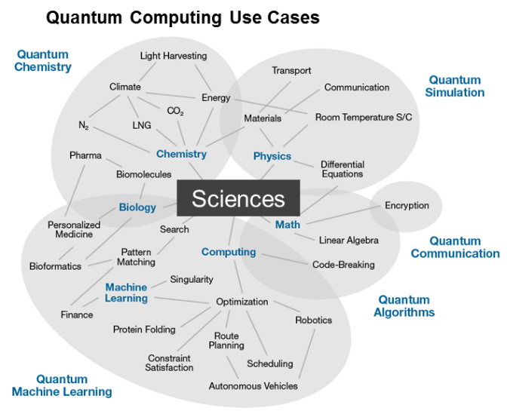
Quantum Computing
Although the marketplace is growing and Accenture estimates $1 billion was invested through public and private initiatives in 2016, consistent enterprise use of quantum hardware is still two to five years out.
–Accenture Labs (2017)
Challenges
A lot has to happen before quantum computing can be applied to real problems or break today’s cryptosystems.
Experts state that useful work requires probably 200 entangled qubits.
Google announced in March 2018 its largest quantum computer, called Bristlecone, which is a 72-qubit quantum computer.
In addition, quantum computers still have high error rates, mainly due to the instability of the underlying subatomic particles.
QuantumComputing Report.com, an industry website, lists 19 publicly traded companies, 64 startups, and 58 investment funds.
Source: Gartner Research

Slide 32

Smart Dust
“Smart dust is composed of self-contained sensing systems called motes, targeting the size of a grain of sand, about 1 cubic millimeter. These systems have the capability to sense, compute, communicate, and power their own activities.
They are used to support a distributed sensing network, such as temperature, pressure, and environmental sensing, potentially using mesh to achieve communication coverage. As they do not use large antennas, these systems have ranges measured in just a few millimeters.” –2018 Gartner Hype Cycle for Emerging Technologies
DoD Connections
Smart dust has huge potential for DoD for ISR and battlespace awareness. Future MEMS will “sense a wide array of information with the processing and communication capabilities to act as independent or networked sensors,” according to Defense One. “Fused together into a network of nanosized particles distributed over the battlefield capable of measuring, collecting, and sending information, Smart Dust will transform persistent surveillance for the warfighter.”

Slide 33

Smart Dust
Potential Areas for Innovation
Algorithms for self-organization and self-healing
Communication protocols
Systems architectures for systems that integrate smart dust
Notes:
Algorithms for self-organization and self-healing? Are there hierarchies between motes?
What communication protocols do motes use? Are they “small enough”?
What are appropriate systems architectures for collecting, processing, and interpreting data coming from motes?

Slide 34
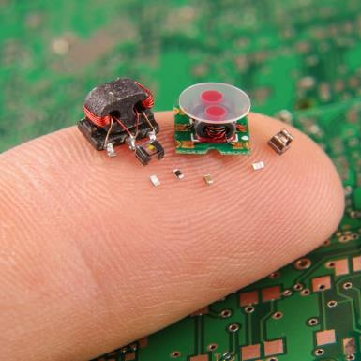
Smart Dust
Smart dust "would be ideal for deployment during a natural disaster where the communications infrastructure is knocked out ... Or, in a combat situation where dust eyes and ears can relay enemy data for troop and support ordinance. On a smaller scale, these motes can be deployed within a house, or on a ranch or farm, or even in a forest to report almost any type of event.”
–Rambus.com
Challenges
Due to the aspired size of motes, the two key challenges are power and communication.
Security and privacy are also challenges given that most applications are related to data collection by “invisible” motes.
“The potential of smart dust to collect information about any environment in incredible detail could impact plenty of things in a variety of industries from safety to compliance to productivity. It’s like multiplying the internet of things technology millions or billions of times over.”
–Forbes

Slide 35
Cross-Cutting Concerns
The team identified several themes that run through the technology areas and use cases/applications researched
Not “emerging technologies” in their own right, but affect multiple (or all) emerging technologies and DoD perspective on exploitation of emerging technologies:
Explainability and Trustworthiness
Security and Privacy
Autonomy Anything
Advancing the State of the Practice
Workforce Development
Ethics
“The Department will invest broadly in military application of autonomy, artificial intelligence, and machine learning, including rapid application of commercial breakthroughs, to gain competitive military advantages.”
–2018 National Defense Strategy

Slide 36

Explainability and Trustworthiness
How can we ensure that humans can explain and trust recommendations and outcomes of models, software, systems, and networks?
Explainability: Do we understand why it did what it did?
Assurance: Can we trust it to function properly and yield error-free results?
Data integrity and provenance: Do we have confidence that the data collected, generated, stored, and consumed has not been/is not compromised and can be traced?
Resilience: Do we have confidence that we can continue operations if compromised?
Notes:
Explainable AI (XAI): The concept of Explainable AI is well defined on the web site of the DARPA project of the same name (https://www.darpa.mil/program/explainable-artificial-intelligence). The goal of XAI is to “produce more explainable models, while maintaining a high level of learning performance (prediction accuracy); and enable human users to understand, appropriately trust, and effectively manage the emerging generation of artificially intelligent partners.” XAI is especially useful in the context of mission-critical decisions and in certification and accreditation processes.
V&V for AI/ML Systems: In a recent keynote by Jerome Pesenti, VP of AI at Facebook, he stated that the hardest problem in AI is V&V of AI/ML systems. This is was also highlighted in Shane Shaneman’s recent presentation at the SSD All-Hands.; DSB recommendation #7 is that DoD, and the SEI specifically, invest in research surrounding testing, IV&V, and cybersecurity resiliency for ML – including establishing a data repository/exchange.

Slide 37

Security and Privacy
Security and privacy as key system quality concerns are put to test with the increasing capabilities of emerging technologies, such as AI and the potential threat of quantum algorithms to break crypto systems.
Approaches and algorithms that further guarantee these quality attributes are critical enablers for all emerging technologies.

Slide 38

Autonomy Anything
An autonomous agent is an intelligent agent operating on an owner's behalf, but without any interference of that ownership entity.
It shifts humans away from repetitive, physical, isolated, or hazardous tasks.
Autonomous agents will increasingly be part of software-enabled systems and capabilities for
automotive and robotics domains
DevOps, low-code programming, and AI
… I think autonomy is going to change everything –Dr. Will Roper, Assistant Secretary of the Air Force for Acquisition, Technology and Logistics

Slide 39
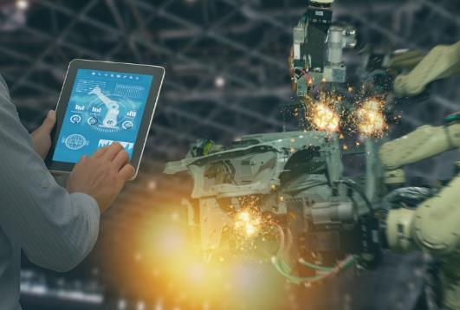
Advancing the State of the Practice
Many technologies and approaches that have been broadly adopted in commercial practice have not yet been widely adopted in DoD/government- unique contexts, including
Agile/Lean/DevOps
open source platforms/tools
microservices/cloud computing
These technologies and approaches also enable or contribute to many of the emerging technology areas.
Appropriately exploiting these opportunities in the design, development, test, and deployment of software will accelerate the delivery of capability and enable future innovation.

Slide 40

Workforce Development
Significant skillset gaps, especially in AI and blockchain technology, will challenge both DoD and its contractors.
These skill gap challenges also apply to cybersecurity and privacy. According to one estimate, by 2021 an estimated 3.5 million cybersecurity jobs will be unfilled. And of the candidates who apply, fewer than one in four are qualified.
Approaches that assist developers even when they are novices or mid-level will help bridge this gap, such as automation in conformance checking, bug fixing, and assurance.

Slide 41

Ethics
ACM and IEEE Computer Society jointly released, and updated in 2018, the Software Engineering Code of Ethics and Professional Practice.
The implications are not just for practice but also for how systems are designed and implemented, ensuring that
data used for analysis is not biased
APIs do not expose details
analysis techniques are safe-guarded against abuse
These concerns are increasingly aspects to be considered during software design and development.
Will ethics be thought of as a quality attribute concern?

Slide 42
Conclusion
This presentation describes a small-scale study of emerging technologies, not a rigorous investigation.
This information is intended to create awareness of technologies that are likely to affect DoD system development, deployment, and acquisition, now and in the future.

Slide 43
References
Reports and Studies
Accenture Technology Vision 2018 – Tech Trends Report, Accenture, https://www.accenture.com/t20180227T215953Z__w__/us-en/_acnmedia/Accenture/next-gen-7/tech-vision-2018/pdf/Accenture-TechVision-2018-Tech-Trends-Report.pdf
Defense Advanced Research Projects Agency (DARPA) Research, https://www.darpa.mil/our-research
Design and Acquisition of Software for Defense Systems, Defense Science Board report, http://www.dtic.mil/dtic/tr/fulltext/u2/1048883.pdf
DoD Digital Engineering Strategy, https://www.acq.osd.mil/se/docs/2018-DES.pdf
Hype Cycle for Emerging Technologies 2018, Gartner report, https://www.gartner.com/doc/3885468/hype-cycle-emerging-technologies-
IDC FutureScape: Worldwide IT Industry 2018 Predictions, International Data Corporation (IDC) report, https://www.idc.com/getdoc.jsp?containerId=US43 171317
Summary of the 2018 National Defense Strategy for the United States of America, https://dod.defense.gov/Portals/1/Documents/pubs/2018-National-Defense-Strategy-Summary.pdf
Tech Trends 2018 Report, Deloitte, https://www2.deloitte.com/content/dam/insights/us/articles/Tech-Trends-2018/4109_TechTrends-2018_FINAL.pdf
Ten Commandments of Software, Defense Innovation Board, https://media.defense.gov/2018/Apr/22/2001906836/-1/-1/0/DEFENSEINNOVATIONBOARD_TEN_COMMANDMENTS_OF_SOFTWARE_2018.04.20.PDF
Technology Radar, ThoughtWorks, https://www.thoughtworks.com/radar
Top 10 Emerging Technologies 2017, World Economic Council report, http://www3.weforum.org/docs/WEF_Top_10_Emerging_Technologies_report_2017.pdf
Presentations and Conference Proceedings
Beyond Bitcoin: What to Do with Blockchain? SATURN 2017, https://resources. sei.cmu.edu/asset_files/presentation/2017_017_001_497577.pdf
Digital Thread Implementation in the Air Force: AFRL’s Role, Air Force Research Laboratory presentation, https://www.nist.gov/sites/default/files/documents /2017/04/19/boden_kobryn_usaf_nist_mbe_2016_dist_a.pdf
Navy Platform Digital Twin, Office of Naval Research presentation, http://onlinepubs.trb.org/onlinepubs/mb/2017Spring/fu.pdf
Proceedings of ACM SIGPLAN Symposium on Principles of Programming Languages, https://popl18.sigplan.org/track/POPL-2018-papers
Proceedings of the International Conference on Software Architecture, http://icsa-conferences.org/2018/attending/program/
Proceedings of MILCOM18, https://events.afcea.org/MILCOM18/Public/enter.aspx

Slide 44
References
Presentations and Conference Proceedings, Continued
Proceedings of Programming Language Design and Implementation, https://pldi18.sigplan.org/track/pldi-2018-papers
Proceedings of the 40th International Conference on Software Engineering, http://conferences.computer.org/icse/2018/#!/home
Proceedings of the International Conference on Software Maintenance and Evolution, https://icsme2018.github.io/
Journal Articles
10 Breakthrough Technologies 2018, MIT Technology Review, https://www.technologyreview.com/lists/technologies/2018/
5 Emerging Trends Software Developers Should Watch in 2017, Web Alive, https://www.webalive.com.au/emerging-trends-software-developers-should-watch-2017/
5 Software Development Trends to Watch for in 2018, DZone, https://dzone.com/articles/5-software-development-trends-to-watch-for-in-2018
A Cyber-skills Shortage Means Students Are Being Recruited to Fight Off Hackers, MIT Technology Review, https://www.technologyreview.com/s/612309/a-cyber-skills-shortage-means-students-are-being-recruited-to-fight-off-hackers/
AI Weekly: For Evidence of Academic Investment in AI, Look No Further than Pittsburgh, Venture Beat, https://venturebeat.com/2018/10/19/ai-weekly-for-evidence-of-academic-investment-in-ai-look-no-further-than-pittsburgh/
ANSYS and Carnegie Mellon University Partner to Drive the Next Industrial Revolution in Making Physical Products, ANSYS, https://www.ansys.com/about-ansys/news-center/06-02-16-ansys-and-carnegie-mellon-university-partner
Digital Twin Technology and Simulation: Benefits, Usage and Predictions 2018, i-SCOOP, https://www.i-scoop.eu/digital-twin-technology-benefits-usage-predictions/
DoD Stands Up Its Artificial Intelligence Hub, C4ISRnet, https://www.c4isrnet.com/it-networks/2018/06/29/dod-stands-up-its-artificial-intelligence-hub/
Edge Computing and IoT 2018 – When Intelligence Moves to the Edge, i-SCOOP, https://www.i-scoop.eu/internet-of-things-guide/edge-computing-iot/
The Era of Quantum Computing Is Here. Outlook: Cloudy, Quanta Magazine, https://www.quantamagazine.org/the-era-of-quantum-computing-is-here-outlook-cloudy-20180124/
Explainable Artificial Intelligence (XAI), DARPA, https://www.darpa.mil/program/explainable-artificial-intelligence
From Smart Dust to Cybernetic Implants, Rambus, https://www.rambus.com/blogs/from-smart-dust-to-cybernetic-implants-2/
Gartner Says Global Artificial Intelligence Business Value to Reach $1.2 Trillion in 2018, Gartner, https://www.gartner.com/newsroom/id/3872933
Get Started with Quantum Development, Microsoft, https://www.microsoft.com/en-us/quantum/development-kit
Glacier, https://mcoblenz.github.io/Glacier/

Slide 45
References
Journal Articles, Continued
How a Cyber Attack Could Cause the Next Financial Crisis, Harvard Business Review, https://hbr.org/2018/09/how-a-cyber-attack-could-cause-the-next-financial-crisis
How Blockchain Can Help Marketers Build Better Relationships with Their Customers, Harvard Business Review, https://hbr.org/2018/10/how-blockchain-can-help-marketers-build-better-relationships-with-their-customers
How Competition Is Driving AI’s Rapid Adoption, Harvard Business Review, https://hbr.org/2018/10/how-competition-is-driving-ais-rapid-adoption
Innovating with Quantum Computing, Accenture Labs, https://www.accenture.com/t00010101T000000__w__/br-pt/_acnmedia/PDF-45/Accenture-Innovating-Quantum-Computing-Novo.pdf
Is DISA Eyeing Blockchain?, C4ISRnet, https://www.c4isrnet.com/disa/2018/01/16/is-disa-eyeing-blockchain/
Machine Learning-Driven Analytics: Key to Digital Transformation, MIT Technology Review, https://www.technologyreview.com/s/611996/machine-learning-driven-analytics-key-to-digital-transformation/
Move Over Bitcoin. There's a New Cryptocurrency in Town, Pittsburgh Post-Gazette, http://www.post-gazette.com/business/tech-news/2018/05/18/bitcoin-cryptocurrency-blockchain-carnegie-mellon-university-cmu-param-vir-singh/stories/201805180027
Navy Aims for “Compile to Combat in 24 Hours,” CHIPS, http://www.doncio.navy.mil/chips/ArticleDetails.aspx?ID=10501
New IoT Opportunities to be Found at DoD Facilities, immixGroup, Inc., https://blog.immixgroup.com/2018/05/11/new-iot-opportunities-to-be-found-at-dod-facilities/
Obsidian, https://mcoblenz.github.io/Obsidian/
Pentagon Sees Quantum Computing as Key Weapon for War in Space, Space News, https://spacenews.com/pentagon-sees-quantum-computing-as-key-weapon-for-war-in-space/
Project Maven to Deploy Computer Algorithms to War Zone by Year’s End, Department of Defense, https://dod.defense.gov/News/Article/Article/1254719/project-maven-to-deploy-computer-algorithms-to-war-zone-by-years-end/
Serious Quantum Computers Are Finally Here. What Are We Going to Do with Them?, MIT Technology Review, https://www.technologyreview.com/s/610250/serious-quantum-computers-are-finally-here-what-are-we-going-to-do-with-them/
Smart Dust Is Coming. Are You Ready? Forbes, https://www.forbes.com/sites/bernardmarr/2018/09/16/smart-dust-is-coming-are-you-ready/#2d76ad935e41
Software Development Trends in 2018 that Will Dominate 2019, Medium Corporation, https://medium.com/@Jessicawlm/software-development-trends-in-2018-that-will-dominate-2019-db1a1681c84d
Stop Thinking About Consent: It Isn’t Possible and It Isn’t Right, Harvard Business Review, https://hbr.org/2018/09/stop-thinking-about-consent-it-isnt-possible-and-it-isnt-right

Slide 46
References
Journal Articles, Continued
The Chairman of Nokia on Ensuring Every Employee Has a Basic Understanding of Machine Learning—Including Him, Harvard Business Review, https://hbr.org/2018/10/the-chairman-of-nokia-on-ensuring-every-employee-has-a-basic-understanding-of-machine-learning-including-him
Top 5 Emerging Software Testing Trends to Follow in 2018, Up Work, https://www.upwork.com/hiring/for-clients/top-5-emerging-software-testing-trends-follow-2018/
Top 10 Technology Trends for 2018: IEEE Computer Society Predicts the Future of Tech, IEEE Computer, https://www.computer.org/web/pressroom/top-technology-trends-2018
U.S. Navy Looks to Blockchain Revolution, The Marine Executive, https://www.maritime-executive.com/article/us-navy-looks-to-blockchain-revolution#gs.iuC66IM
Upcoming IoT Regulations and Laws: How to Survive and Stay Compliant, IoT World Today, https://www.iotworldtoday.com/2017/08/21/upcoming-iot-regulations-and-laws-how-survive-and-stay-compliant/
USAF Selects Lead Programs For ‘Digital Twin’ Initiative, Aviation Week, http://aviationweek.com/technology/usaf-selects-lead-programs-digital-twin-initiative
Variations to Support Exploratory Programming, National Science Foundation, http://www.exploratoryprogramming.org/
What Are Smart Contracts on Blockchain? IBM, https://www.ibm.com/blogs/blockchain/2018/07/what-are-smart-contracts-on-blockchain/
What Happens When Spies Can Eavesdrop on Any Conversation?, Defense One, https://www.defenseone.com/technology/2014/12/what-happens-when-spies-can-eavesdrop-any-conversation/100142/
What We Often Get Wrong About Automation, Harvard Business Review, https://hbr.org/2018/10/what-we-often-get-wrong-about-automation
What You Need to Know as AI Grows at DoD, Washington Technology, https://washingtontechnology.com/articles/2018/06/29/insights-meloni-ai-opportunities-trends.aspx
Why Agile Goes Awry—and How to Fix It, Harvard Business Review, https://hbr.org/2018/10/why-agile-goes-awry-and-how-to-fix-it
Why Design Thinking Works, Harvard Business Review, https://hbr.org/2018/09/why-design-thinking-works
Why Doctors Shouldn’t Dismiss the Apple Watch’s New ECG App, Harvard Business Review, https://hbr.org/2018/10/why-doctors-shouldnt-dismiss-the-apple-watchs-new-ecg-app
Why SDN Is Hot at the Pentagon, Fed Tech, https://fedtechmagazine.com/article/2017/11/why-sdn-hot-pentagon

