Slide 1
WELCOME DevSecOps Days DC October 1, 2020

Slide 2
Copyright 2020 Carnegie Mellon University.
This material is based upon work funded and supported by the Department of Defense under Contract No. FA8702-15-D-0002 with Carnegie Mellon University for the operation of the Software Engineering Institute, a federally funded research and development center.
The view, opinions, and/or findings contained in this material are those of the author(s) and should not be construed as an official Government position, policy, or decision, unless designated by other documentation.
NO WARRANTY. THIS CARNEGIE MELLON UNIVERSITY AND SOFTWARE ENGINEERING INSTITUTE MATERIAL IS FURNISHED ON AN "AS-IS" BASIS. CARNEGIE MELLON UNIVERSITY MAKES NO WARRANTIES OF ANY KIND, EITHER EXPRESSED OR IMPLIED, AS TO ANY MATTER INCLUDING, BUT NOT LIMITED TO, WARRANTY OF FITNESS FOR PURPOSE OR MERCHANTABILITY, EXCLUSIVITY, OR RESULTS OBTAINED FROM USE OF THE MATERIAL. CARNEGIE MELLON UNIVERSITY DOES NOT MAKE ANY WARRANTY OF ANY KIND WITH RESPECT TO FREEDOM FROM PATENT, TRADEMARK, OR COPYRIGHT INFRINGEMENT.
[DISTRIBUTION STATEMENT A] This material has been approved for public release and unlimited distribution. Please see Copyright notice for non-US Government use and distribution.
This material may be reproduced in its entirety, without modification, and freely distributed in written or electronic form without requesting formal permission. Permission is required for any other use. Requests for permission should be directed to the Software Engineering Institute at permission@sei.cmu.edu.
DM20-0895

Slide 3
DevSecOps Days Washington DC
We are the DevSecOps Community
DevSecOpsDays.com, the central hub
Our purpose is to support DevSecOps practitioners like you who deserve more exposure and encouragement for the work you are doing

Slide 4
How to Track and Engage?
Live Session at SEI YouTube channel
YouTube Chat
Live session chat
Add your questions for the speakers here
Fireside Chat during Lunch
Interact with the speakers during this session

Slide 5
Schedule - Morning
9:00-9:15 Welcome - Hasan Yasar
9:15-9:45 The Need for Threat Modeling in a DevSecOps World - Simone Curzi
9:45-9:50 Short Break
9:50-10:20 Close the Gap: Bringing Engineering & Security/Compliance Together - Sare Ehmann
10:20-10:25 Short Break
10:25-10:55 Delivering DevSecOps Value Faster? Use Metrics and Standards - Steven Woodward
10:55-11:00 Short Break
11:00-11:30 Navigating DevOps Requirements with Risk Management - Vicky Hailey
11:30-11:35 Short Break
11:35-12:05 Make it Personal to Make it Happen - Ruth Lennon

Slide 6
Schedule - Afternoon
12:05-12:45 Lunch Break and Fireside Chat with Speakers
12:45-1:30 Keynote: Successful DevSecOps Implementation for Production Environments
is a Journey Not a Milestone - Christopher Brazier
1:30-1:35 Short Break
1:35-2:05 Evolve Your DevSecOps to Manage Speed and Risk - Altaz Valani
2:05-2:10 Short Break
2:10-2:40 How Software Acquisition and DevSecOps Can Improve the Lethality of the DoD
- Sean Brady
2:40-2:45 Short Break
2:45-3:15 Why Organizations Need DevSecOps Now More Than Ever - Krishna Guru
3:15-3:30 Wrap Up - Hasan Yasar

Slide 7
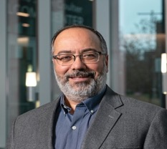
Hasan Yasar – Technical Director, Adjunct Faculty Member
Hasan Yasar is the Technical Director of the Continuous Deployment of Capability directorate at the Software Engineering Institute, CMU. Hasan leads an engineering group to enable, accelerate and assure transformation at the speed of relevance by leveraging DevSecOps, Agile, Lean AI/ML and other emerging technologies to create a Smart Software Platform/Pipeline. Hasan has more than 25 years’ experience as a senior security engineer, software engineer, software architect and manager in all phases of secure software development and information modeling processes. He is also an Adjunct Faculty member in the CMU Heinz Collage and Institute of Software Research where he currently teaches “Software and Security” and “DevOps: Engineering for Deployment and Operations.”

Slide 8
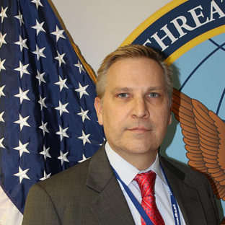
Keynote
Mr. Christopher J. Brazier is the chief of the Operations and Integration Directorate (OI) Mission Support Department (OI-MS) Technology Solutions Division (OI-MST) at the Defense Threat Reduction Agency (DTRA). As the OI-MST Chief, he supports DTRA’s mission by providing oversight and direction to enable the dissemination of operational information and technology through analytical tools to aid in countering threat networks throughout the world. Flexibility is critical to this evolving threat landscape and Mr. Brazier guides the oldest (5+ years) DoD DevSecOps paths to production. The agility of this pipeline has supported rapid updates to the tools and underlying cloud stack to accommodate the rapid programmatic changes associated with threat domains. Prior to coming to DTRA, Mr. Brazier’s federal employment included providing leadership and technical direction to various government agencies Including the Department of State, Department of the Interior, Department of the Treasury, and Federal Communications Commission (FCC). Mr. Brazier was active duty military for seven years and is a veteran of the First Gulf War, where he received several medals to acknowledge his achievements while in service.
Christopher Brazier
Defense Threat Reduction Agency

Slide 9
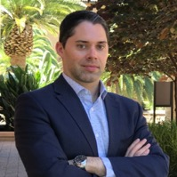

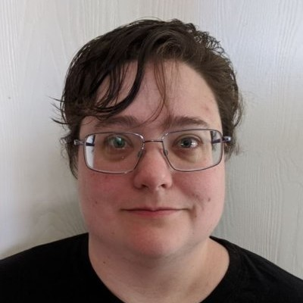
Speakers - 1
Sean Brady
Undersecretary of Defense (Acquisition & Sustainment)
DoD Senior Lead for Software Acquisition
Simone Curzi
Microsoft Services
Principal Consultant, Cyber Security
Sare Ehman
CMU, SEI
Senior DevOps Engineer

Slide 10
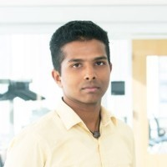

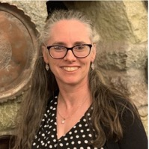
Speakers - 2
Krishna Guru
InterSystems Corporation
Release Engineer
Victoria (Vicky) Hailey
The Victoria Hailey Group Corporation
President
Ruth Lennon
Craobh Technology Consulting
Director

Slide 11
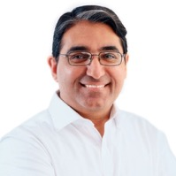
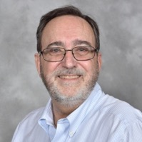
Speakers - 3
Altaz Valani
Security Compass
Director, Insights Research
Steve Woodward
Cloud Perspectives
Founder

Slide 12
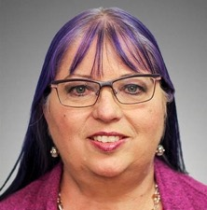
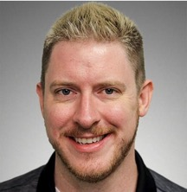
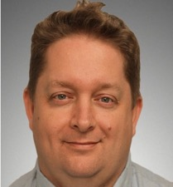
Moderators
Suzanne Miller
CMU, SEI
Principal Researcher
Aaron Volkmann
CMU, SEI
Senior Software Engineer
David Shepard
CMU, SEI
Software Developer

Slide 13
Sean Brady – Undersecretary of Defense (Acquisition & Sustainment) DoD Senior Lead for Software Acquisition
Mr. Sean Brady is the DoD’s Senior Lead for Software (SW) Acquisition Policy and Workforce, in the Office of the Deputy Assistant Secretary of Defense for Acquisition Enablers (DASD(AE)). He serves as the functional manager for defense SW modernization policy, programs, and initiatives to ensure the US dominates in digital warfighting capability delivery. He leads development of the new DoD Software Acquisition Pathway policy, major program enablement and adoption of DevSecOps, and workforce development for the DoD SW Engineering & Acquisition workforce (200K+ professionals). Professor Brady served as the Learning Director for Software Acquisition at the Defense Acquisition University. He led strategy to transform DoD’s practices, competencies, training, and workforce—and accelerate the adoption of modern, commercial SW development practices across DoD and DAU’s curriculum. He launched DAU’s DevSecOps practice, the DevSecOps Academy, integrating elite full-stack Cloud One engineers and armed forces pioneers with DAU professors.
Prior to DAU, Mr. Brady served 9 years as the Deputy Director for Software Engineering (SWE), in the Office of the Deputy Assistant Secretary of Defense for Systems Engineering (DASD(SE)), within the Office of the Secretary of Defense (OSD). He led change, provided oversight of 170+ major programs (a $1.7T portfolio), and managed governance of Software Acquisition and Development within DoD. He led SWE oversight on DoD's most complex, highest-visibility defense programs (RD&E > $480M; procurement > $2.79 billion). Mr. Brady is an expert in software parametric statistical analysis and assessing large-scale Agile software development efforts. He informed DoD's senior-decision makers, industry CEOs, and Congress on SWE across Army, Navy, Marine Corps and Air Force programs.

Slide 14
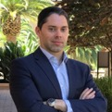
Sean Brady – Undersecretary of Defense (Acquisition & Sustainment) DoD Senior Lead for Software Acquisition - continued
His strategic duties include leading policy and guidance development; workforce planning; and outreach to optimize the DoD's SWE capability. He launched DoD's largest acquisition workforce modernization initiative (impacting 200K+ professionals). In addition, he championed OSD's efforts to improve performance measurement practices across DoD and industry.
Prior to his role in the Pentagon, he served in the Army's RDECOM/ARDEC as an Armament Software Engineering Center (ASEC) Special Projects Team Lead and as a Program Manager, Close Combat Systems Project Officer (PO) where he planned and executed high-visibility experimental and rapid fielding programs -- supporting elite special operations and front-line Warfighters. He is the Defense Innovation Board’s Software Acquisition workforce co-lead, a member of the Army's Acquisition Corps and has served as a US Delegate to NATO. Mr. Brady holds a Bachelor of Science in Computer and Electrical Engineering from Rutgers University; a Master of Science in Quantitative Software Engineering from Stevens Institute of Technology; a Master of Business Administration from the University of Virginia; and holds a graduate certificate in Entrepreneurship and Innovation from Stanford University.

Slide 15
Simone Curzi – Microsoft Services, Principal Consultant, CyberSecurity
Simone Curzi is a Principal Consultant at Microsoft Consulting Services. Simone has more than 20 years’ experience covering various technical roles in Microsoft Services, and has fully devoted himself to Security for more than 5 years. A renowned Threat Modeling and Microsoft Security Development Lifecycle (SDL) expert, Simone is also one of the leaders of the Worldwide Microsoft Community on Application Security and a subject matter expert for the Security Community. Some of Simone's contributions are available through his blog, which can be accessed from https://simoneonsecurity.com. He is also the maintainer of a repo for an open source framework to build threat modeling tools, called Threats Manager Platform, which is accessible from https://github.com/simonec73/threatsmanager. He can also be reached via LinkedIn (https://www.linkedin.com/in/simone-curzi-a357b334/).

Slide 16
Sare Ehman - CMU Software Engineering Institute, Senior DevOps Engineer
Sare Ehmann joined the SEI in April 2020 after spending 5 years as a software engineer/
consultant with Pivotal (now VMware). At Pivotal, Sare helped many companies change the
way they built and ran software, from upskilling their development competencies, to creating
automated deployment pipelines, to agile culture transformation, to user-centered
development and design. Sare is passionate about:
Test Driven Development & testing in general
Pair Programming
Software Development Wastes (and reducing them)
User-Centricity
Story Writing
Cloud-Native Application Maturation
Emergent Architecture as a feedback loop
Effective Communication
Allyship and Mentoring

Slide 17
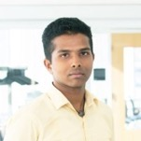
Krishna Guru – InterSystems Corporation, Release Engineer
Krishna Guru is a Release Engineer at InterSystems Corporation where he works on automating a wide variety of tasks and contributes to the successful development and timely deployment of robust products and customer solutions by providing technical knowledge to build processes and procedures to package together all elements of the product. Prior to his role at InterSystems Corporation, he graduated with a master's degree in information technology from the School of Computer Science at Carnegie Mellon University. During his time at Carnegie Mellon University, he finished courses on best practices for software engineering and DevOps. He also worked as a graduate teaching assistant for the DevOps course where he taught deployment process, associated tooling, and best practices to enable high velocity deployments to all the participants.

Slide 18
Victoria (Vicky) Hailey – The Victoria Hailey Group Corporation, President
Vicky is a CMC (Certified Management Consultant) with over 30 years experience in virtually every aspect of systems engineering, using emerging technologies to serve a diverse customer base from governments to multinational corporations, from utilities to charities, with a primary competency for engineering trust by first doing no harm. She has experience at every level from social responsibility and ethical governance of AI, to risk management and product conception, to big data security and privacy requirements and design through to customer and supplier audits. As well as being a practicing Lead Auditor/Assessor, she is also an accredited ISO Lead Auditor Instructor in many ISO management systems standards and a Lead Assessor Instructor for SPICE/ISO/IEC/ 15504/33000 and other maturity model frameworks, such as CMMI.

Slide 19

Ruth Lennon – Craobh Technology Consulting, Director
Ruth Lennon is the director of Craobh Technology Consulting providing personalised solutions to industry problems. Ruth has 20 years of experience as a lecturer in the Department of Computing in Letterkenny Institute of Technology, Ireland. Ruth's research interests focus on enterprise scale systems with particular focus on DevOps and Cloud technologies. She has been a member of many technical panels and committees including NSAI/TC 2/SC 11 on cloud and distributed systems, NSAI/TC 2/SC 2 on Software Engineering and ISO/IEC JTC 1/AG 3 "Open Source Software". Ruth is a member of the working group developing the P2675 DevOps standard. Ruth’s goal in DevOps is to ensure that security and performance are seen as core to development projects just as it is in configuration projects. Ruth has worked on security projects in the area of threat modelling and security reviews. In addition, Ruth is a member of the ACM, ACM-W, IEEE, IEEE-WIE and the IEEE Computer Society. Ruth is the Chair of the ACM-W Europe.icky is a CMC (Certified Management Consultant) with over 30 years experience in virtually every aspect of systems engineering, using emerging technologies to serve a diverse customer base from governments to multinational corporations, from utilities to charities, with a primary competency for engineering trust by first doing no harm. She has experience at every level from social responsibility and ethical governance of AI, to risk management and product conception, to big data security and privacy requirements and design through to customer and supplier audits. As well as being a practicing Lead Auditor/Assessor, she is also an accredited ISO Lead Auditor Instructor in many ISO management systems standards and a Lead Assessor Instructor for SPICE/ISO/IEC/ 15504/33000 and other maturity model frameworks, such as CMMI.

Slide 20
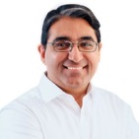
Altaz Valani – Security Compass, Director, Insights Research
Altaz Valani manages the overall research vision and team as the Director of Insights Research at Security Compass. He is a regular conference speaker who conducts ongoing research in the software security domain. Prior to joining Security Compass, he was a Senior Research Director and Executive Advisor at Info-Tech Research Group, Senior Manager at KPMG, and held various positions working alongside senior stakeholders to drive business value through software development. Altaz is on the SAFECode Technical Leadership Council, CIO Strategy Council, and several IEEE Working Groups where cyber security and privacy challenges are being tabled at the international standards level. He is a frequent collaborator within industry and academic circles on a wide range of topics related to governance, risk, cyber security, and software development.

Slide 21

Steven Woodward – Cloud Perspectives, Founder
Steven Woodward is the founder of Cloud Perspectives, a cloud change agent. He is a co-editor with ISO/ IEC JTC1 SC7 for the Agile and DevSecOps subject areas and has contributed to the DevOps and DevSecOps standards with IEEE and the Cloud Security Alliance. Steven served as the convener with ISO/ IEC JTC1 SC38 for the Cloud Service Connectivity advisory group, is the liaison between SC7 and SC38, and continues to contribute to several other standards groups. Steven has over 30 years’ experience in software metrics and service level agreements, authoring several chapters in books and industry publications. A frequent presenter at various universities, he enjoys the continuous learning opportunities and the opportunity to influence the next generation of IT service professionals. Steven is known for his real-life examples and for providing practical insights to reduce risk and improve IT decision making. Affiliation: Cloud Perspectives, contributor to NIST, IEEE, CSA, ISO/ IEC, ITU-T, and other standards.

Slide 22
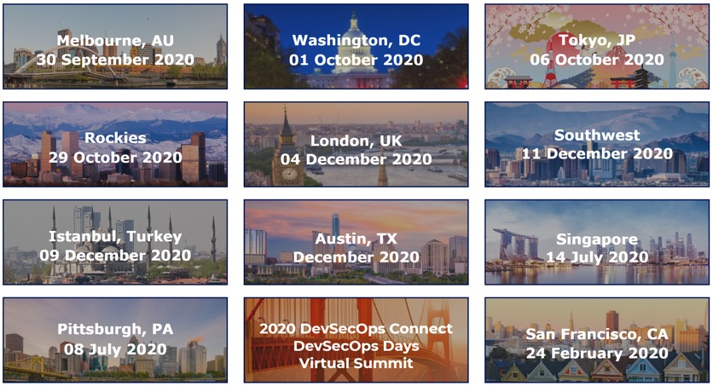
2020 DevSecOps Days

Slide 23
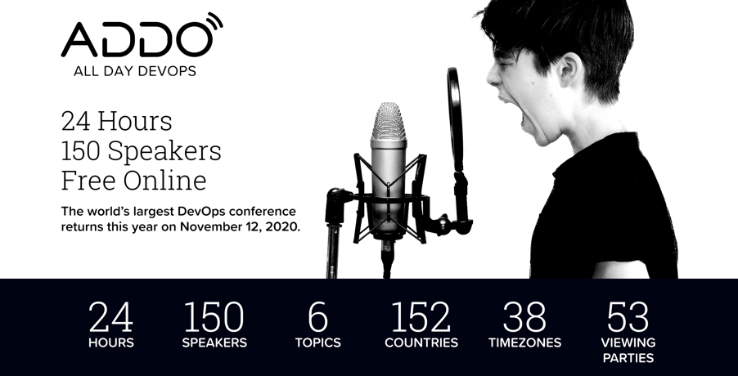

Slide 24
For More Information
DevOps: https://www.sei.cmu.edu/go/devops
DevOps Blog: https://insights.sei.cmu.edu/devops
Webinar: https://www.sei.cmu.edu/publications/webinars/index.cfm
Podcast: https://www.sei.cmu.edu/publications/podcasts/index.cfm

Slide 25





Thank You

