Slide 1
Dynamic Analysis of an Executable’s System Impact
Lyndsi Hughes, Senior Systems Engineer, Silent Sentinel Project Lead
Mark Sherman, Technical Director
CERT
Software Engineering Institute
Carnegie Mellon University
Oct 27, 2025
[DISTRIBUTION STATEMENT A] This material has been approved for public release and unlimited distribution.

Slide 2
Copyright 2025 Carnegie Mellon University.
This material is based upon work funded and supported by the Department of Defense under Air Force Contract Nos. FA8702-15-D-0002, and FA870225DB003 with Carnegie Mellon University for the operation of the Software Engineering Institute, a federally funded research and development center.
The view, opinions, and/or findings contained in this material are those of the author(s) and should not be construed as an official Government position, policy, or decision, unless designated by other documentation.
References herein to any specific entity, product, process, or service by trade name, trademark, manufacturer, or otherwise, does not necessarily constitute or imply its endorsement, recommendation, or favoring by Carnegie Mellon University or its Software Engineering Institute nor of Carnegie Mellon University - Software Engineering Institute by any such named or represented entity.
NO WARRANTY. THIS CARNEGIE MELLON UNIVERSITY AND SOFTWARE ENGINEERING INSTITUTE MATERIAL IS FURNISHED ON AN "AS-IS" BASIS. CARNEGIE MELLON UNIVERSITY MAKES NO WARRANTIES OF ANY KIND, EITHER EXPRESSED OR IMPLIED, AS TO ANY MATTER INCLUDING, BUT NOT LIMITED TO, WARRANTY OF FITNESS FOR PURPOSE OR MERCHANTABILITY, EXCLUSIVITY, OR RESULTS OBTAINED FROM USE OF THE MATERIAL. CARNEGIE MELLON UNIVERSITY DOES NOT MAKE ANY WARRANTY OF ANY KIND WITH RESPECT TO FREEDOM FROM PATENT, TRADEMARK, OR COPYRIGHT INFRINGEMENT.
[DISTRIBUTION STATEMENT A] This material has been approved for public release and unlimited distribution. Please see Copyright notice for non-US Government use and distribution.
This material may be reproduced in its entirety, without modification, and freely distributed in written or electronic form without requesting formal permission. Permission is required for any other use. Requests for permission should be directed to the Software Engineering Institute at permission@sei.cmu.edu.
CERT® and Carnegie Mellon® are registered in the U.S. Patent and Trademark Office by Carnegie Mellon University.
DM25-1364

Slide 3
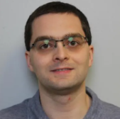
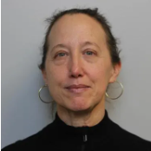
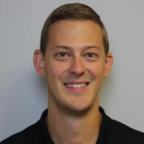
Silent Sentinel Team
Joe Sible
Lori Flynn
Dave Belasco
Software Engineer
Software Engineering Institute/CERT
Senior Software Security Researcher
Software Engineering Institute/CERT
Senior Threat Analyst
Software Engineering Institute/CERT
[DISTRIBUTION STATEMENT A] This material has been approved for public release and unlimited distribution.

Slide 4
Agenda
Goals and Shortcomings of Software Testing
How to Close the Gap?
Examples and Outputs (Videos)
Availability and Access
Questions

Slide 5
Goals and Shortcomings of Software Testing

Slide 6

Traditional Goals of Software Testing
Unit testing: validate small modules of code
Regression testing: validate new doesn’t break existing
Performance testing: app can handle anticipated loads
Plus many more…

Slide 7
Modern Improvements to Software Testing
Static Application Security Testing
Dynamic Application Security Testing
Interactive Application Security Testing
aka SAST
White-box testing
Analyzing code for weaknesses, e.g., potential buffer overflow
And more…
aka DAST
Black-box testing
Analyzing exposed interfaces, e.g., penetration testing
Code coverage
And more…
aka IAST
Inserts sensors into system
Detects known vulnerabilities by measuring internal performance
Integrated with development tools at development time
Notes:
AST frequently includes SCA Software Composition Analysis as well

Slide 8
Still Many Threats to Testing Success
Unaddressed challenges
Negative Outcomes
Incomplete testing procedures
Manual testing procedures
Inadequate testing tools
Inconsistent test results can negatively impact software quality
Poor software quality can negatively impact business success

Slide 9
Much of Dynamic Testing Focuses on Program Specified Behaviors
Functional Testing
Non-Functional Testing
Prompts accurate
Inputs properly checked
Outputs match specifications
Errors handled appropriately
Response performance
Scaling performance
Memory management enforced
Authorizations enforced
Acceptable code-coverage

Slide 10
Expanding Dynamic Testing (DAST) to Environmental Interactions without Internal Sensors (IAST)
Program Quality Checks
Looking for Malicious Behavior
Memory use as expected
  Total memory
  Growth
Process use as expected
  Number and structure
  Creation/destruction
File use as expected
  Number
  Size
  Location
Aberrant network behavior
  Command and control presence
  Exfiltration presence
Unknown processes used
Unknown files used
Privilege escalation
(Presence of tainted libraries)

Slide 11
How to Close the Gap?

Slide 12

New Testing Framework: Silent Sentinel
Combines software profiling and dynamic testing
Observes changes made by the program under test in a sandbox environment
Provides data about the program under test and the observed system changes to analysts
Framework accepts additional (external) sensors and analysis

Slide 13
Some Gaps Addressed by Silent Sentinel
Silent Sentinel can help answer these types of questions:
What data should I look at to assess the risk of deploying this program?
What is the risk of deploying this capability in my environment?
Does this program behave the way the developers say it does?
Are there behaviors that were not considered in the specifications?
Might this program interfere with another program?
Are there behaviors that should not be present?
Is the entire DevSecOps process secure from build to operate?

Slide 14
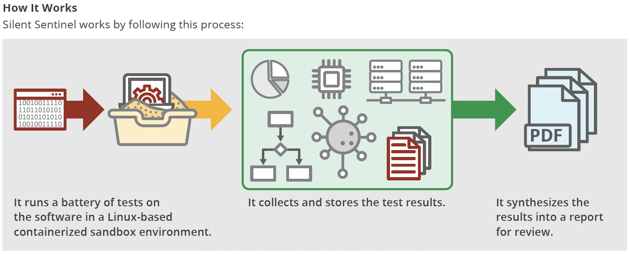
How It Works

Slide 15
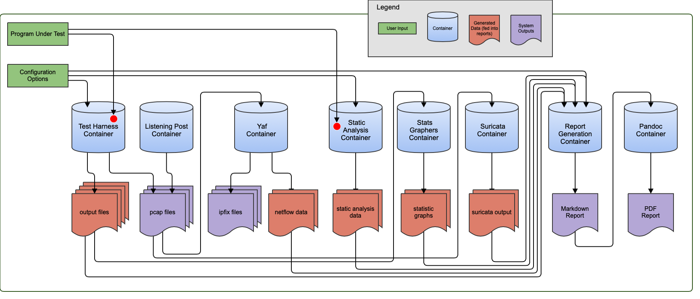
System Diagram

Slide 16
Containers and Their Purposes
testharness – The main container where the program under test is ran, along with the instrumentation
listeningpost – Serves as a remote host for the program under test to try to connect to
reportgeneration – Creates the report from the data collected by the listeningpost and testharness containers
YAF – Processes the pcap generated on the listeningpost and testharness containers and outputs data as netflow and ipfix
pandoc – Parses the markdown report created by the reportgeneration container and generates a PDF

Slide 17
Design Decision – Containerization of Test Harness
Upsides of containerized testharness
  Fast builds, setups, and teardowns
  Good tooling to automatically interact with and execute things inside the container without introducing false-positive network traffic
  Trivial to show changes on filesystem
  Can be more easily instrumented from the outside
Downsides of container testharness
  Kernel versions and modules cannot be containerized
  auditd cannot be containerized
  Tools like systemd are difficult to run in a container

Slide 18
Metric Collection Methods
Continuous Monitoring
One-shot Collection
Runs in the background the entire time the program under test is running and produces a continuous stream of output.
The entire output ends up in the final report.
Example: tcpdump
Runs once before the program under test starts, at the user's discretion while the program under test is running, and once after the program under test exits.
The results of each consecutive run are diffed, and only the diffs appear in the final report.
Example: ps

Slide 19
Tools Used to Generate Data for Findings
strings – strings in binary
pspy – command tracking
netstat – network tracking/stats
ps – process tables/info
iptables – ip filter rules
tcpdump – traffic monitoring
ifconfig – network interface data
Suricata – net flow analysis
ClamAV – virus detection
memory_stat – running memory tracking
crontabs – checking on whether modifying or introducing unexpected tasks on system
dockerdiff – tracking changes in docker images
strace – tracing system calls
YAF – Yet another flowmeter, tracking netflow
YARA – Yet another recursive algorithm -- rule matching for data pattern detection
cpu_stat – running CPU tracking

Slide 20
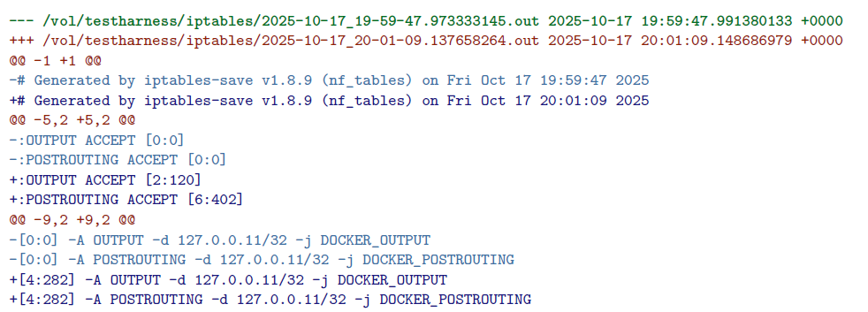

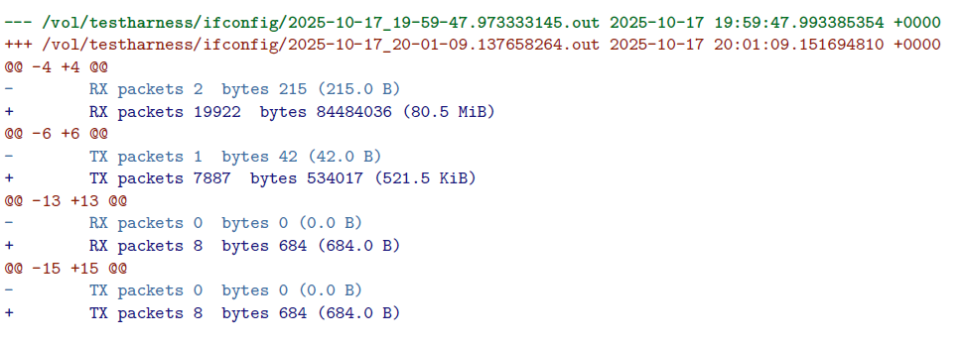
Raw Output Generated

Slide 21
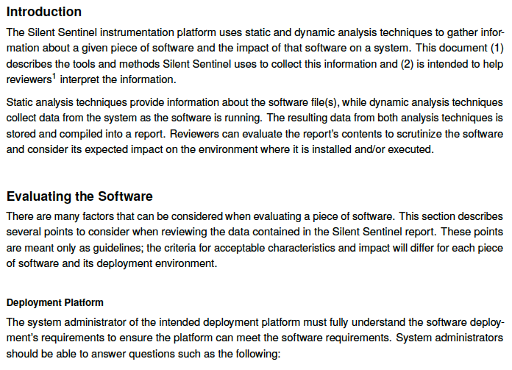
Interpretation Guide - 1
Intended to help the testers and evaluators interpret the information in the report.
First section provides high-level information about risk evaluation and tips for analyzing binary behavior.

Slide 22
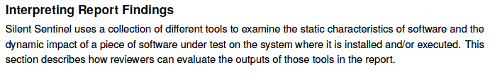
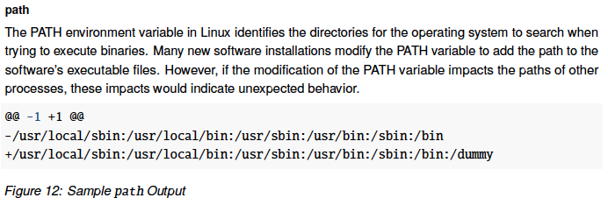
Interpretation Guide - 2
Second section provides:
Commentary about the report sections
Sample outputs

Slide 23
Formatting of Report Findings
For each tool used in the instrumentation, a `diff` is done between the output each time it is run to the next time it is run. Additionally, a diff is run on the first iteration and the last to compare the baseline output to the final output.
Example for 3 runs of netstat tool:
diff -c netstat_1.out netstat_2.out >> netstat_1.diff
diff -c netstat_2.out netstat_3.out >> netstat_2.diff
diff -c netstat_1.out netstat_3.out >> netstat.diff

Slide 24
Findings Generated From Data
Disk performance
  Disk space usage
  Disk I/O graphs
Network performance
  Network bandwidth
  End point analysis
  Protocols used
  Latency
  pcap derivatives
Configuration analysis
  Path manipulations
  Director layout manipulation
  Hidden or unexpected strings

Slide 25
Examples and Outputs
Notes:
Notes on all Examples:
They’re run on a RHEL 9 vm with:
Docker 28.5.1
Docker Compose plugin
jq 1.6
16GB available disk space

Slide 26
Examples
Series of examples to illustrate ways that Silent Sentinel can be set up
Actual “applications” are purposefully simple to demonstrate tool use, not generate diagnostic data
Each example will show
  Capability to be illustrated
  Video of example being run
  Sample output
Runnable scripts for each example are in this presentation

Slide 27
Example Common Environment
Examples run on a RHEL 9 vm with:
  Docker 28.5.1
  Docker Compose plugin
  jq 1.6
  LaTex
  16GB available disk space

Slide 28
Example 0:
Silent Sentinel Command Line

Slide 29
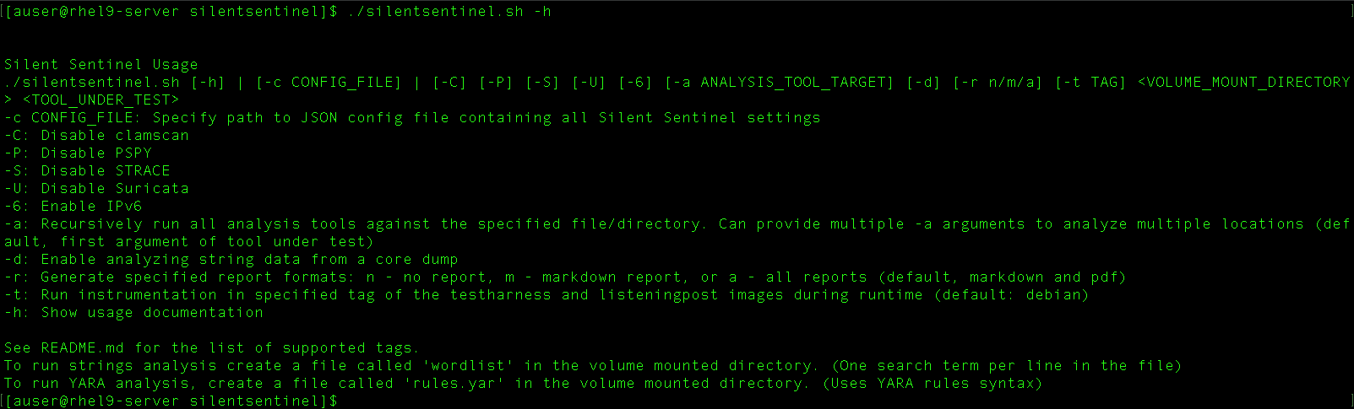
Both Command Line and Configuration Files are Supported
for Directing Silent Sentinel
Notes:
Clamscan is the on-demand scanner tool built into ClamAV.

Slide 30
Example 1:
Run Command in Container $PATH
Notes:
List content of directory in test harness container.
Program under test can be something in the test harness container.
This is a way to make sure that everything is installed, build all the container images, and run a simple program

Slide 31
Example 1 Background
Silent Sentinel needs to pull down and install dependencies, such as specific containers
Example uses the command line interface to “test” the program “ls –a1” under Fedora
Illustrated steps:
Bring down docker containers
Start containers
Run the program under test (generate dynamic data)
Examine the (binary) program with static tools
Analyze data from dynamic tools
Analyze data from static tools
Generate reports (Markdown and PDF)
Stop and remove docker containers
Show docker containers that were built, and the files of data collected

Slide 32
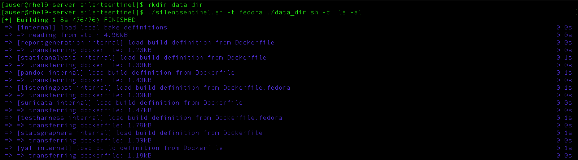
Notes:
First install silent sentinel and bring down dockefr containers
Run the program under test (generate dynamic data)
Run the program (statically) with static tools
Analysis dynamic data, e.g., suricata
Generate reports (markdown and PDF)
Stop and remove docker containers
Show docker containers that were built, and the files of data collected

Slide 33
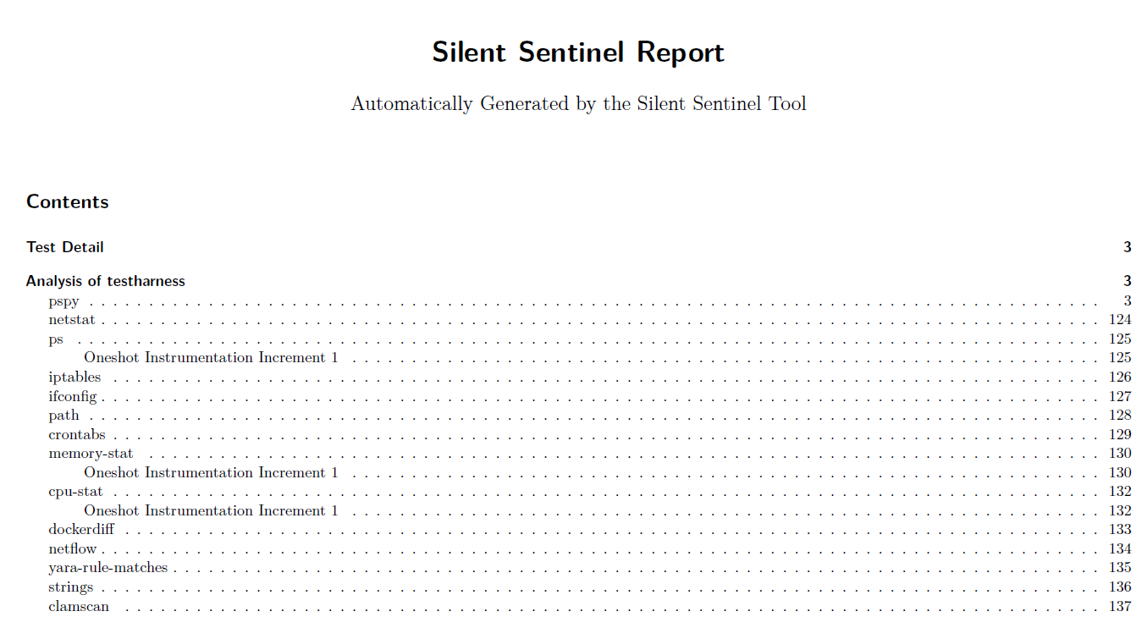

Slide 34
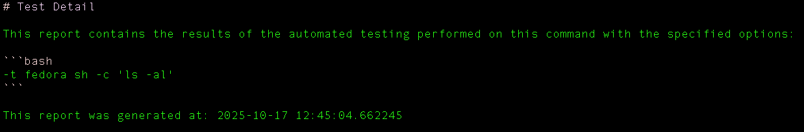
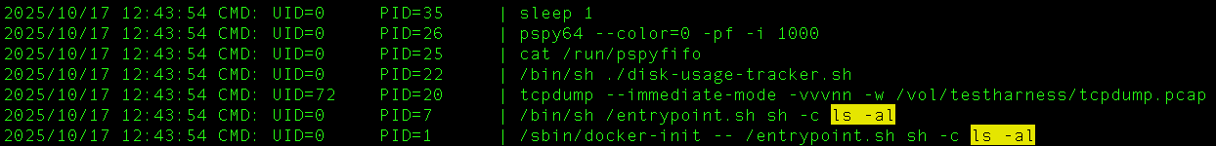
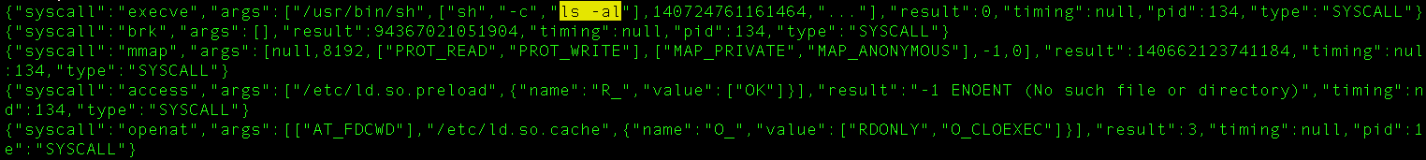
Example 1 Outputs

Slide 35
Example 2:
Run Custom Bash Script
Notes:
Instead of running a command that exists in a container, run a script as the program under test (Bash)
Shows the scrip making changed t firewall rules, cron job, extend a path, etc
Script in the exampls is /vol/example2.sh (and listeningpost is an argument to that script as needed.)
Reuses some “helper” containers that are not running the program, for the program undertest (and listeningpost) build under the container it wants.
Example 1 containers except for debian containers
Same as before, running static analysis, analyzing dynamic data, building reports
Show containers build, and fiels with data

Slide 36
Example 2 Background
Example uses the command line interface to “test” the program that is a Bash script under Debian
Illustrated steps:
Instead of running a command that exists in a container, run a Bash script as the program under test
  Shows the script making changes to firewall rules, cron job, extend a path, etc.
Script to be tested is /vol/example2.sh
  Listeningpost is an argument to that script as needed for the test program
Reuses previous “helper” Fedora containers that are not for the program undertest (and listeningpost), e.g., report generators
Process similar to Example 1:
  Running static analysis, analyzing dynamic data, building reports
  Showing containers built, and files with data

Slide 37
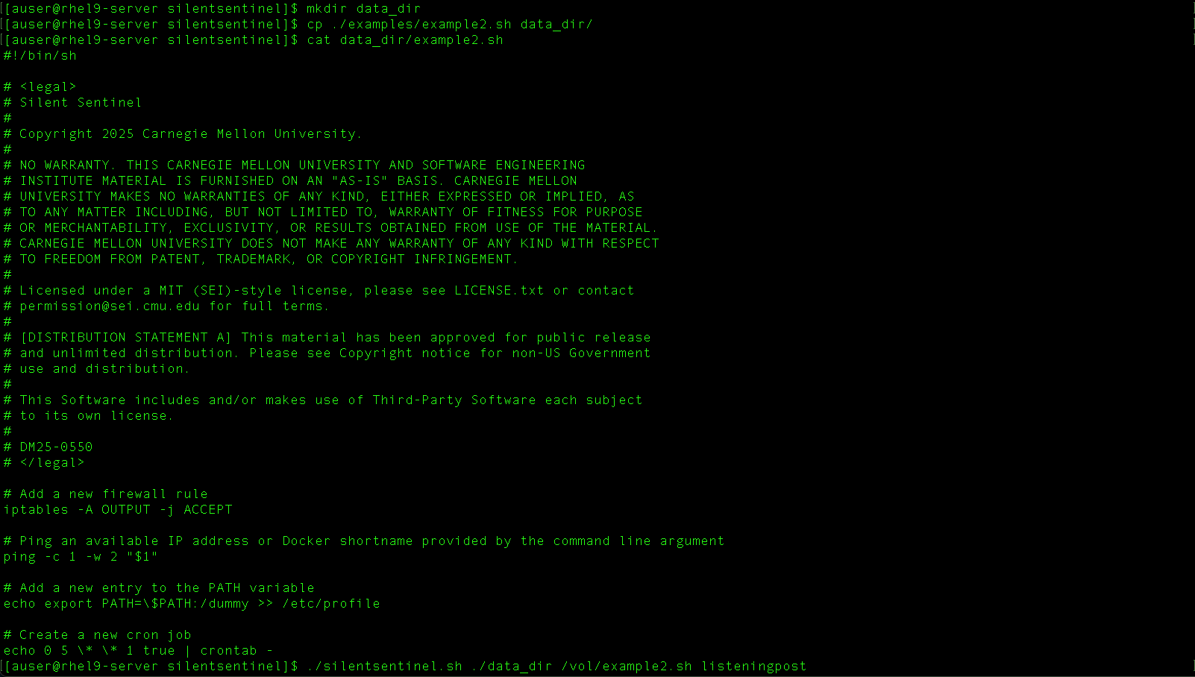
Bash script “program”

Slide 38
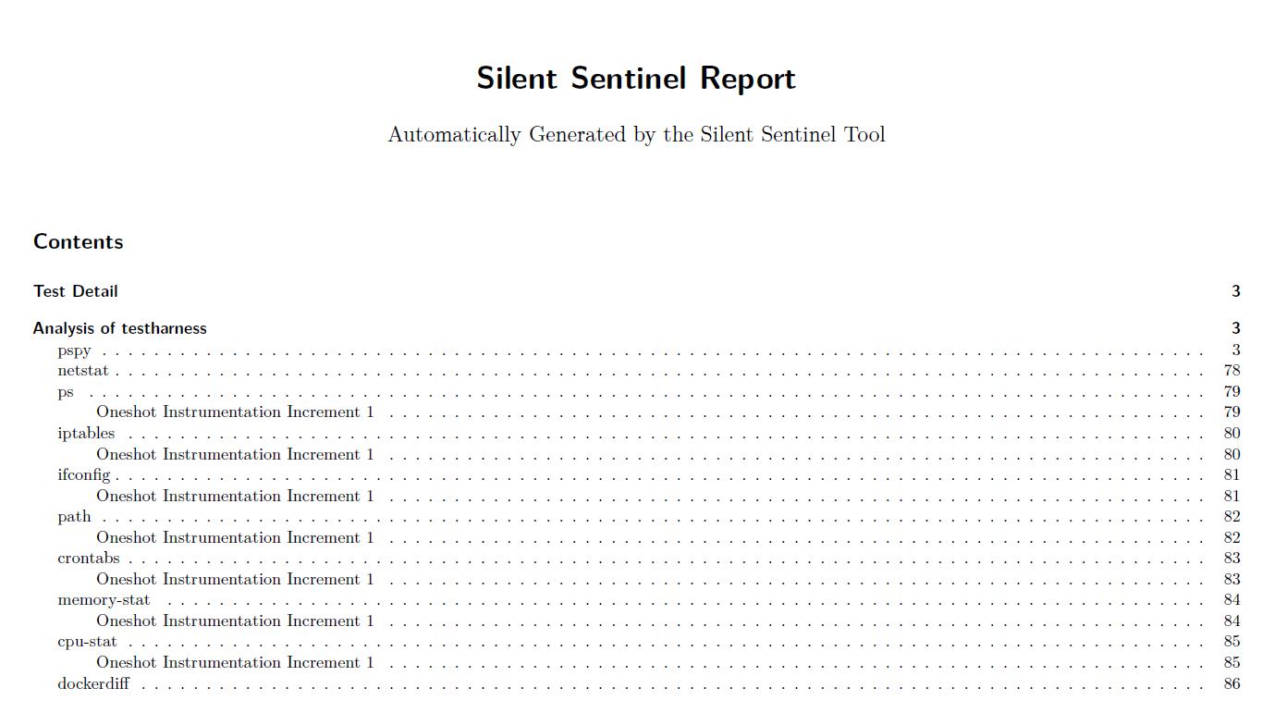

Slide 39
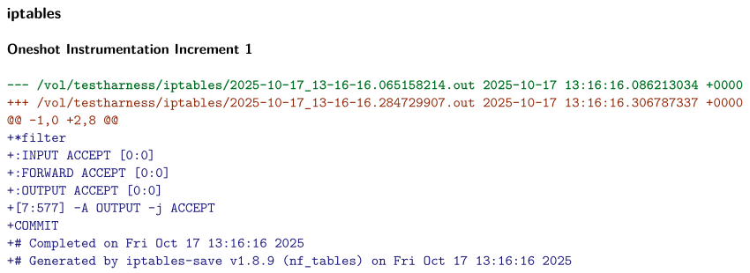
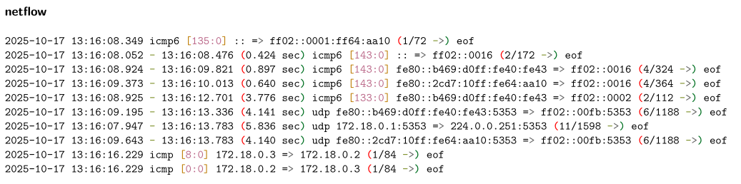
Example 2 Outputs (1)

Slide 40
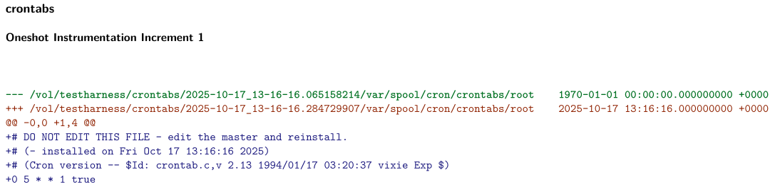
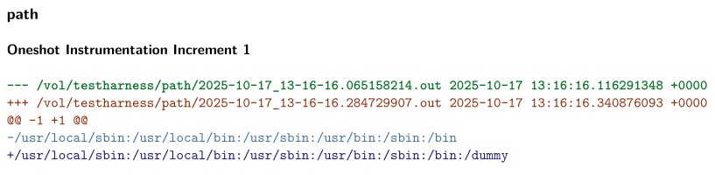
Example 2 Outputs (2)

Slide 41
Example 3:
Compile, Install and Test Binary from Source
Notes:
The program under test is the compilation process, compiling, installing and run application. – SolarWinds example, build (SunSpot) and install (SunBurst)
First two examples, command line, this tim giving it a config file
Note first the files for the example have to be manually take apart from the tar file
First shows the “program” scrit under text
Next shows the silent sentinel config file
Same last steps as before: run t he dynamic test, run the static test, process the data, generate the reports

Slide 42
Example 3 Background
Example uses a configuration file to build, install and run a program.
The “problem template” matches the SolarWinds scenario where bad behavior was observed during construction, installation and execution
Illustrated steps:
Source code files unpacked from a tar file (not part of Silent Sentinel)
Shows the program script under test that makes, installs and run a program
Shows the Silent Sentinel configuration files
Process similar to Examples 1 and 2
  Running static analysis, analyzing dynamic data, building reports
  Showing containers built, and files with data
Note that generated data for all three steps are combined
Notes:
The program under test is the compilation process, compiling, installing and run application. – SolarWinds example, build (SunSpot) and install (SunBurst)
First two examples, command line, this tim giving it a config file
Note first the files for the example have to be manually take apart from the tar file
First shows the “program” scrit under text
Next shows the silent sentinel config file
Same last steps as before: run t he dynamic test, run the static test, process the data, generate the reports

Slide 43
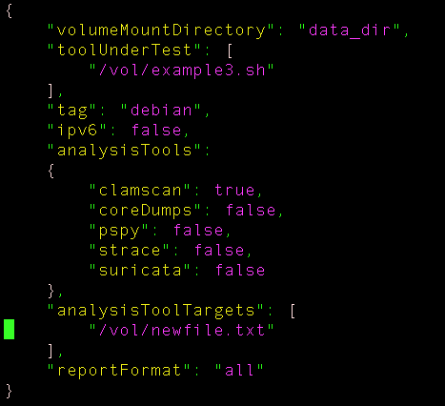
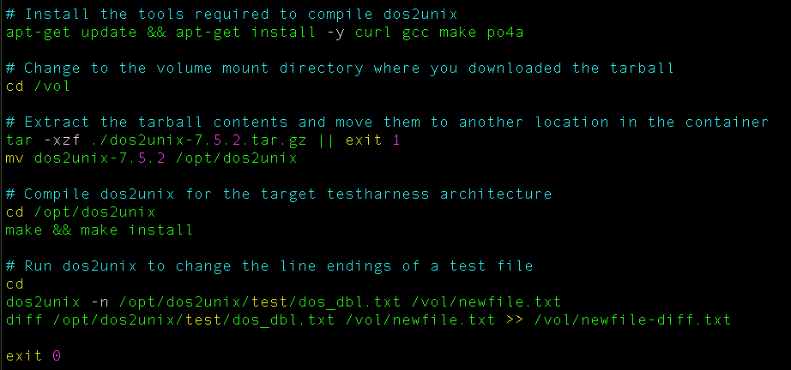
Silent Sentinel Configuration File
Creating and processing source

Slide 44
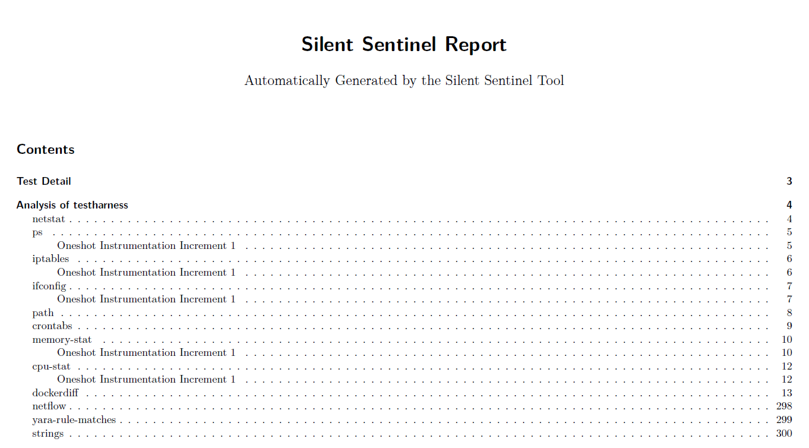

Slide 45
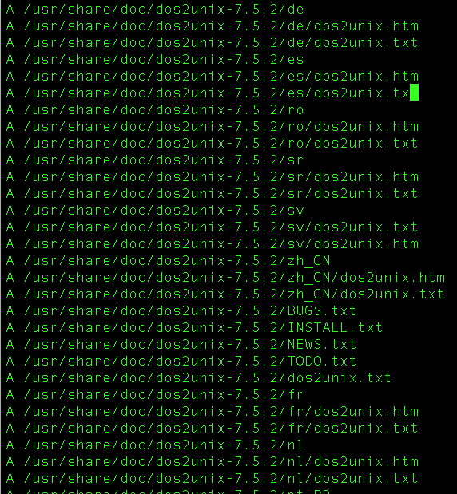
Example 3 Outputs (1)
The `docker diff` check detected over 9000 changes to files on the testharness container

Slide 46
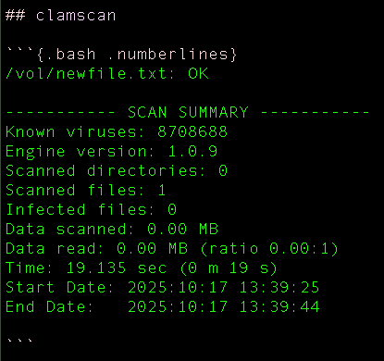
Example 3 Outputs (2)
The `clamscan` test determined the new file we created was not malicious.

Slide 47
Example 4:
Run Custom Python Script
Notes:
Example uses a modified docker file to create a modified test contain, need to install python into test container. Way to add dependencies into test harness so that it does not confound the resultys of thye application under test, as well as more effectively reflect the environment that the application will run in.
(Can restore changed testharness docker back to the default environment.)

Slide 48
Example 4 Background
Example uses a specially configured test container
Way to provide the same environment that the program will execute in
Desired when there are special dependencies that should not be included in the test
Avoid confounding the data between dependencies and program, e.g., like in Example 3
Illustrated steps:
Shows how to specialize the test container
Shows the program script under test
Shows the Silent Sentinel configuration files
Process similar to Examples 1, 2 and 3
  Running static analysis, analyzing dynamic data, building reports
  Showing containers built, and files with data
Note test container without special configuration still available as needed
Notes:
Example uses a modified docker file to create a modified test contain, need to install python into test container. Way to add dependencies into test harness so that it does not confound the resultys of thye application under test, as well as more effectively reflect the environment that the application will run in.
(Can restore changed testharness docker back to the default environment.)

Slide 49
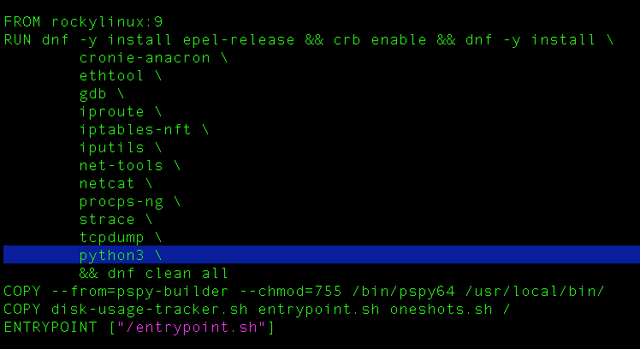
Adding Python to the container

Slide 50
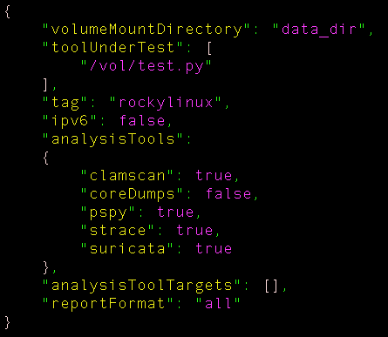
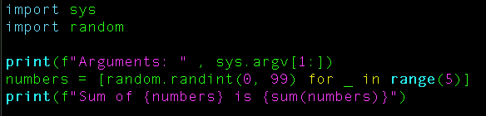
Silent Sentinel Configuration File
Python program

Slide 51
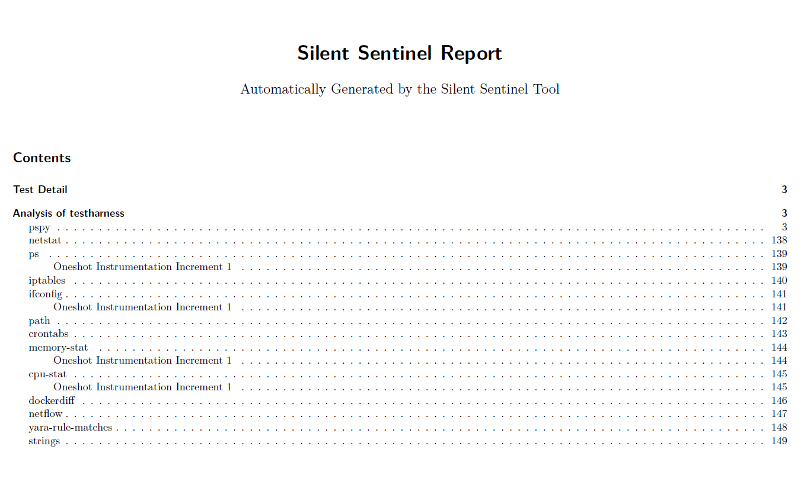

Slide 52
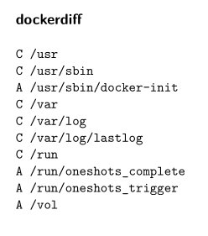
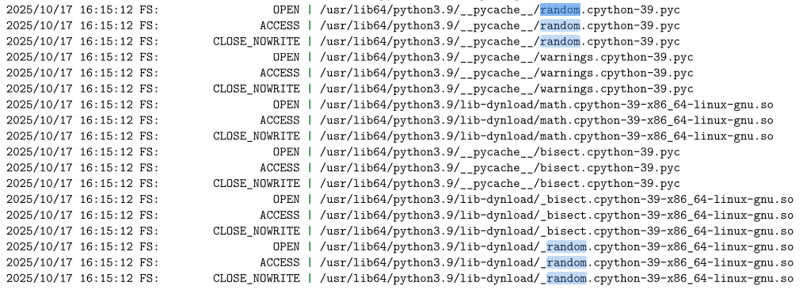
Example 4 Outputs (1)

Slide 53
How Does Silent Sentinel Help?
Supplements analysis provided by SAST, DAST and IAST
Passively collects and analyzes program and system behavior
Supports flexible and extensible environments
Configure for special environmental scenarios
Analyze single program or multistep process
Add new sensors within framework
Retains all intermediate data for additional analysis
Integrates into DevSecOps and CI/CO environments
Built with containers to allow easy orchestration

Slide 54


Try It Out!
Get Silent Sentinel on GitHub:
https://github.com/cmu-sei/silentsentinel
Download the Fact Sheet:
https://www.sei.cmu.edu/library/do-you-know-what-your-software-is-actually-doing/

Slide 55
Example Instructions

Slide 56
Page 1 / 4
These assume you're working from a Linux system that meets the System Requirements defined in the README. Namely:
Internet access to pull docker container images and clone the repository from github
Git, Docker, Docker Compose V2, and jq packages installed
Sufficient disk space is available to store and run the images, containers, and output data
Step-by-step setup:
1. Clone the source code from GitHub: https://github.com/cmu-sei/silentsentinel:
git clone https://github.com/cmu-sei/silentsentinel.git
2. Change to the `silentsentinel` directory:
cd silentsentinel
3. Initialize the pspy submodule:
git submodule update --init --recursive
4. Create a directory to store the Silent Sentinel outputs and results:
mkdir data_dir
The data_dir must be in a location that is writable by your user account and the root account, as the containers orchestrated by Silent Sentinel run some processes as root. This may cause issues if you leverage kerberos authenticated NFS shares for storage.

Slide 57
Page 2 / 4
Running the predefined examples:
1. View the usage information:
./silentsentinel.sh -h
2. Run Example 1 using the command line:
# Run the command
./silentsentinel.sh -t fedora ./data_dir sh -c 'ls -al'
3. Run Example 2 using the command line:
# Remove old results
rm -rf data_dir/*
# Copy our example script into the volume mounted directory
cp ./examples/example2.sh data_dir
# Run the command
./silentsentinel.sh ./data_dir /vol/example2.sh listeningpost

Slide 58
Page 3 / 4
4. Run Example 3 using the config file:
# Remove old results
rm -rf data_dir/*
# Get the source of the dos2unix tool
curl https://waterlan.home.xs4all.nl/dos2unix/dos2unix-7.5.2.tar.gz -o data_dir/dos2unix-7.5.2.tar.gz
# Copy our example script into the volume mounted directory
cp ./examples/example3.sh data_dir
# Run the command
./silentsentinel.sh -c ./examples/example-config3.json

Slide 59
Page 4 / 4
5. Run Example 4 using the config file:
# Remove old results
rm -rf data_dir/*
# Create test.py
cat <<EOF > data_dir/test.py
#!/usr/bin/python3
import sys
import random
print(f"Arguments: " , sys.argv[1:])
numbers = [random.randint(0, 1000000000) for _ in range(100)]
print(f"Sum of {numbers} is {sum(numbers)}")
EOF
# make the script executable
chmod 755 data_dir/test.py
# Use our example Rocky Linux Dockerfile as the testharness
cp ./examples/Dockerfile.rockylinux.example4 testharness/Dockerfile.rockylinux
# Run Silent Sentinel using the config file
./silentsentinel.sh -c ./examples/example-config4.json
# To revert the custom Dockerfile, use git
git restore testharness/Dockerfile.rockylinux

